Slide 1
Particle Studio simulations of the resistive wall impedance of copper cylindrical and rectangular beam pipes
E. Metral, G. Rumolo, B. Salvant, C. Zannini
(CERN – BE-ABP-LIS)

Slide 2
Overview
Objectives
Definition of the detuning, driving and general wake
First simulations
New boundary condition in CST 2009
Form factor studies
Conclusions
Open questions
Future Plans

Slide 3
Objectives
Separation of the dipolar and quadrupolar terms of the rectangular shape with Particle Studio simulations, and comparison with theory.
Simulation of the wake form factor in a rectangular shape

Slide 4
Overview
Objectives
Definition of the detuning, driving and general wake
First simulations
New boundary condition in CST 2009
Form factor studies
Conclusions
Open questions
Future Plans

Slide 5
Detuning and driving terms of the transverse wake
y
simulated
calculated
simulated
y
x
x
y
y
simulated
calculated
simulated
x
x
Notes:
This is the approch followed in the first simulations and shown in the previous meeting.

Slide 6
Overview
Context and Objectives
Definition of the detuning, driving and general wake
First simulations
New boundary condition in CST 2009
Form factor studies
Conclusions
Open questions
Future Plans
Notes:
We Show again the principal results obtained in the first simulations

Slide 7
Simulation Parameters
Geometric parameters
Thickness Copper = 0.2cm
Length = 1m
Vacuum Chamber:
Rectangular shape : height=2cm; width= 6cm
Particle Beam Parameters
σbunch = 1cm
Charge = 1e-9
β=1
Notes:
For the simulations I use the following parameters. The boundary condition used they are shown in pictures.

Slide 8
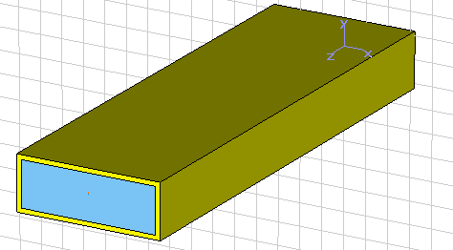
Horizontal wake in a rectangular shape
→ In the horizontal plane, W_{general}=0, and W_{driving}=- W_{detuning}
Notes:
We show an zoom

Slide 9
Vertical wake in a rectangular shape
Detuning
General
Driving (calc.)
→ In the vertical plane, W_{general}=3*W_{detuning}, and W_{driving}= 2* W_{detuning}

Slide 10
Summary plot for the rectangular shape: Vertical and horizontal wakes
Wx driving (calc.)
Wx detuning
Wy driving (calc.)
Wy general
Wx general
Wy detuning

Slide 11
Detuning and driving terms of the transverse wake
y
simulated
simulated
simulated
y
y
x
x
x
y
y
x
x
simulated
simulated
simulated
y
x
Notes:
Following the approach of Elias illustrated in the previous meeting for the time domain analysis and valid for simulation I have separated the detuning and the driving terms for the transverse wake in cylindrical and rectangular shape with the geometric parameters previously shown.

Slide 12
Number of mesh ~
Device length = 2.5cm
Displacement =0.0333*b,h
Boundary conditions: electric in x and y open in z
Normalization at device of 1m
2 b
2 h
q=0.5 ➔ h=3b

Slide 13
Overview
Context and Objectives
Definition of the detuning, driving and general wake
First simulations
New boundary condition in CST 2009 and comparison with theory
Form factor studies
Conclusions
Open questions
Future Plans

Slide 14
New boundary condition in CST 2009
Modelling a lossy metal without the conducting wall condition in CST 2009
The lossy metal is explicitly modelled around the vacuum
The lossy metal is only modelled through a boundary condition

Slide 16
Comparison of the simulated wake potential with the theoretical wake potential of a point charge
Theory: from Palumbo, Vaccaro, Zobov, INFN, 1994
Number of mesh ~ 10⁶
Device length = 20 cm
b=1cm
Rms bunch length = 1 cm
Displacement =0.1*b (0.5*b for cylindrical)
Boundary conditions: conducting wall in x and y open in z
Normalization at device of 1m
But we are comparing the simulated wake of a gaussian bunch with the theoretical wake of a point charge. We need to convolute the theoretical wake with the source bunch

Slide 17
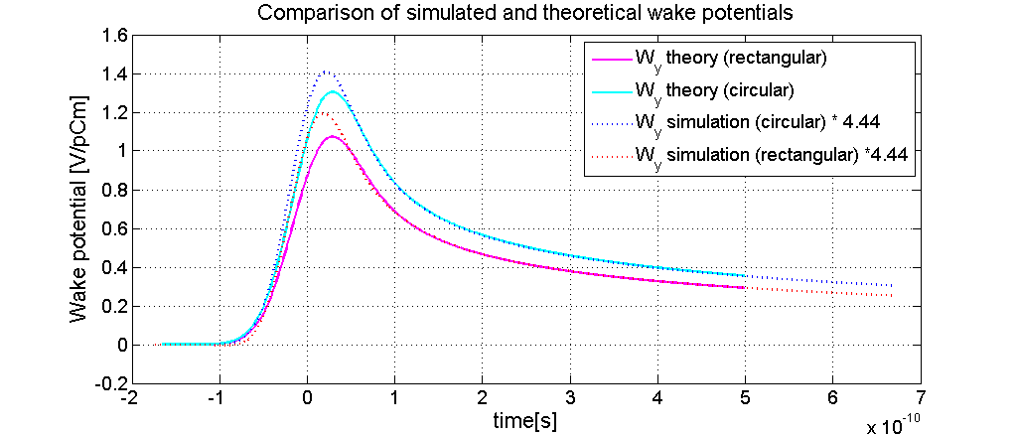
Comparison of the simulated wake potential with the theoretical wake potential of a Gaussian bunch
Theoretical and simulated wake potential are very similar
Short range wakes are subject to more noise in simulations
Also the theory is not valid at high frequencies

Slide 18
Overview
Context and Objectives
Definition of the detuning, driving and general wake
First simulations
New boundary condition in CST 2009
Form factor studies
Conclusions
Open questions
Future Plans

Slide 19
Simulations with MWS 2008 form factor studies
Form factor q:
2 b
2 h

Slide 20
Simulation parameters
Number of mesh
Device length = 20cm
b=1cm
Displacement = 0.1*b,h
Boundary conditions: electric in x and y open in z
Normalization at device of 1m
All wakes (including the driving term) are now simulated

Slide 21
Rectangular shape with form factor q=0.5
2 b
2 h
q=0.5 ➔ h=3b

Slide 22
Rectangular shape with form factor q=0.33
2 b
2 h
q=0.33 ➔ h=2b

Slide 23
Rectangular shape with form factor q=0.1
2 b
2 h
q=0.1 ➔ h ~ 1.22 b

Slide 24
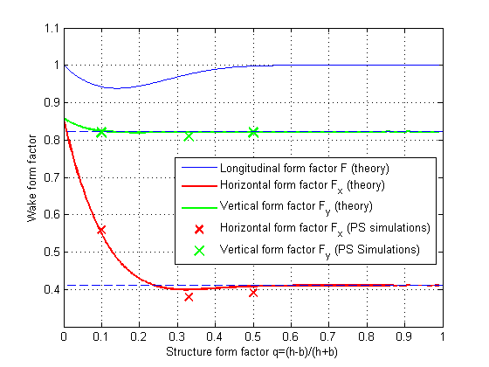
Comparison of the theoretical and simulated wake form factor
Theory: from Gluckstern, Ziejts, Zotter, Phys. Rev., 1992

Slide 25
Conclusion
A factor 4.4 (probably ) is observed between the amplitude of simulated wakes and theoretical wakes.
This amplitude factor aside, we have separated the dipolar and quadrupolar terms in the rectangular shape, and they agree with the theory.
The simulated wakes obtained for several rectangular shape form factors also agree with the theoretical curve.

Slide 26
Open questions
Factor 4.4 between theory and simulations
- most likely a difference of convention
Issues with cylindrical shape

Slide 27
Overview
Context and Objectives
Definition of the detuning, driving and general wake
First simulations
New boundary condition in CST 2009
Form factor studies
Conclusions
Open questions
Future Plans

Slide 28
Future plans: coupling terms and non linear terms
In Headtail, the wake is assumed to have linear uncoupled dependance on the source particle and the test particle.
This linear approximation should be valid for small particle amplitudes.
If the amplitude grows, do we have to include higher order terms? At what displacement?
Besides, are there coupled terms between planes?

Slide 29
First results of simultaneously moving x and y location of the source beam
Test beam
Source beam
y
x
δx
bx
the displacement is along the diagonal of the rectangular shape and the wake is normalized to the displacement
These first results are difficult to explain without involving non linear or coupled dependance of the wake on the transverse location.
The threshold for the onset of a nonlinear or coupled dependance seems very low (δ~0.1 b)

Slide 30
Nonlinear uncoupled terms (first qualitative picture)
Displacement in y
W_{y}=k_{y1} y
< 1% of linear term
80%
W_{y}=k_{y1} y +k_{y3} y³ + k_{y4} y⁴
2 b
40%
< 5% of linear term
2 h
10%
q=0.5 ➔ h=3b
W_{y}=k_{y1} y +k_{y3} y³ + k_{y4} y⁴
3%
< 30% of linear term
0
3%
10%
40%
80%
Displacement in x
W_{y}=k_{y1} y +k_{y3} y³ + k_{y4} y⁴
+k_{y5} y⁵ +k_{y6} y⁶
y
test beam
x
source beam

Slide 31
Nonlinear coupled terms (first qualitative picture)
< 0.1% of linear uncoupled term
y
2 b
W_{x}=k_{x1} x +k_{xy1} y
<2% of linear term
2 h
60%
q=0.5 ➔ h=3b
W_{x}=k_{x1} x + k_{xy1} y+ k_{xy2} y² k_{xy3} y³
40%
10%
<30% of linear term
3%
W_{x}=k_{x1} x + k_{xy1} y+ k_{xy2} y² k_{xy3} y³
0
3%
10%
40%
80%
x
<75% of linear term
y
test beam
W_{x}=k_{x1} x + k_{xy1} y+ k_{xy2} y² k_{xy3} y³
x
source beam

Slide 32
Thank you for your attention!

