Slide 1
Separating dipolar and quadrupolar wakes with Mafia
Andreas Wagner (IT/IS) 8th SPS impedance informal meeting Wednesday 17/12/2008

Slide 2
Overview
Transverse Wakefield Properties
Axially Symmetric Structures
Non- Axially Symmetric Structures
Numeric calculation of Wakefield components

Slide 3
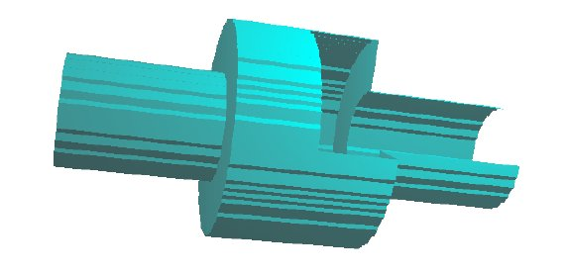
Axial Symmetric Structures
Pillbox cavaity

Slide 4
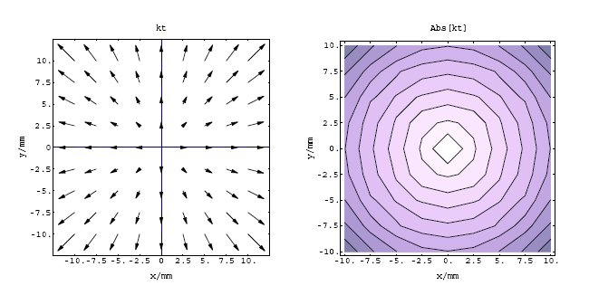
Axial Symmetric Structures
Energy Loss vs beam offset

Slide 5
Axial Symmetric Structures
Magnitude of wake field depends on displacement of source charge and is independent of test charge position !

Slide 6
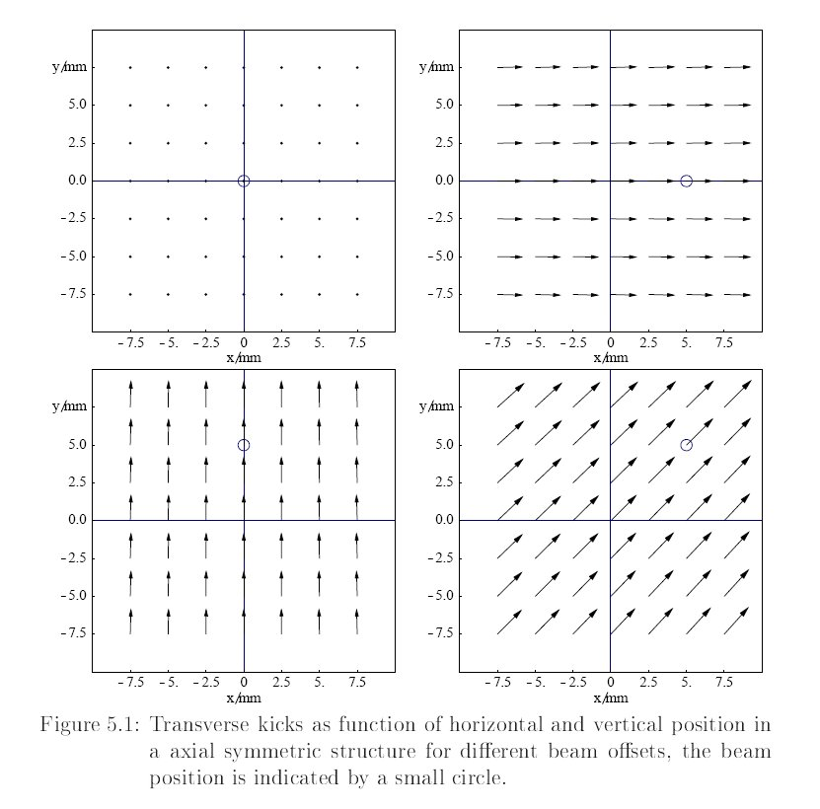
Axial Symmetric Structures
Transverse kicks vs test charge position

Slide 7
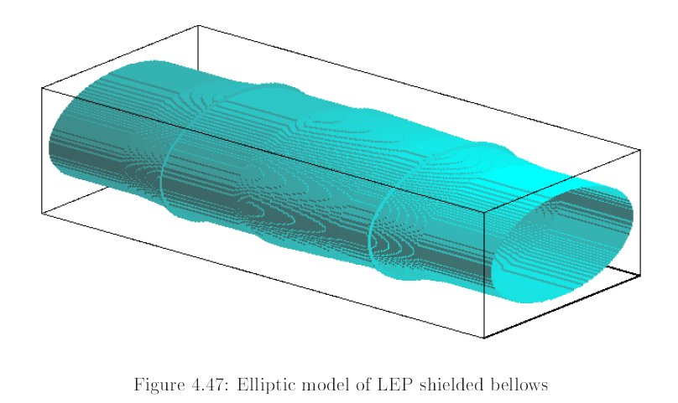
Non-axially-symmetric structures
Elliptic Model of LEP Shielded bellows

Slide 8
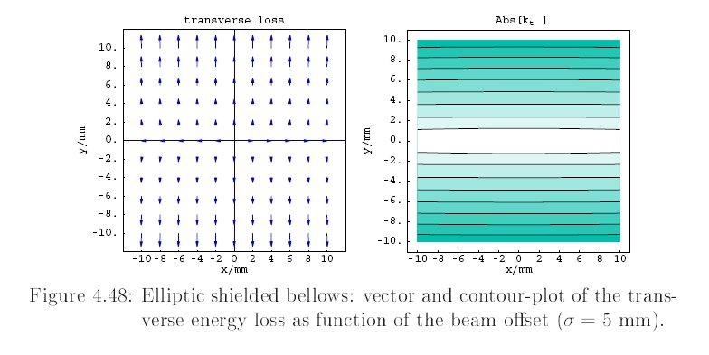
Non-axially-symmetric structures
Elliptic Model of LEP Shielded bellows

Slide 9
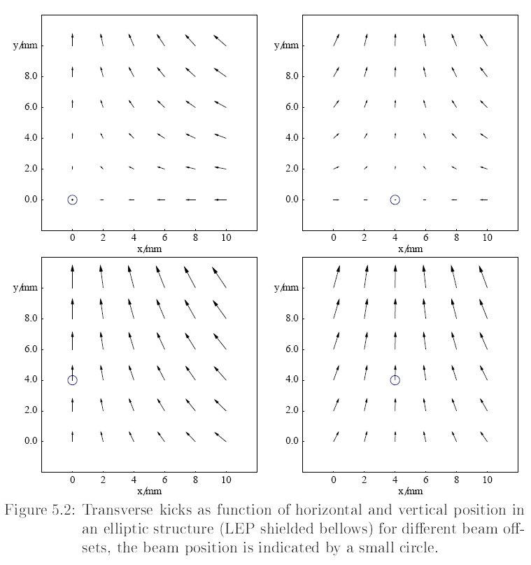
Non-axially-symmetric structures
Transverse kicks vs test charge position

Slide 10
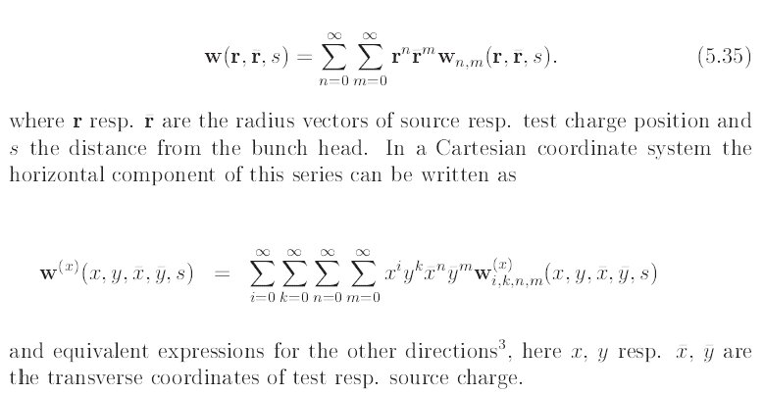
Non-axially-symmetric structures
Generalized Impedance

Slide 11
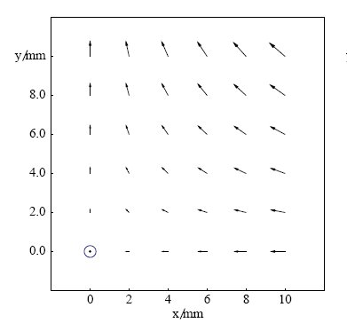
Non-axially-symmetric structures
Transverse kicks for on axis beam:
Ansatz: Subtract this wake for beams with finite offset !

Slide 12
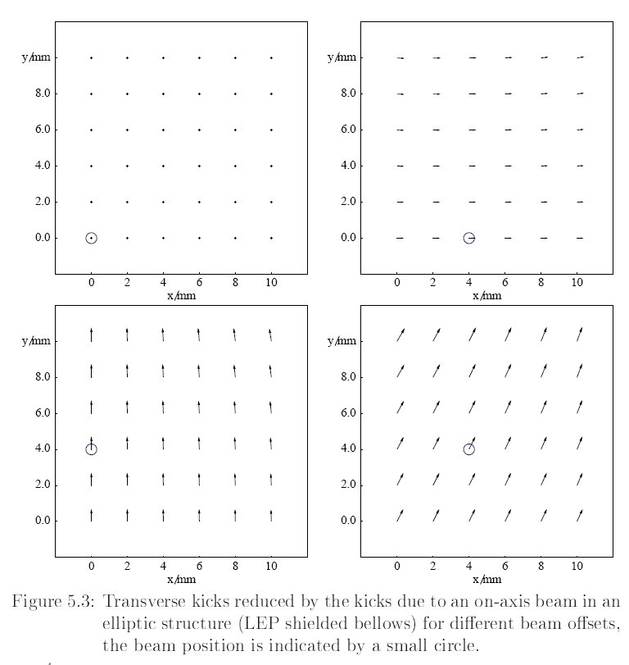
Non-axially-symmetric structures
Transverse kicks vs test charge position minus contribution of on-axis beam

Slide 13
Non-axially-symmetric structures
The major difference to axially symmetric structures is this offset dependent "quadrupolar“ wake potential acting on a trailing particle:

Slide 14
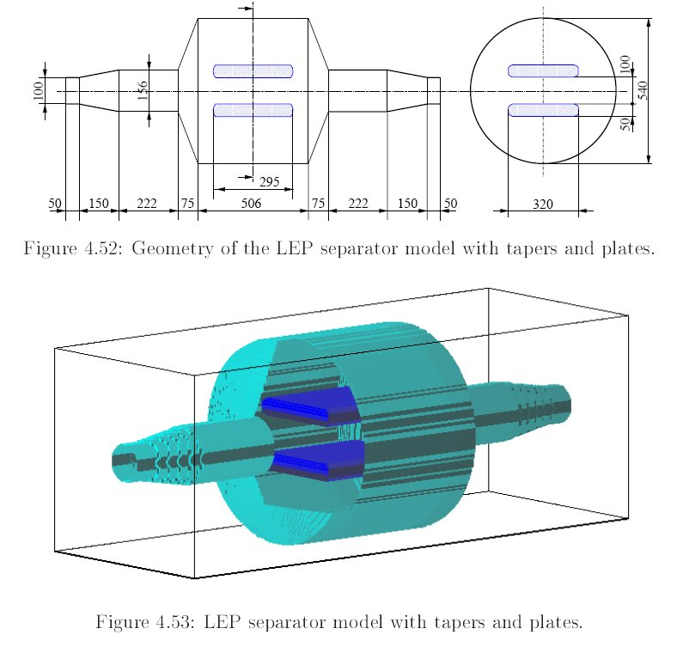
Non-axially-symmetric structures
Electrostatic Separators

Slide 15
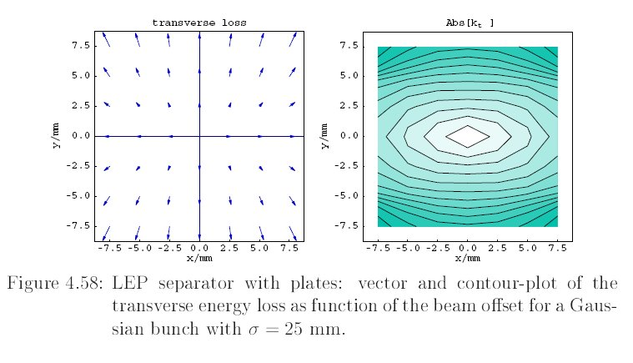
Non-axially-symmetric structures
Electrostatic Separators

Slide 16
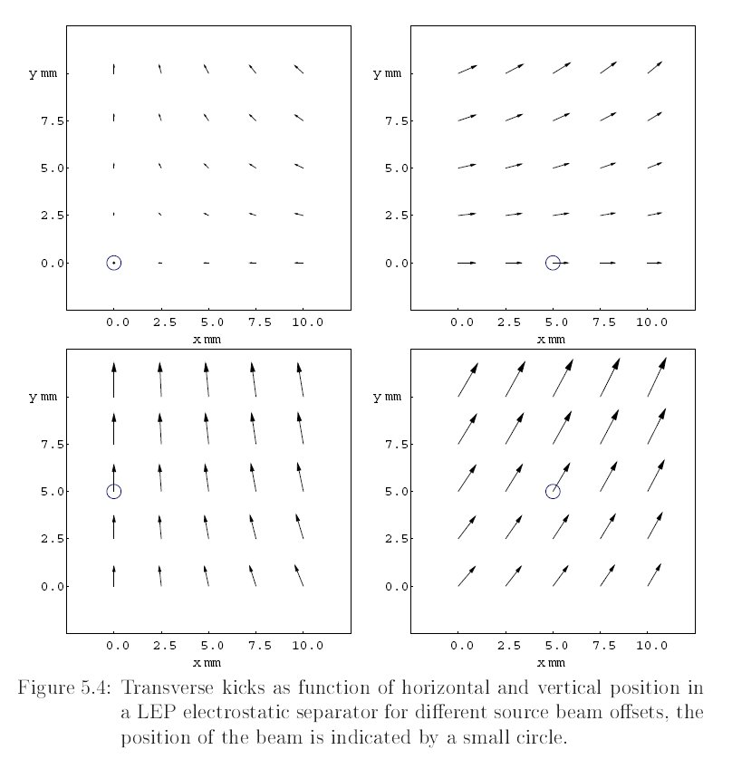
Non-axially-symmetric structures
Transverse kicks vs test charge position

Slide 17
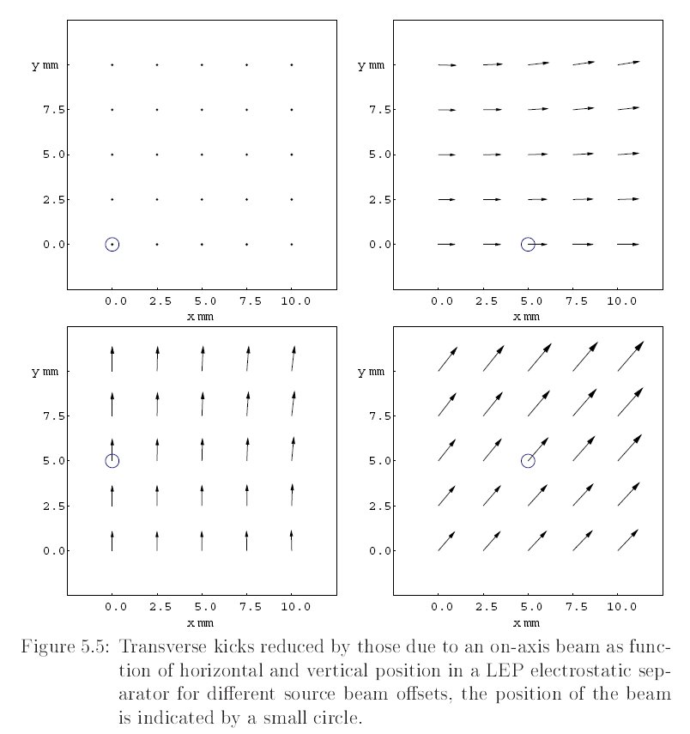
Non-axially-symmetric structures
Transverse kicks vs test charge position minus contribution of on-axis beam

Slide 18
Calculation of “Quadrupolar Wakes”
Separating dipolar and quadrupolar wakes with Mafia/GdfidL ...
Calculation with on-axis source charge to obtain “quadrupolar” wake component
Calculation with displaced source charge distribution; substraction of “quadrupolar” component yields the “dipol”wake

Slide 19
Wakes in non-axially-symmetric structures
➔ To describe a non-axially-symmetric structure one needs typically 4 transverse wake tables

Slide 20
Thank you for your attention !
Questions ?

