Slide 1


Two-stream effects: electron clouds and ion instabilities
G. Rumolo and E. Métral
USPAS Course on collective effects
Thursday, 25.06.2009

Slide 2
Two stream
Multi-particle effects
Collective
Two-stream
Incoherent/collisional
Transverse
Longitudinal
Beam/beam
E-cloud/trapped ions
Multi- bunch
IBS/Touschek
Microwave/turbulent
Potential well distortion
Head-tail
TMCI
Incoherent tune spread
Instability/beam loss
Coherent tune shift
Beam quality degradation/ emittance growth

Slide 3
Program of this lecture
Primary sources of two-stream phenomena in accelerators: general concepts
Positively charged beams:
  Formation of the electron clouds for bunched beams
    Secondary electron emission
    Build up process due to multipacting
    Transverse beam instability
  Observables related to electron clouds
  Mitigation and cures
Negatively charged beams:
  Trapping of ions for coasting and bunched beams
  The ion instabilities for circular and linear machines
The impact of two-stream phenomena on the design/upgrade of high intensity machines

Slide 4
Charge production in vacuum pipes
There are several mechanisms that cause generation of charged particles inside the vacuum pipe of an accelerator. The most dangerous are:
  Ionization of the residual gas via scattering. Scattering of beam particles against the molecules of the residual gas also influences the beam lifetime and can be a significant component of it in colliders/storage rings, where beam lifetime is an important parameter.
  Emission of electrons from photoelectric effect due to synchrotron radiation hitting the beam pipe
  Desorption from the walls caused by beam loss
1. and 3. produce both electrons and ions (the former one with the same rate, the second one with different rates depending on the desorption yields), 2. is only a source of electrons
Which of these mechanisms is the dominant one, depends upon the beam parameters, the vacuum level, the design (material, shape), roughness and cleanness of the inner surface of the beam pipe, etc.

Slide 5
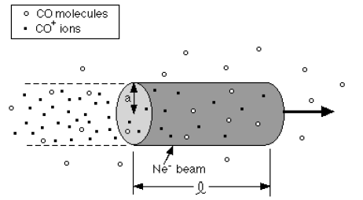
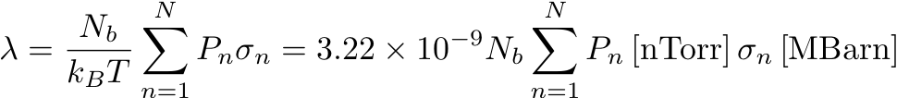
Beam ionization
The number of electron/ion pairs created per unit length (λ=dN_{ion}/ds=dN_{el}/ds) depends on the partial pressures of the components of the residual gas (P_{n}), the cross section of the ionization process for each of these species (σ_{n}), the number of particles per bunch (N_{b}). We assume room temperature T=300 K

Slide 6
Beam ionization
A list of features of charge production through scattering ionization of the residual gas:
  Electron/ion pairs are all produced basically at rest in the volume swept by the passing beam
  The amount of produced pairs is mainly determined by the quality of the vacuum and the beam intensity. To keep this value low, the higher intensity we want to put into an accelerator, the better vacuum is required
  There is a weak dependency on the beam energy through the cross section of the ionization process. In fact, the ionization cross section does not vary significantly in the ranges of energy usually covered in accelerators.
  While it is not essential to distinguish between the different species when we are concerned by electron production (mainly for machines operating with positively charged particles, e.g. positrons, protons, heavy ions), the composition of the rest gas is important to have a knowledge on the types of ions produced through this process (for machines operating with negatively charged particles, e.g. electrons, antiprotons). In fact, some ions can be trapped by the beam and accumulate, while some others can escape.

Slide 7
Photoemission
cross sectional view (x,y)
view from above (x,s)
When the beam is bent in a dipole magnet, it emits synchrotron radiation in the horizontal plane (bending plane)
When the synchrotron radiation hits the beam pipe, partly it produces electron emission within a 1/γ angle from the point where it impinges, partly it is reflected inside the pipe and hits at different locations, too, producing electrons with a more complicated azimuthal distribution.

Slide 8
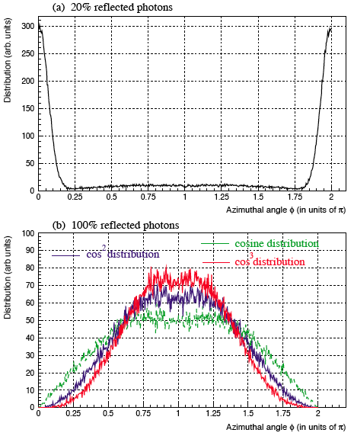
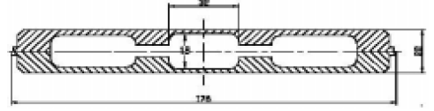
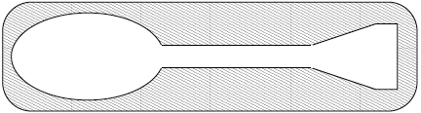
Photoemission
The vacuum chamber in dipoles can be designed in such a way as to absorb the direct synchrotron radiation into an antechamber (one sided in arcs, two-sided in wigglers). This solution is adopted in many synchrotron light sources (especially for heat load) and foreseen for positron damping rings of linear colliders
The surface directly hit by synchrotron radiation can be also machined in a way as to change the azimuthal distribution of the reflected radiation.
  With smooth chamber it is assumed to be uniform on the beam pipe
  E.g. with saw-tooth shape, distributions can be more like cos² or cos³
Percents of directly absorbed and reflected radiation come from measurements.

Slide 9

Photoemission
The rate of electron production (λ=dN_{el}/ds) is given by the number of photons per beam particle per meter multiplied by the number of beam particles and by the photoemission yield of the surface (Y)
An effective photoemission yield (Y*) is used, which usually takes into account also of the antechamber or absorbers (e.g. Y*=0.1 Y if we know that 90% of the radiation goes into the antechamber)
The rate of electron production is actually spread over the inner surface of the beam pipe according to the known azimuthal distribution.
α is the fine structure constant, γ the relativistic factor of the beam, L the total length over which there is emitted radiation.

Slide 10
Beam particle loss
lost particle
ions
neutrals
electrons
Electrons and ions can be also produced as a result of beam particle losses on the walls of the beam pipe. Also neutrals are produced by the interaction of lost particles with the pipe wall and usually degrade the vacuum, determining the value of the dynamic pressure, i.e. the pressure in the beam pipe in presence of circulating beam. When the increased pressure causes in turn an increase of beam losses and this process diverges, pressure runaway (i.e. a vacuum instability) can be triggered.
The different species are produced with rates dependent on their specific desorption yields. The types of ions desorbed depend on the material and surface of the pipe wall
Desorption rates are functions of the beam energy and of the angle of incidence. The incidence is mainly considered to be grazing (shallow angles)

Slide 11
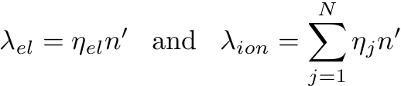
Beam particle loss
An estimate of the average beam losses is based on the percent of beam lost over a certain number of turns, which is translated in number of beam particles lost per meter (n’)
Beam particle loss is a slow process and usually takes place because of diffusion (IBS, scattering, bremsstrahlung, Touschek, beam-beam, noise, periodic resonance crossing, …), which causes the particles to exit the dynamic aperture and eventually hit the physical aperture. Losses at the beginning of an accelerating ramp take place due to uncaptured beam.
Diffusion losses are spread around the machine, or can be concentrated if there is at least one significant aperture restriction point. Capture losses, but also e.g. losses of ions having undergone charge exchange processes (stripping/capture), usually happen downstream from the bending magnets. Both can be intercepted with purposely designed collimators.

Slide 12
Part I
Electron cloud build up and instability

Slide 13
Electron cloud formation
Electrons can strongly affect the performance of machines operating with positively charged particles (positrons, protons, heavy ions). There are observations of electron accumulation also for electron machines.
Trapping of electrons can occur with coasting beams
  Electrons created at the pipe surface do not contribute, as they would be accelerated and decelerated in the beam field, and come to the other side of the pipe with a zero net energy gain
  Only ionization electrons are trapped and move with high frequency. They have to be shaken off the beam before they accumulate to a density that may endanger the beam stability.
With bunched beams the situation is more complicated
  Short bunches: under certain conditions, a process of multi-bunch multiplication is possible through the secondary electron emission, i.e. the electrons generated with the mechanisms so far considered (called primary) just seed an avalanche process that leads to very high electron densities inside the beam pipe
  Long bunches: they can behave partly like coasting beams, with the advantage of having clearing gaps. However, again due to secondary electron emission, they may suffer from the so called trailing edge multipacting, which can cause intolerable electron accumulation especially at the tail of this type of bunches

Slide 14
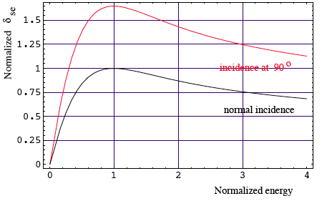

Secondary electron emission
The main reason why electrons can build up to very high densities around positively charged bunched beams is that, when electrons hit the pipe wall, the do not just disappear…..
  High energy electrons easily survive and actually multiply through secondary electron emission
  Low energy electrons tend to survive long because of the high probability with which they are elastically reflected.
Secondary electron emission is governed by the typical curve below
Secondary electrons have very low energies (<10 eV) and an angular distribution like (cos θ)
The big problems arise when δ_{max}>1, which means that from only 1 electron more electrons are created…….

Slide 15
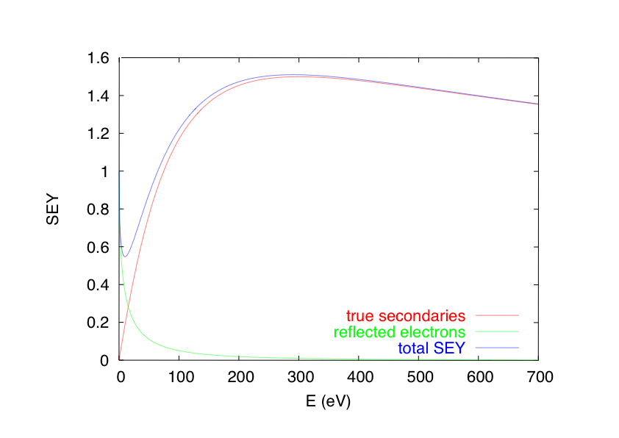
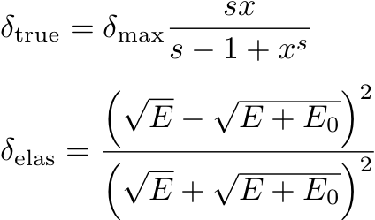


Secondary electron emission
Another parametrization is presently used, which also includes the contribution of elastic reflection
s and E₀ are fitting parameters (e.g. s=1.35 and E₀=150eV for SPS)
To include the angular dependence δ_{max} and E_{max} have to be replaced by δ_{max}(θ) and E_{max}(θ)

Slide 16
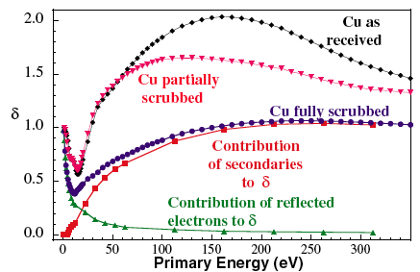
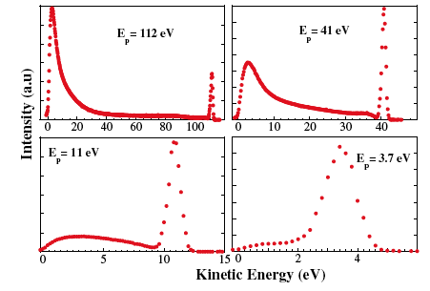
Secondary electron emission
Elastically reflected electrons, and their dominance at very low energies, have been measured (Cimino & Collins, 2004)
From these measurements both secondary emission and elastic reflection can be fully characterized.
What happens to this sample ? Why does the SEY decrease ?
What are the electrons in these long tails ? Are they redifussed electrons ?

Slide 17
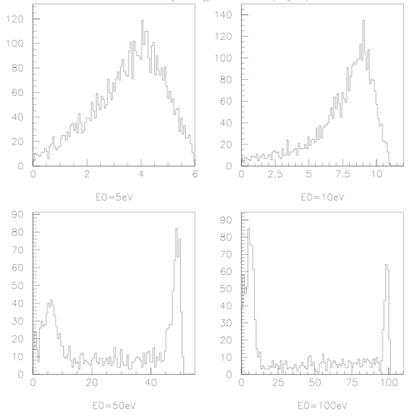
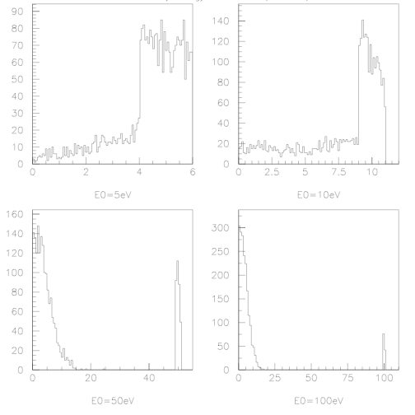
Secondary electron emission
Most of the measurements of the energy spectra of electrons produced by bombarding a sample agree on the existence of electrons with energies between 10 eV (considered to be the upper limit for true secondaries) and the energy of the bombarding electrons
These electrons can be attributed to
  tails in the energy distribution of the secondaries
  what is called the rediffused component of the electrons (i.e. like elastically reflected electrons, but just emerging of the surface with lower energy)

Slide 18
Secondary electron emission
The SEY can be lowered by electron bombardment (scrubbing effect, efficiency depends on the deposited dose) or by radiation bombardment (conditioning effect). Also the PEY decreases by radiation.
It is known, for instance, that Stainless Steel has a SEY that decreases from above 2 to ~1.6 after relatively high electron bombardment. Other materials, like the TiN, rely on conditioning to get very low maximum SEY (even below 1)
Schematic view of the in-situ SEY detector installed in the SPS

Slide 19
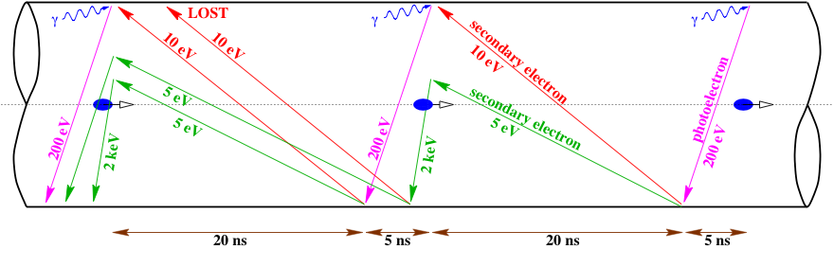

Schematic of electron cloud build up (1)
Principle of the multi-bunch multipacting.
The resonance condition does not need to be exactly matched, wide ranges of parameters allow for the electron cloud formation

Slide 20
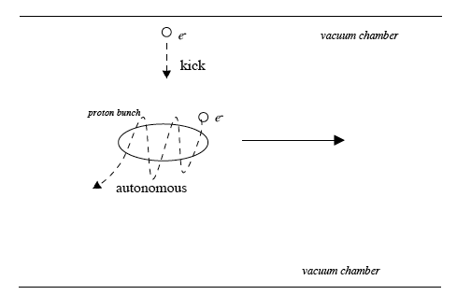
Schematic of electron cloud build up (2)
The picture proposed on the previous slide, though instructive, is extremely simplified, because electrons actually fill the pipe and evolve differently according to where they are (in phase space!) when the bunch passes
Even for larger bunch spacings, electrons survive for a long time in the beam pipe, and can still be accelerated by the next bunch that will come and produce a new generation of secondaries
For shorter spacings, electrons can receive multiple kicks and eventually gain enough energy as to hit the beam chamber and produce more electrons
Electrons close to the beam and with low velocities are in autonomous regime, i.e. they oscillate around the bunch. The frequency of this oscillation, as well as the number of oscillations per bunch passage, are two important parameters!
Electrons far enough from the beam are in kick regime, i.e. they just feel a strong electric kick when a bunch passes

Slide 21
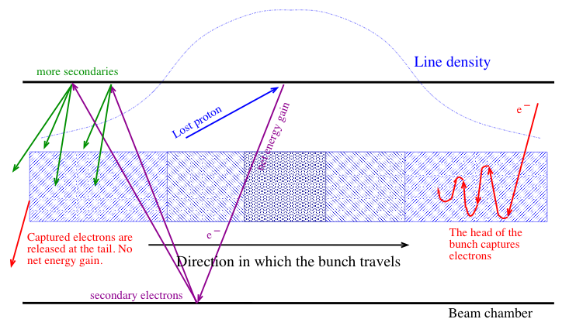
Schematic of electron cloud build up (3)
Principle of the trailing edge multipacting.
For long bunches, electrons produced on the falling edge of the bunch can gain energy and contribute to multipacting

Slide 22
Features of the electron cloud build up
It is clear that the electron cloud build up depends on a significant number of parameters, and the dependences are generally non-monotonic and non-trivial
  Maximum SEY and energy at which it occurs, E_{max}
  Bunch spacing and bunch length
  Beam pipe radius
  Beam transverse sizes
  Beam current (number of particles per bunch)
The electron cloud can grow
  More or less linearly, when there is no multiplication effect, and then it saturates when electron losses balance electron production, usually at a density value that neutralizes the average beam charge.
  Exponentially, when there is multipacting. In this case saturation will only occur when newly emitted electrons from the surface do not have enough kinetic energy to diffuse into the pipe before they are repelled back by the space charge of the electrons themselves.
Numerical simulation is the best way to study electron cloud….

Slide 23
Simulation of e-cloud build up
General principle
focus on a beam line section (1m for ex.)
Beam pipe
slice bunch and interbunch gaps
+
+
represent e- by macroparticles: create and accelerate e- in beam and image fields
if the e- hits the wall create secondaries by changing its charge.

Slide 24
Simulation of e-cloud build up
Ingredients
Single/multi-bunch passage, dipole/field-free/solenoid sections
3D electron kinematics
Transverse electron space charge effects
Transverse beam-electron forces
Circular/elliptical/rectangular chamber
Perfectly conducting walls

Slide 25
Simulation of e-cloud build up
Existing codes
Electron cloud build up codes:
  ECLOUD (CERN, Zimmermann, Rumolo, Bellodi, Brüning, Schulte, Xiang)
  POSINST (LBNL, Furman, Pivi)
  CLOUDLAND (BNL-SLAC, Wang)
  CSEC (BNL, Blaskiewicz)
  PEI (KEK, Ohmi)
  FAKTOR2 (CERN, Bruns)

Slide 26
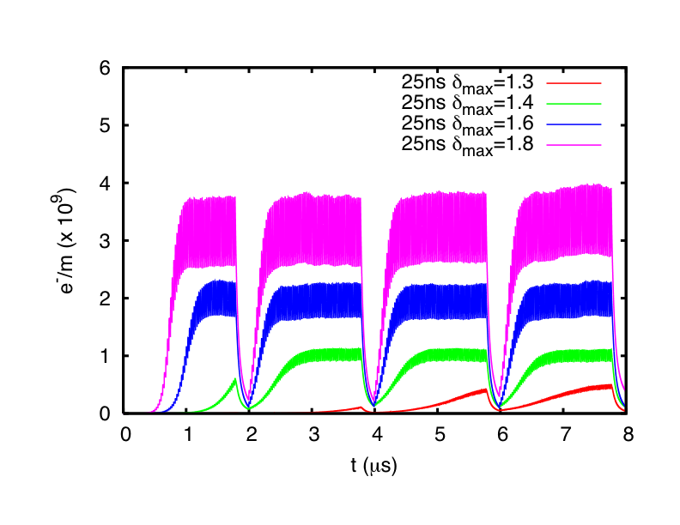
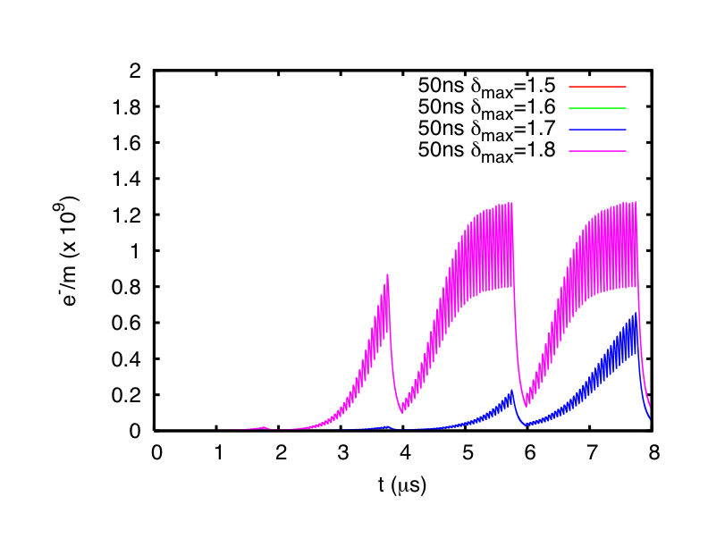
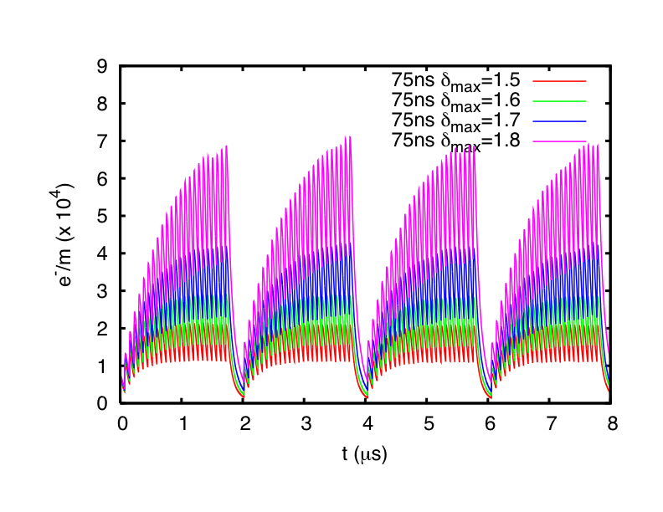
Simulation of e-cloud build up
Sample results
Example of electron cloud build in an SPS kicker for different kinds of beam
A dependence on the bunch spacing is clear: the larger the bunch spacing, the less electron cloud
Fixed the bunch spacing, a threshold value for δ_{max} can be found, above which the electron cloud forms

Slide 27
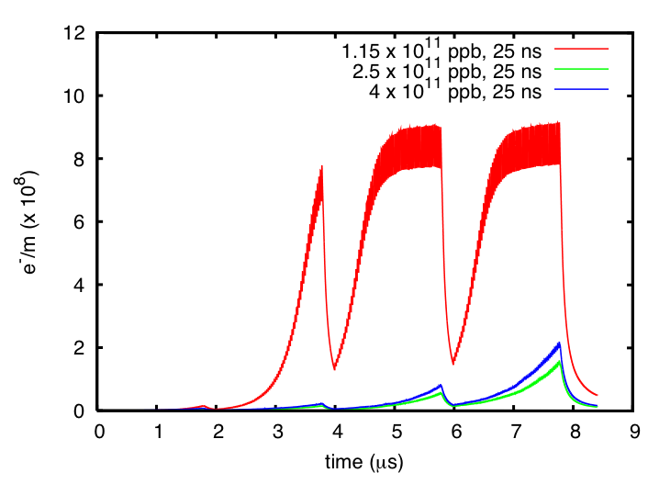
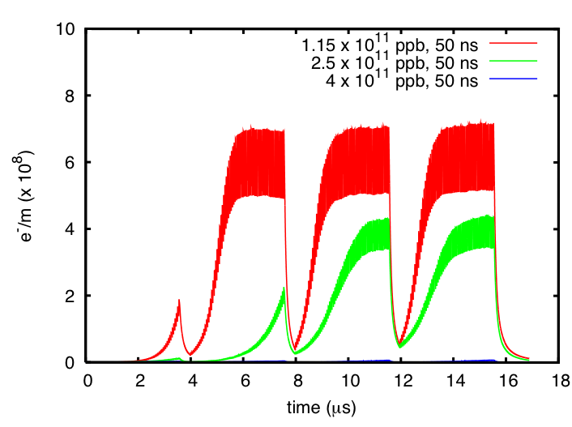
Simulation of e-cloud build up
Sample results
δ_{max}=1.3
δ_{max}=1.6
Example of electron cloud build up in an MBB dipole magnet for two different bunch spacings and different beam intensity values (from present nominal to possible future intensities after pre-injector upgrades)
The values of δ_{max} are chosen such that we are just at the limit to have electron cloud formation in these magnets
The dependence on the bunch current is not trivial. It appears not to be monotonic for the 25 ns spacing, and it even has a “counterintuitive” behaviour (i.e. e-cloud decreasing with increasing intensity) for the 50 ns spacing.

Slide 28
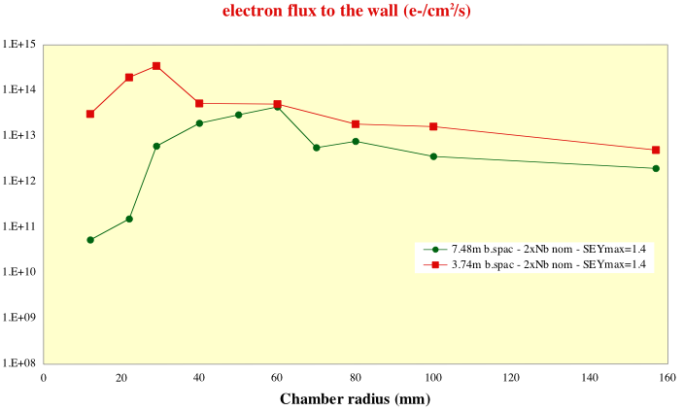
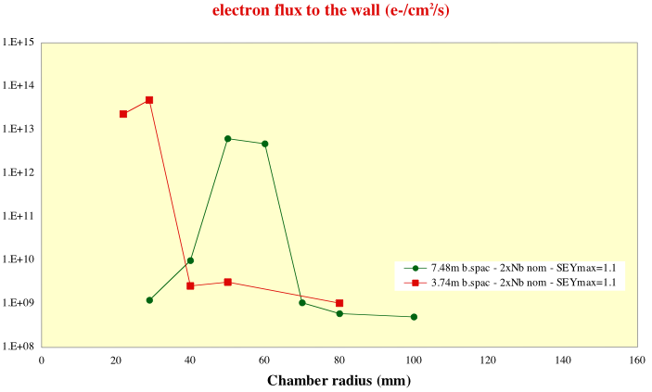
Simulation of e-cloud build up
Sample results
Example of electron cloud build in the LHC interaction region
A complex dependence on the chamber radius is found for two different values of δ_{max} and for two different bunch spacings and intensities (nominal spacing with double intensity, i.e. the interaction point, and half spacing with nominal current, i.e. half L_{sep} upstream or downstream from the IP)

Slide 29
Simulation of e-cloud build up
Sample results
12m ~ 40ns
Be pipe
Example of e-cloud build up in one of the former experimental regions of RHIC (PHOBOS)
It was observed that, when bunches are rebucketed, becoming half their original length, a severe pressure rise occurs in the PHOBOS region, which later “switches off” at some stage during the store.
Electron cloud is the most probable suspect, especially because in the experimental region there is a beryllium pipe, which has very high SEY. Also the bunch length dependence and the sudden switch off lead to think that this a threshold effect.

Slide 30
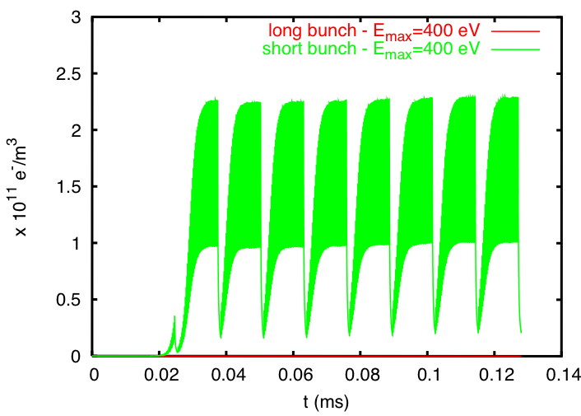
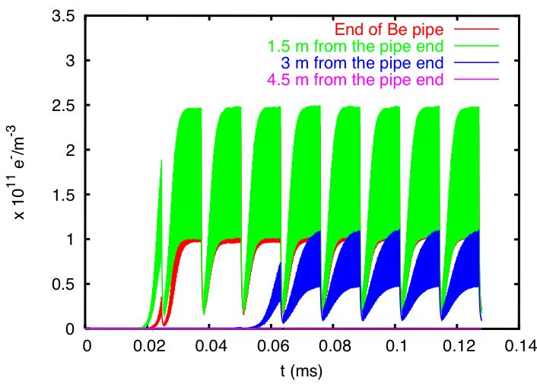
Simulation of e-cloud build up
Sample results
Example of e-cloud build up in one of the former experimental regions of RHIC (PHOBOS)
A dependence on the bunch length is found: only if nominal RHIC bunches are shortened (half length) through rebucketing, an electron cloud forms
It is also interesting that the e-cloud only forms in ~ the outer half of the 6m long PHOBOS beryllium pipe. This depends on the different filling patterns (with non-uniform bunch spacings) seen at the different points of the pipe.

Slide 31

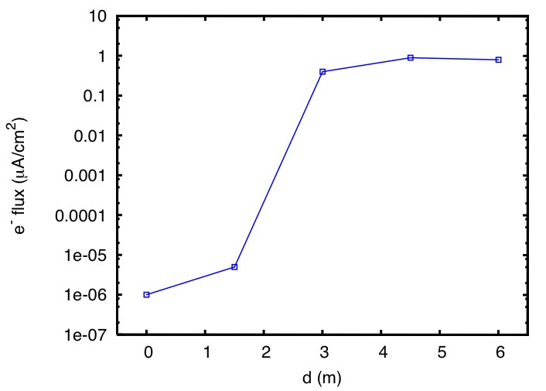
Simulation of e-cloud build up
Sample results
Beryllium pipe
IP
Electron flux to the wall in PHOBOS

Slide 32
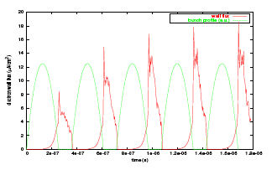
Simulation of e-cloud build up
Sample results
Example of electron cloud build through trailing edge multipacting in an the PSR with a long bunch (almost filling the whole machine)
Beside the trailing edge effect, which shows in the rise of the electron flux during the falling edge of the each bunch, also a multi-bunch effect can be observed, because the flux increases from one bunch to the next one.
The flux drops as the next bunch comes in because the electrons are drawn in.

Slide 33
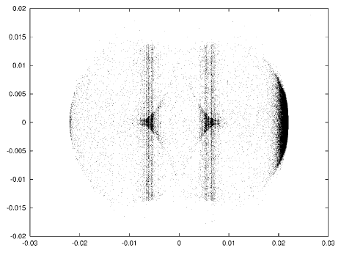
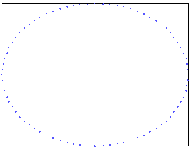
Simulation of e-cloud build up
Sample results
The electrons have different transverse (x,y) distributions, according to the type of region in which the electron cloud is formed
  In field free regions, the electrons tend to occupy uniformly all the pipe cross section
  In dipole regions, the electron motion is confined along the lines of the magnetic field, and the cloud develops along one central or two side stripes, according to the beam current and the position of E_{max} in the curve of the SEY.

Slide 34
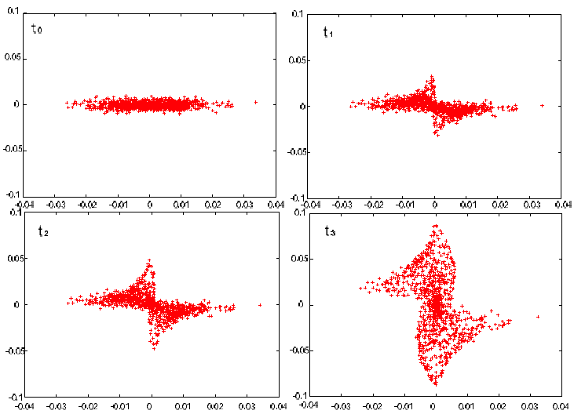
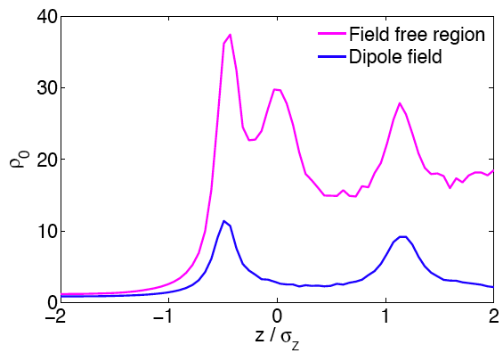
Simulation of e-cloud build up
Sample results
movie
z-dependent electron density on axis
Movie2 (free space)
Movie3 (dipole)
It is also interesting to have a look into the electron dynamics during the bunch passage. When the bunch arrives the electrons are drawn in and start to perform oscillations (electron pinch)
The pinch is always directed towards the local centroid. This is the mechanism that can couple the motion of head and tail of a bunch
The increasing electron density seen by the passing bunch creates a z-dependent tune shift/spread along the bunch.

Slide 35
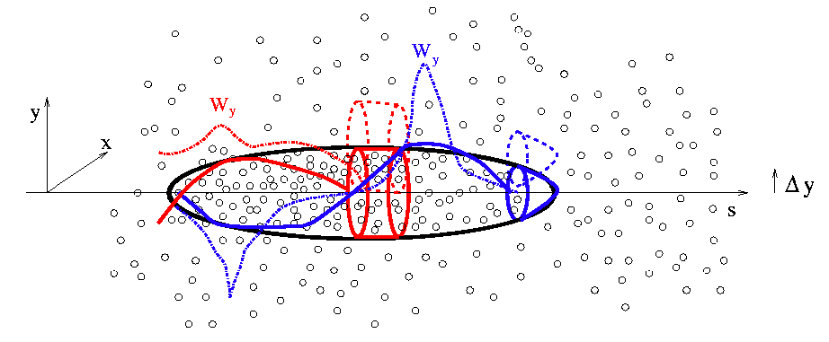
Transverse beam instability
A beam that goes through an electron cloud can become unstable due to head-tail coupling from the electron cloud itself
We imagine that the effect of the head on the tail happens through a kind of wake field, which can be quantified by displacing a bunch slice and then calculating the average electric field acting on the centroid of the following slices (centered) due to this displacement (normalized by the charge and displacement of the displaced source)
Unlike conventional wake fields, the electron cloud wake field depends separately on the locations of the source and test slices, and not on their difference

Slide 36
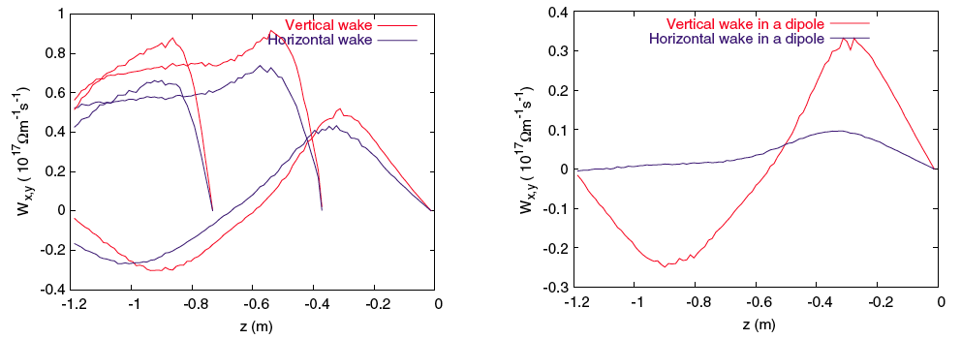
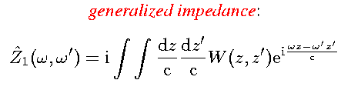
Transverse beam instability
Example of horizontal and vertical wake fields of an SPS bunch at 26 GeV/c going through a uniformly distributed electron cloud (field-free region) and through a dipole
The dependence of the shape of the wake on the displaced slice is shown in the left plot
The frequency associated to the head-wake (wake calculated from the head displacement) is related to the oscillation frequency of the electrons in autonomous regime (i.e. those electrons that are pinched while the bunch is passing and contribute most to the head-tail coupling via the e-cloud)

Slide 37
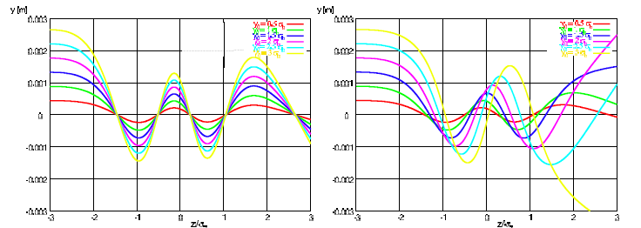
Transverse beam instability
The electron dynamics in the beam field, for electrons close enough to the beam, is that of a nonlinear oscillator.
The nonlinearity comes from the usually non uniform transverse and longitudinal profiles. Assuming a longitudinal Gaussian profile:
  if the distribution is transversely uniform, all the electrons will execute oscillations with the same frequency (modulated over the bunch passage, left plot)
  If the distribution is transversely also Gaussian (for example), the frequency will change not only over the bunch, but also according to the electron initial amplitude (right plot)

Slide 38

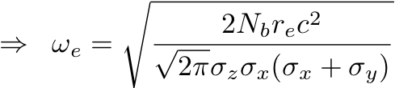
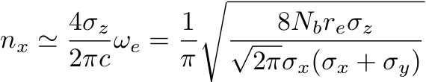
Transverse beam instability
Even if there is clearly a spread of frequencies, we usually define the characteristic electron bounce frequency as the frequency of the electrons in the linear region of the transverse force and around the peak of the longitudinal distribution (where the longitudinal distribution is most flat)
This is the maximum frequency of the electron motion, i.e. is the upper limit of the spectrum of the electron distribution evolution
From the frequency we can also estimate the maximum number of oscillations performed by an electron during one bunch passage

Slide 39
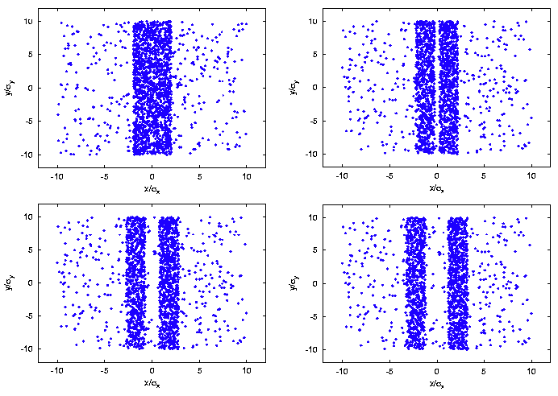
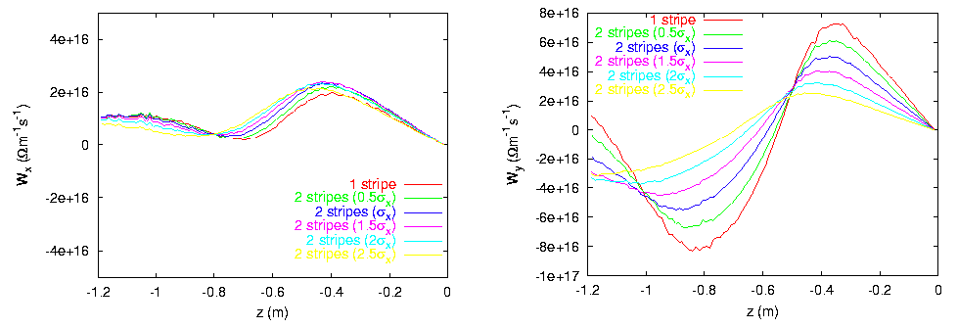
Transverse beam instability
In a dipole field, the electron distribution is different and the associated wake fields also change
Also the particle dynamics is different in a dipole, because it is mainly confined along the magnetic field lines
Amplitude and frequency of the wakes, as well as ratio between horizontal and vertical wake, change with the distance between the stripes

Slide 40
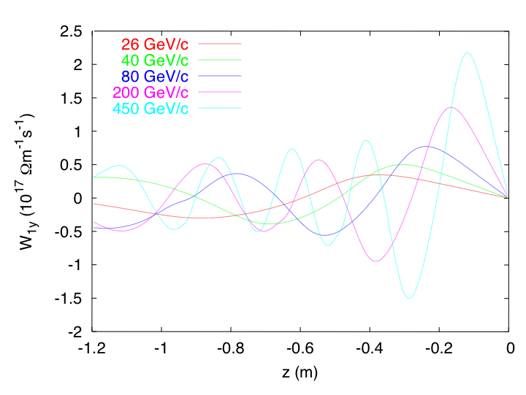
Transverse beam instability
It is interesting that the frequency of the head wake also changes with the beam energy (figure shows example of the wake field over the SPS bunch at some sample points of the accelerating ramp)
This is due to the fact that, as the bunch is accelerated, its transverse sizes decrease (constant normalized emittance), and therefore the frequency of the electrons in the autonomous regime correspondingly increases (since the sizes decrease like γ^{−1/2}, the frequency increases like γ)

Slide 41
Transverse beam instability
The transverse beam instability due to electron cloud (usually referred to as ECI, Electron Cloud Instability) is mainly studied through simulation codes (details of simulations in the next lecture)
Simulations help define thresholds (in beam current and/or electron cloud density) above which a bunch can become unstable
Instability simulation codes:
  HEADTAIL (CERN, Rumolo, Zimmermann, Benedetto)
  QuickPIC (USC-GSI, Katsouleas, Ghalam, Rumolo)
  PEHTS (KEK, Ohmi)
  WARP-POSINST (LBNL, Vay, Furman)
  CMAD (SLAC, Pivi)

Slide 42
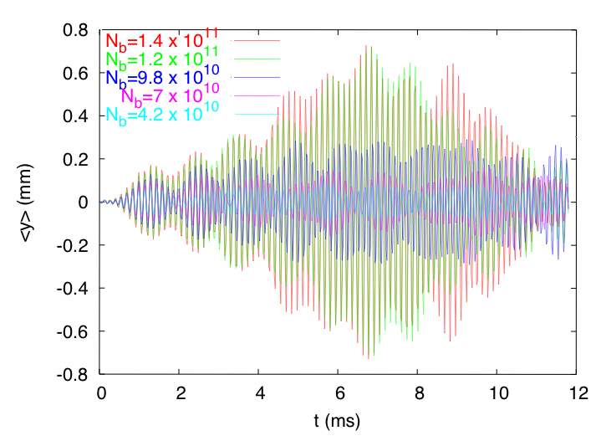
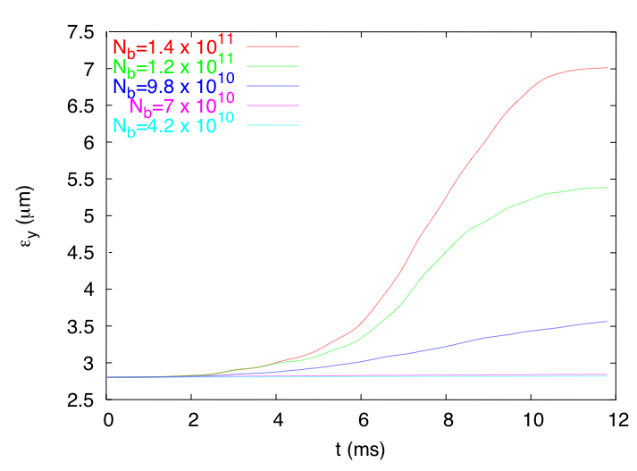
Transverse beam instability
When the beam suffers from ECI, simulations typically show a significant growth in the beam centroid motion (in the plane of the instability), and an emittance growth (generally sum of a coherent component coming from the mode excited along the bunch and an incoherent component)
The ECI is characterized by a threshold mechanism. If we fix the electron cloud density, there is a threshold value for the bunch intensity above which it sets in. However, strictly speaking, the e-cloud intensity is not independent of the beam intensity….

Slide 43
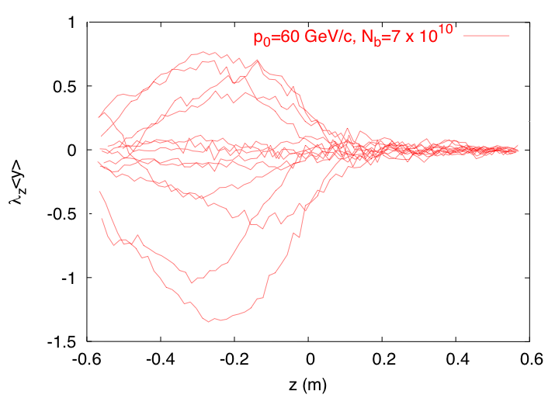
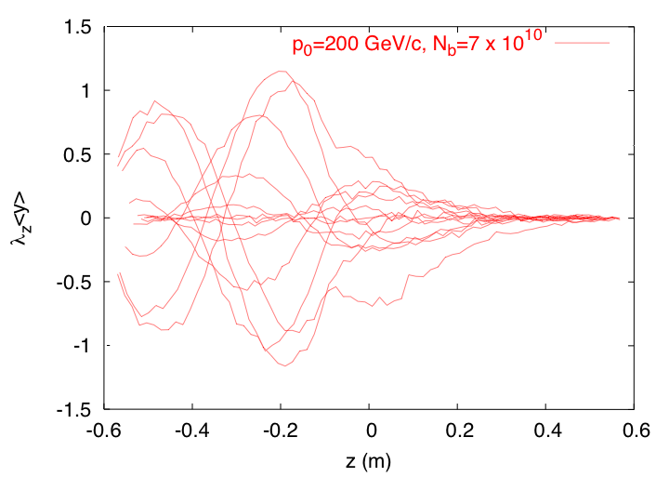
Transverse beam instability
A wide band pick up able to resolve the D signal along the bunch would see a collection of snapshots like those in the plots above.
In the two cases shown above the tail is excited much more than the head because the instability is fast and develops over a shorter time than the synchrotron period. This instability is of beam break-up type.
The mode excited in the left plot is higher frequency than the one on the right. As could be expected, mode frequencies are related to the electron bounce frequency.

Slide 44
Transverse beam instability
We can resort to the help of some movies to gain an insight on the evolution of the ECI in a bunch
Old movies (2002), produced with one of the first versions of HEADTAIL, show the ECI of an SPS bunch with space charge and a KEKB-LER bunch. The evolution of the instability is displayed in the yz plane
New movies (2009), produced with the new and parallel CMAD, show the evolution of an ILC-DR bunch interacting with an electron cloud. In the case with higher electron cloud density, an ECI appears, the case with lower electron cloud density is stable. This time the evolution of the bunch is displayed in the transverse plane xy
Movie1, Movie2 (from HEADTAIL, 2002)
Movie3 (ρ_{ε}=10¹¹), Movie4 (ρ_{ε}=10¹²) (from CMAD, 2009)

Slide 45
Transverse beam instability
It can be instructive to draw a list of similarities and differences between ECI and TMCI
  Both are single bunch phenomena. However, while the ECI has a single bunch mechanism but relies on the presence of other bunches to create the electron cloud, the TMCI is fully single bunch and can also affect one single bunch circulating inside the machine.
  Both are fast and have an intensity threshold.
  Both can be suppressed, at some intensities, by running the machine with high chromaticity or, in principle, by a wide-band high-gain feedback system
  Both feel the beneficial effect of higher synchrotron tunes, because a faster longitudinal motion naturally helps against all resonant phenomena.
  The TMCI does not exhibit an explicit dependence on the transverse emittances of the beam (except through space charge). The ECI depends on the transverse emittances because the pinch is affected by the transverse sizes of the beam
  Under constant bunch length and longitudinal emittance, while the TMCI threshold scales with energy like |η|, the ECI threshold decreases with increasing energy (in spite of the increasing stiffness of the beam particles)
  To fight TMCI requires the reduction of the impedance of the machine, to fight ECI electron cloud mitigation is needed.

Slide 46
A little bit of history....
Novosibirsk proton storage ring (1967): unusual transverse instabilities occurred for bunched and unbunched beams. Model of coupled electron/beam centroid oscillation.
CERN ISR (1970s): coasting beam instability and fast pressure rise for bunched proton beam.
Los Alamos PSR (1988): fast instability with beam loss above a threshold current (for bunched and unbunched beams)
KEK PF (1989): multibunch instability for positron bunch trains.

Slide 47
From the 90ies up to nowadays
CERN 1997: a crash program is launched to study electron clouds because it is suspected that they may endanger LHC operation
SPS and PS (since 1999): evidences for electron cloud with LHC type beams (pressure rise, signals at the PUs, instability)
KEKB and PEP-II (1999): e-cloud induced tune shifts along bunch train and instabilities.
RHIC (2002): pressure rise, tune shift, still unexplained instabilities (at transition). Electron detectors installed.
Tevatron, SNS, DaΦne (2003-2008): several signatures of electron cloud, like pressure rise or beam instabilities, are noticed in high intensity operation. Even ANKA suspects electron cloud to justify vacuum degradation and heating in the superconducting wiggler.
Cesr-TA (2008-2009): A program to study specifically electron cloud issues is launched. Thanks to its tunability, the ring is used with positrons to study e-cloud and benchmark simulation codes.

Slide 48
Electron cloud indicators
The presence of an electron cloud inside an accelerator ring is revealed by several typical signatures
Nonlinear pressure rise, outgassing
Anomalous heat load
Spurious signal collected at the pick-up electrodes
Tune shift along the bunch train
Coherent instability affecting the last bunches of a train
Beam size blow-up and emittance growth
Luminosity drop in colliders
Active monitoring: signal on dedicated electron detectors (e.g. strip monitors) and retarding field analysers

Slide 49
Electron cloud indicators
The electron cloud signal first appeared in the SPS on the signal from a pick up as a shift of the baseline (depending on the charge collected by the electrodes)
Correlation with train structure, length, gap were immediately apparent.

Slide 50
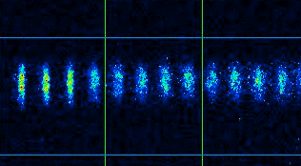
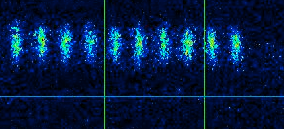
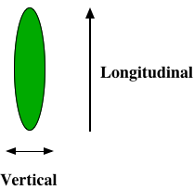
Electron cloud indicators
Vertical beam size blow up observed with a streak camera
Train head
Train tail
The electron cloud causes beam size blow up (through instability and incoherent effects) that manifests itself at the tail of the bunch train
Above an example of yz beam scan done in the KEK-LER

Slide 51
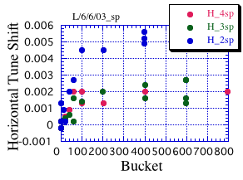
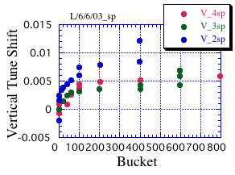
Electron cloud indicators
Tune shift from the e-cloud:
The electron cloud causes a positive tune shift along the bunch train (if we could measure along the bunch, the tune shift would be also modulated along the bunch)
Above an example tune shift along the train in the KEK-LER, for three different bunch spacings

Slide 52
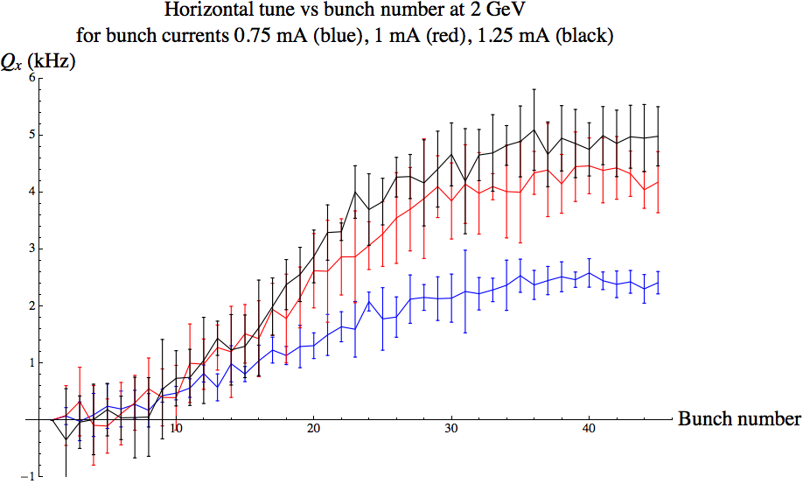

Electron cloud indicators
Horizontal and vertical tune shifts along a 46 bunch train in Cesr-TA (Cornell facility presently used for electron cloud studies) taken during a positron run
Dependence on the beam current is shown, clearly pointing to stronger electron cloud for higher currents.

Slide 53

Electron cloud indicators
Some times some witness (trailing) bunches are located behind a train to measure the tune shift while the electron cloud is decaying (positrons)

Slide 54

Electron cloud indicators
Some times some witness (trailing) bunches are located behind a train to measure the tune shift while the electron cloud is decaying (electrons)

Slide 55

Electron cloud indicators
The electron cloud measured with pick up electrods at BNL-RHIC (signal collected over two turns, RHIC period is about 12.67 μs)
The beam structure is of 3 batches of 16 bunches with 4 empty buckets between them

Slide 56

Electron cloud indicators
The electron cloud measured the Interaction Region (IR) of the BNL-RHIC.
The electron cloud only builds up when both beams come to the IR (requires therefore a shorter bunch spacing than the one in single ring)

Slide 57

Electron cloud indicators
110 bunches of Au ions are injected into RHIC.
At the injection of the 45th bunch a fast pressure rise, which is found perfectly correlated with the measurement from an e-cloud monitor, stops temporarily the injection process

Slide 58
Electron cloud indicators
In the SPS a special strip-detector is installed, which measures the distribution of the electron cloud in the horizontal plane.
It shows the two stripes in the electron distribution inside a dipole field region. The position of the stripes depends on the bunch intensity and on the field strength.

Slide 59

Electron cloud indicators
Electron cloud strip monitors in the SPS are attached to chambers in which special coatings are laid in order to study their SEY properties (see the mitigation part)
The electron cloud appears as a clear 1- or 2-stripe signal that grows during injection, saturates, and disappears when the beam is dumped.

Slide 60

Electron cloud indicators
The integrated electron dose, as measured by the strip monitors on the previous slide, can be integrated over each cycle, normalized by the beam current and plotted versus time
We can clearly see the SCRUBBING EFFECT

Slide 61

Electron cloud indicators
The ECI appears at the end of a batch or of a train of batches. Even if it is a single bunch instability, it remains a multi-bunch effect, because it relies on the previous bunches for the build up of the cloud.
High chromaticity can cure it, but some times it is not desirable to operate with high chromaticity if there are lifetime issues.
It usually causes beam loss, but not necessarily, because the unstable motion can saturate at a level such as not to produce losses

Slide 62

Electron cloud indicators
The ECI shows as a strong dipole motion on the last bunches of the train(s)
Here we captured the instability at its saturation
If we could now zoom on one of these unstable bunches and look at the intra-bunch motion while the instability develops and eventually saturates…..Movie1, Movie2

Slide 63
Electron cloud mitigation
Clearing electrodes installed along the vacuum chambers (only local)
Solenoids (only applicable in field-free regions)
Live with e-cloud but damp the instability: feedback system
Possible Solutions
To find out other thin films with an intrinsically low SEY.
To render the surface rough enough to block secondary electrons.
… or both combined
Lower activation temperature NEG
No need of heating once in vacuum
By machining
By chemical or electrochemical methods
By coating

Slide 64



Electron cloud mitigation
Solenoids
Solenoids have been successfully used at the LER of KEKB
Switching them on drastically reduces the beam size blow up as well as the tune shift along the batch

Slide 65

Electron cloud mitigation
Solenoids
Also at RHIC the beneficial effect of the solenoids has been observed
By changing the intensity of the magnetic field, the electron cloud could be efficiently suppressed in a region with an electron detector.

Slide 66



Electron cloud mitigation
Rough surfaces: grooves
zoom
To reduce the effective SEY, the inner surface of the beam pipe can be grooved, so that emitted electrons remain trapped
Figure shows the effective SEY as a function of the groove angle and period, for a sample having δ_{max}=1.74 at E_{max}=330 eV

Slide 67


Electron cloud mitigation
Rough surfaces: grooves
Once angle and period are fixed, the efficiency of the grooving to reduce the SEY is found to depend on the shape of the tips.
This solution raises the following concerns:
  Impedance enhancement (beam stability)
  Increased surface, which would make pumping more difficult (good vacuum)

Slide 68
Electron cloud mitigation
Surface treatment
For traditional beam pipe metals, e.g. StSt, after surface cleaning SEY is higher than 2.
A SEY as low as 1.3 would be desirable in most cases, ideally SEY<1 would be perfect
SEY can be reduced by:
in situ bake-out (for T=300°C, e.g. δ_{max} of Cu: 2.3 ⇨ 1.5)
increasing the electron/radiation impingement dose (so called conditioning or scrubbing): fully conditioned surface for 10⁻³ C mm⁻².
δ_{LIM}= 1.3

Slide 69
Electron cloud mitigation
Surface treatment
Low SEYs are obtained
for Ti-Zr-V (NEG) coatings after heating in vacuum at a temperature as low as
180 °C. Additional benefits:
high distributed pumping speed
low desorption yields
Most of the Long Straight Sections of the LHC are coated with Ti-Zr-V.
However,
the SEY becomes as high as 1.4 after several cycles of venting/activating
Dipole chambers cannot usually be heated as they are embedded in the magnets

Slide 70
Electron cloud mitigation
Surface treatment
The ideal film material :
has intrinsically low SEY;
is not prone to adsorb water vapor, oxygen and hydrocarbons;
can be easily deposited on stainless steel beam pipes;
is compact, smooth and not inclined to produce dust;
is UHV compatible;
has possibly low resistivity.
Graphite could be a good compromise…
wherefrom the idea of trying to deposit
amorphous carbon on the inner side of
the vacuum chamber….

Slide 71

Electron cloud mitigation
The most promising solution to date...

Slide 72
Electron cloud mitigation
The most promising solution to date...
Coatings with a-C have exhibited very good reproducibility in giving low SEY (even below 1) in all the lab tests
The coating has been shown not to produce any additional dusts (not even under extreme conditions of external stress). It is stable and does not flake off into the vacuum chamber.
Measurements with liners inside the SPS have confirmed the low SEY in presence of circulating beam
Measurements in a beam line of ESRF have demonstrated that these coatings have low photodesorption yield (quantifying the gas desorption due to incident radiation)
Being checked:
  Effects of aging in terms of SEY (in vacuum, with air exposure)
  Stability inside the accelerator
  Contribution to the impedance
  Photoelectron yield

Slide 73
Electron cloud mitigation
Why is it so important?
The performance of many high current hadron/positron machines around the world are presently limited by electron cloud instabilities. E. g.
  The CERN-SPS suffers from ECI when operating with nominal LHC beams (25 ns bunch spacing). The upgrade plan foresees injecting into the SPS at a higher energy, which unfortunately would not improve the situation
  BNL-RHIC suffers from an instability at transition, which is believed to be caused by electron cloud
Future machines could also be operating in regimes, in which the electron cloud can build up and destabilize the beam. E. g.
  CLIC damping rings: with very small emittances and low gaps in the wigglers, the electron cloud becomes dangerous even only from photoelectrons
  SIS100-300 in the GSI-FAIR project are planned to operate with high intensity heavy ion beams in a range of (nominal) parameters that could trigger electron cloud build up.

Slide 74
Part II
Ion trapping and instabilities

Slide 75
Ion accumulation
The accumulation of ions can strongly affect the performance of machines operating with negatively charged particles (electrons, antiprotons).
Trapping of ions can occur obviously with coasting beams, but also with bunched beams, because the ions are heavier particles than electrons and they usually feel only a sequence of attractive kicks from the passing bunches, which can keep them confined in the neighborhood of the beam
If the ions can only move little distances during the bunch separation, their motion can be basically approximated with a purely oscillatory motion in the proximity of the beam –which behaves as continuous
More in general, we can calculate a trapping condition for ions such that their trajectories remain stably oscillating around the beam. This condition obviously depends on the ion mass, beam charge (electrons per bunch) and size, and on the distance between subsequent bunches

Slide 76



Trapping condition (Gaussian beams)
Ion of mass A
T_{b}
Section i
Section i+1
Transport through the drift space between bunches
Kick from the passing bunch

Slide 77


Trapping condition
Stability of ion motion during the train passage requires that: |Tr[A]|<2

Slide 78




Trapping condition
This condition can be read in terms of how large the atomic mass of an ion must be to become trapped in a beam with given parameters:
… or in terms of how some critical beam parameters must be combined such as to trap a given species of ions:

Slide 79


Trapping condition
The trapping condition can also be expressed in terms of relation between the oscillation frequency of the ions (ω_{ion}=2πf_{ion}) and the repetition frequency of the beam (ω_{b}=2πf_{b}=2π/T_{b})
from the trapping condition
The ions are trapped if they receive kicks at a larger frequency than about twice their oscillation frequency

Slide 80

Trapping condition
Note that the oscillation frequency of the ions is related to an averaged beam line density, i.e. it is the same oscillation frequency that the ion would have if it were trapped around a continuous beam with density λ(s)=λ_{b}=N_{b}/L_{sep}
In reality the kick is given over a much shorter time (≈4σ_{z}/c << T_{b}), which corresponds to much higher peak electric fields than that visible in the ion oscillation frequency

Slide 81


Trapping condition
This is an example of trajectories of trapped ions (two different species)
In the long transport line to transfer the beam from the damping rings to the main linac for CLIC, the parameters of the beam are such that both CO and H₂O ions are trapped and execute many oscillations over the train passage (more in the vertical direction, because the beam is flat)

Slide 82

Trapping condition
The ions focused in the beam field potential, and trapped around the beam, keep oscillating around the bunches and they are only released at the end of the train
They will be lost to the pipe wall if the next coming train is far enough. Otherwise, there could be inter-train trapping (specially dangerous situation)

Slide 83



Trapping condition
The density of ions at a given location can be calculated assuming the bunches to have uniform transverse radial distributions (radius a)
Each passing bunch produces ions with a density R₀(r)=R(r,t=0), which later evolves under the focusing and further production from the next bunches
We assume that all the ions are generated at rest.
The above summation can be recast in continuous time

Slide 84


Trapping condition
The density of ions at a given location can be calculated assuming the bunches to have uniform transverse radial distributions (radius a)
Each passing bunch produces ions with a density R₀(r)=R(r,t=0), which later evolves under the focusing and further production from the next bunches
We assume that all the ions are generated at rest.

Slide 85

Trapping condition
The steady-state density of ions at a given location exhibits therefore a singularity in r=0 (it diverges due to the linear focusing from the beam at a fixed frequency)
The ion distribution actually extends over the full transverse section occupied by the beam
Real distribution of ions at the passage of the i-th bunch
For analytical estimations, we prefer to approximate the real distribution with a uniform distribution in a radius a/√2.
With this description we obviously lose the effect of the “tail” ions (small, note the log scale), and that of the diverging peak on the core particles.

Slide 86

Trapping condition
An example that shows how ions are produced and accumulate around the beam, while the 270 bunches of the CLIC beam are passing through a section of the long transfer line.

Slide 87



Trapping condition
In a linac, for example the beam size shrinks along the line (because of acceleration), so that ions are produced over different cross sections at different points of the line
Horizontal and vertical ion distributions after the first bunch passage (no focusing yet, just Gaussian).

Slide 88



Trapping condition
The trapping condition also changes along the linac, making it possible to have trapping of some species only locally. The degree of trapping in different regions of the linac can be seen by the extension of the tails of the distribution
Horizontal ion distributions after the first and last bunch passage.
Note that the beam gets smaller transversely, while its tails extend farther.

Slide 89


Trapping condition
All that we calculated is true as long as the density of the ions is low enough that their own space charge has little effect on their dynamics
However, in conditions of trapping, the local density of ions quickly escalates with the number of passing bunches, leading to some degree of neutralization of the beam line charge (dependent on the bunch number): λ_{ion}=η(i) λ_{b}
In these conditions, an additional driving term (defocusing) must be put into the equation of motion of the ions, which will change ion oscillation frequency and the trapping condition. More species can be trapped.
We can assume that the transverse extension of the ion distribution is in the average about √2 smaller than that of the beam in each transverse direction (because of the transverse focusing, as discussed earlier)

Slide 90
Tune shift
Obviously, the beam will also feel the effect of the ions
As long as no two-stream instability sets in because of the interaction between beam and ions, the only effect of the ions on the beam will be a net extra-focusing, which results in a tune, or phase advance, shift (increase) dependent on the position of the bunch in the train (bunch number i)
With the model of the ions uniformly distributed in a stripe of width 2√2σ_{x} the inner electrons feel a linear force and the outer ones are subjected to the nonlinear part.
Electric force from the ions
Beam
x
Ions

Slide 91

Tune shift
Assuming uniform focusing along the accelerator, we have an unperturbed perfectly harmonic motion, constant beta function, and we can just add the extra focusing term coming from the electric field of the ions
This allows us to find an easy expression for the tune shift of the i-th bunch of a train inside a circular machine

Slide 92


Tune shift
We can also take a more realistic modeling for the accelerator, i.e. remove the assumption of constant focusing
It is easy to show that the general formula reduces to the one on the previous page in the smooth approximation.

Slide 93

Transverse beam instability
If the ions around the beam accumulate to high enough density, a two-stream instability can be driven by the mutual interaction.

Slide 94

Transverse beam instability
In circular machines two possible regimes exist:
  Bunches are uniformly distributed around the machines. In this case no clearing gap is present and ions accumulate indefinitely giving rise to a classical ion instability
  Bunches are distributed in one (or more) train(s) with a long enough gap between them that the ions are cleared. In this case the instability could develop over one train length and is called fast ion instability

Slide 95
Transverse beam instability
In linear machines, the fast ion instability can develop with the same mechanism as in a circular machine
The ion accumulate along one bunch train and can make the tail of the train unstable. The frequency of oscillation is related to the ion oscillation frequency.
(c)
Gap
e⁻
e⁻
Bunch train
Gap
e⁻
e⁻

Slide 96

Transverse beam instability
The main difference with the electron cloud instability (ECI) for positively charged beams is that the fast ion instability is a multi-bunch effect and does not affect the internal motion of the single bunches
The reason is that the ions are much heavier particles which do not move significantly over one bunch passage, but carry memory from one bunch to the next one.

Slide 97

Transverse beam instability
Example of instability: if the pressure in the pipe of the CLIC transport line exceeds 0.1 nTorr, the fast ion instability sets in
The vertical centroid motion along the train clearly shows a coherent pattern propagating from the tail of the train towards the head

Slide 98

Transverse beam instability
Example of instability: if the pressure in the pipe of the CLIC transport line exceeds 0.1 nTorr, the fast ion instability sets in
The instability also affects the bunch by bunch emittance. An emittance growth appears at the tail of the train

Slide 99



Transverse beam instability
Example of instability: if the pressure in the pipe of the CLIC transport line exceeds 0.1 nTorr, the fast ion instability sets in
We can also diagnose the instability by looking at the evolution of the centroid motion over subsequent parts of the train (1/3).
It is usually assumed that a number of rise times below ≈3 along the line is acceptable in order not to degrade the beam significantly.
~ 6 „e-folding“ times

Slide 100
Transverse beam instability
Usually existing machines (especially light sources) operate with large enough gaps as to clear away the ions and avoid conventional instabilities
Other techniques used to clear the ions are:
  Static electrodes
  Alternating field electrodes excited on the bounce frequency of the ions
  Beam shaking
Beam parameters and vacuum pressures are such that the present rings do not suffer from fast ion instability. However, this instability has been observed by injecting gas on purpose (e.g. ALS injected 25 nTorr He compared to 1 nTorr normal pressure) or, in some rings, during the commissioning phase, when the pressure had not yet reached its nominal value
For future machines, with designs oriented towards ultra-low emittances and high beam currents (both damping rings for linear colliders or even transport lines and linacs), the fast ion instability is one of the most serious concerns and usually dictates the vacuum specifications.

