Slide 1
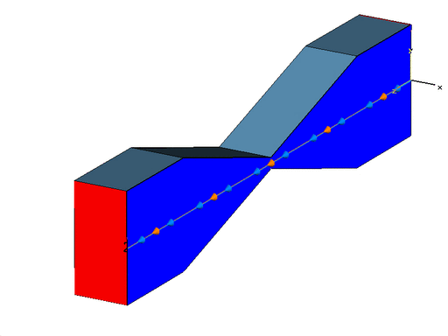
EXAMPLES OF ELECTROMAGNETIC SIMULATIONS (1/17)
Example from CST (Computer Simulation Technology: http://www.cst.com/Content/Applications/Article/Wake+Field+Simulation+of+a+Collimator) => Wake field simulation of a collimator

