Slide 1


Collective effects in the longitudinal plane
G. Rumolo and E. Métral
USPAS Course on collective effects
Tuesday, 23.06.2009

Slide 2
Longitudinal plane
Multi-particle effects
Collective
Two-stream
Incoherent/collisional
Collective
Transverse
Longitudinal
Beam/beam
E-cloud/trapped ions
Multi- bunch
IBS/Touschek
Microwave/turbulent
Potential well distortion
Head-tail
TMCI
Incoherent tune spread
Instability/beam loss
Coherent tune shift
Beam quality degradation/ emittance growth

Slide 3
Program of the day
Space charge in the longitudinal plane
Equations of motion in the longitudinal plane
  Stationary bucket
  Accelerating bucket
Synchrotron tune shift due to space charge
Energy loss (single pass, multi pass)
Vlasov equation:
  Stationary distributions without collective terms (linear and nonlinear matching)
  Stationary distributions with collective terms (potential well distortion)
    Haissinski equation
    Synchronous phase shift, bunch lengthening or shortening, synchrotron tune shift
  Non-stationary solutions: perturbative approach
    Bunched beams (azimuthal and radial modes for low beam intensities, mode coupling, turbulent bunch lengthening)
    Coasting beams

Slide 4
Some references
(reading recommended)
Yesterday’s lecture on Space Charge, Wake Fields and Impedances (E. Métral)
A. Chao, “Physics of collective beam instabilities in high energy accelerators”
  Chapter 1, Introduction, pages 20-27
  Chapter 2, Wake fields and impedances, pages 117-126
  Chapter 6, Perturbation formalism, pages 273-332, 361-363
  Chapter 5, Landau damping, pages 251-263
  Chapter 4, Macroparticle models, pages 162-172

Slide 5
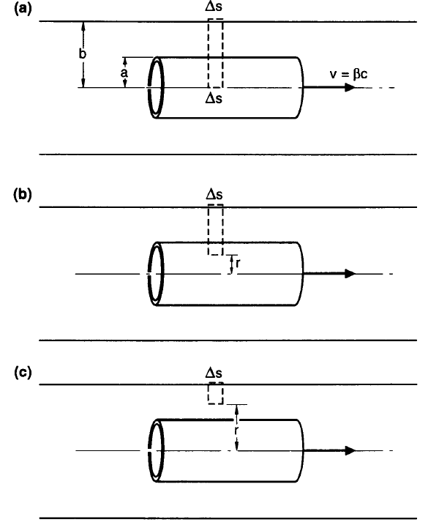

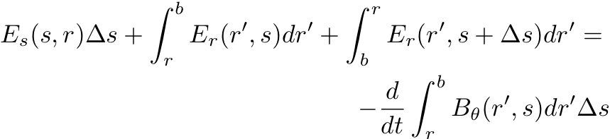
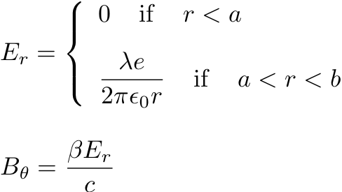
Space charge
We do the calculation for a ring-shaped distribution λ(s-βct)
3rd Maxwell equation, or Faraday-Neumann law

Slide 6
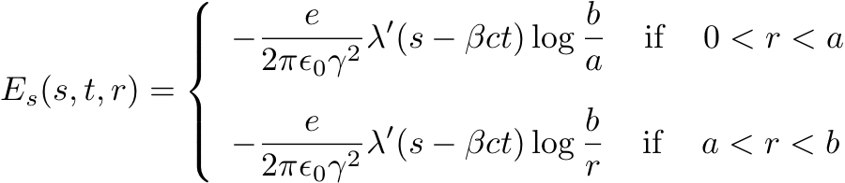
Space charge
All dependencies on s are actually on s-βct
Therefore d/dt =-βc d/ds
We carry out the integrals in the equation obtained and take the limit for Δs->0

Slide 7
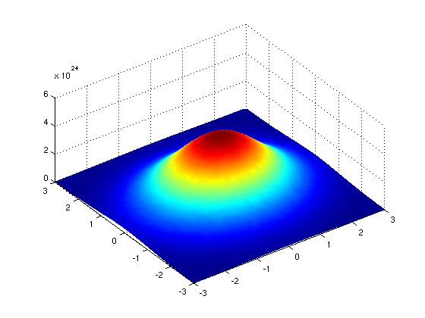

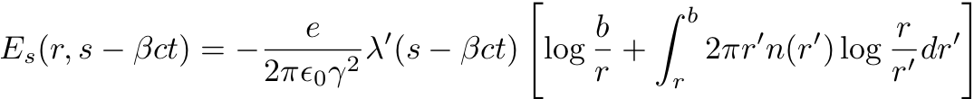
Space charge
We have found the space charge longitudinal electric field for a cylindrically symmetric ring shaped distribution
Let’s assume now that we have a beam with a radial distribution n(r)
Then for the linearity of Maxwell’s equations, we can calculate its longitudinal space charge electric field as the superposition of the contributions given by the various rings composing the actual distribution

Slide 8
Space charge
Longitudinal space charge has the following interesting dependencies:
  It decreases with energy like γ⁻². Therefore it vanishes in the ultrarelativistic limit
  It is proportional to the opposite of the derivative of the line density –λ’. This can be understood intuitively because it must be directed from a region with higher charge density to a region with lower charge density (i.e. it pushes with the opposite of the gradient of the line charge)
  Space charge would then spread out charge bumps. However, remember that only below transition energy, accelerated particles go faster and space charge has this smoothing action. Above transition, accelerated particles take a longer time to go around the accelerator and density peaks can be enhanced. This is the origin of the so-called negative mass instability. Momentum spread (unbunched beams) or synchrotron motion (bunched beams) can usually stabilize this effect.

Slide 9


Space charge: exercises
Prove the formula on the previous page (Slide 8)
Calculate the radial distribution of E_{s} for a bunch with a uniform distribution for r<a and with parabolic radial distribution n(r)=k(a²-r²) for r<a
Verify that the fields on Slide 5 and 6 (E_{r}, B_{θ,} E_{s}) do not satisfy Maxwell’s equations, unless a correction term is taken into account. Calculate the leading term for the correction and show that it can be neglected as long as the bunch is much longer than b/γ
Compare the strength of transverse and longitudinal space charge forces, and find under which condition the transverse one is dominating.

Slide 10
Equations of longitudinal dynamics
Observer
(impedance)
To describe the motion of particles in the longitudinal phase space, we will use the pair (z,δ), which represent the arrival delay of the particle at an observation point (multiplied by the particle velocity, z=-βcτ) and its relative momentum offset, respectively, with respect to the synchronous particle.
The pair is s-dependent, i.e. it is defined with respect to a chosen observation point in the accelerator, but this is not critical for the longitudinal plane, because longitudinal motion is generally much slower than the revolution time
(z,δ)=(0,0) for the synchronous particle
z

Slide 11
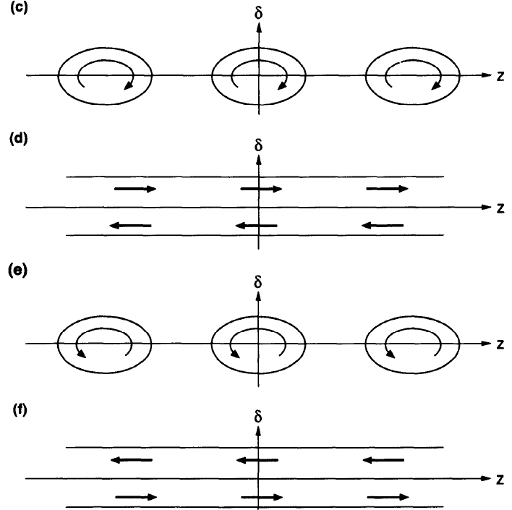
Equations of longitudinal dynamics
The synchronous particle has zero momentum offset and always takes T₀ to go around, i.e. is always observed with z=0.
Particles with positive z arrive earlier at the observer (negative delay τ), those with negative z arrive later (positive time delay τ)
Bunched beams: below transition particles are focused back by deceleration. Opposite above transition.
Coasting beams: below transition particles with positive momentum offset shear toward positive z (absence of focusing). Opposite above transition

Slide 12
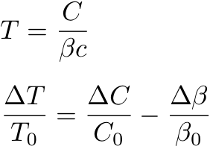



Equations of longitudinal dynamics
The difference in revolution time between a generic particle and the synchronous
particle, that is its delay in arrival time at a point, can be easily related to its
momentum offset δ

Slide 13

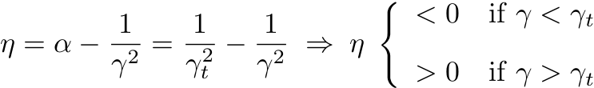
Equations of longitudinal dynamics
Reminder of vocabulary and meaning of symbols:
is the momentum compaction factor
is the slippage factor
C is the mean circumference of the accelerator C=2πR
γ_{t} is the γ transition (corresponding to the transition energy)
Remember that γ is a property of the beam, whereas γ_{t} is a property
of the machine. η depends on both, but in the limit of very high
energies, it tends to α, and therefore depends only on the lattice.

Slide 14
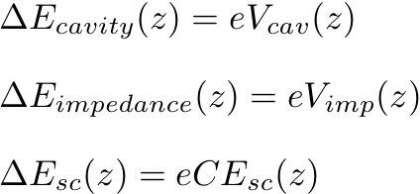



Equations of longitudinal dynamics
Energy change per turn
Actually a kick that the beam receives at the cavity location(s)
Actually a kick that the beam receives at the impedance location(s)
Actually a force felt by the beam constantly over the revolution

Slide 15
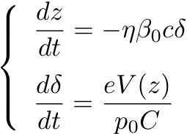
Equations of longitudinal dynamics
V(z) is the sum of the external voltage from the rf systems and self-induced from space charge and impedances. The rf component is 0 when z=0 for a stationary bucket.
Above transition, the regime is negative-mass due to η>0: the particle will move to lower z for positive momentum deviation, and vice versa.
We are interested in the particle motion only in the stable regions, i.e. where particle motion is confined around a stable point. These regions are called rf buckets and are determined by the phase of the rf with the motion of the synchronous particle

Slide 16
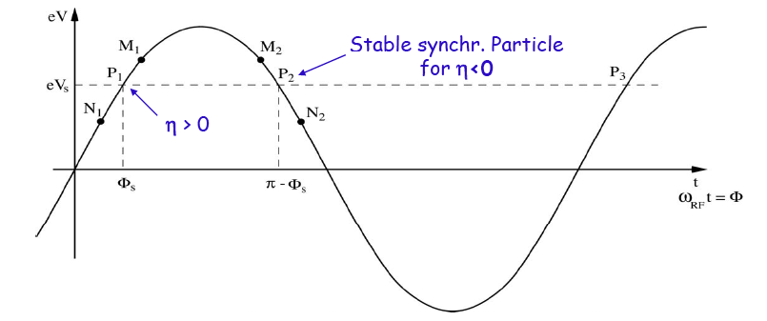

Equations of longitudinal dynamics
Example: V(z) is only external due to the main rf system and has a sinusoidal waveform tuned on harmonic number h (means that the rf frequency ω_{rf} is h times the revolution frequency ω₀). Case of stationary bucket
Φ = h/R z

Slide 17

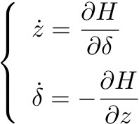


Equations of longitudinal dynamics
If V(z) is can be derived from a scalar potential U(z), the system is Hamiltonian and we can also express its Hamiltonian function.

Slide 18
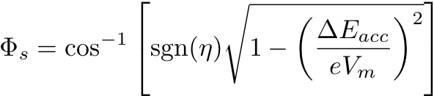


Equations of longitudinal dynamics
For an accelerating bucket, the bunch needs to be synchronized around a phase different from 0 or π, which can guarantee a desired rate of momentum (energy) increase per turn. Obviously, the rf system can only accelerate up to an energy gain per turn [eV] that equals its maximum voltage [V] (ideally, because the bucket area shrinks to zero when V_{m}=ΔE_{acc}).
Φ = h/R z

Slide 19

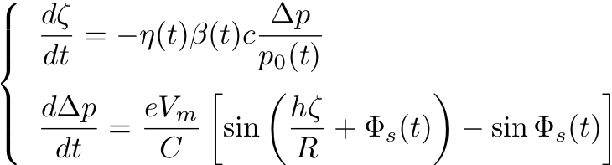
Equations of longitudinal dynamics
For an accelerating bucket, we redefine the pair of coordinates we use to describe the system, in such a way that they keep being both zero for the synchronous particle The acceleration rate does not need to be constant in time….
Usually Φ_{s} is not constant at the beginning and end of an accelerating ramp, to make the curve B(t) smoother (it is made linear piece-wise). Also when crossing transition, there might be a γ_{t}-jump scheme in place to minimize the time the beam spends on transition.
The above equations can be derived by a slowly time varying Hamiltonian H(t).

Slide 20
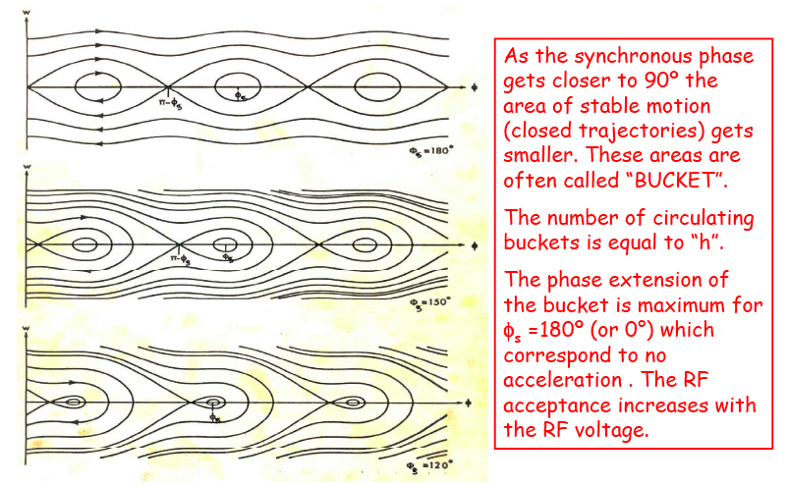
Equations of longitudinal dynamics

Slide 21
Equations of longitudinal dynamics
Usually p₀, Φ_{s}, β, γ, etc. vary on a time scale that is long with respect to the time the synchrotron motion, described in the longitudinal phase space (ζ, Δp), evolves. Yet another time scale in the beam particle dynamics inside an accelerator:
  Transverse motion has a periodicity of fractions of a turn
  Longitudinal motion has typically a periodicity of ~100 turns (only when crossing transition longitudinal motion becomes much slower)
  Acceleration takes usually several hundreds of thousands of turns.
Even if the beam is usually accelerated at the expense of one (the main) rf system alone, the longitudinal dynamics can make use of more than one rf-system. Additional rf systems are usually programmed to be ‘slaves’ of the main system, i.e. they are made to have their 0 or π phase correspondingly to the synchronous phase, which is solely determined by the main rf.
  For example the CERN-PSB accelerates the beam over the full length of its cycle and makes use of the 2 rf systems h=1 and h=2. In some configurations, h=1 is the main rf system and h=2 is used for flattening the bunch against space charge. In some other configurations, h=2 is the main system and h=1 is used to reduce the bunch spacing and synchronize the transfer into the CERN-PS waiting buckets.

Slide 22
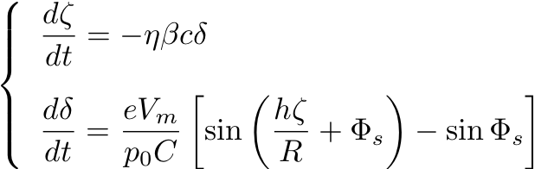

Equations of longitudinal dynamics
Some times the bunch is made to sit in an accelerating bucket only to compensate for external losses
in a lepton storage ring, to compensate for synchrotron radiation losses
in general, a bunch in a stationary bucket can move to a synchronous phase different from 0 or π in order to compensate for impedance losses (see further)

Slide 23


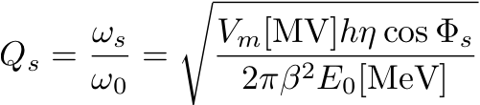
Synchrotron tune
From linearization of the rf force around ζ=0, the synchrotron motion is reduced to a harmonic oscillator with a characteristic oscillation frequency (or tune, if divided by the beam mean revolution frequency)

Slide 24

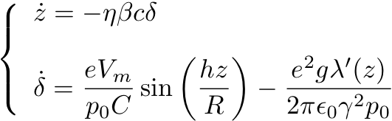

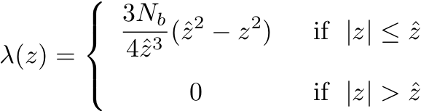
Synchrotron tune shift due to space charge
We consider the case of a parabolic bunch inside a stationary single rf bucket

Slide 25


Synchrotron tune shift due to space charge
The rf force has to be linearized around z=0, while the space charge force is already linear with the chosen bunch line density.

Slide 26
Synchrotron tune shift due to space charge
Remarkably, the space charge induced synchrotron tune shift depends on
  Number of particles in the bunch N_{b} (linear)
  Beam energy
    Explicit inverse quadratic dependence on β and γ
    There is another energy dependence in η. In particular the shift changes sign below and above transition. The tune shift is negative below transition (η<0), where space charge is defocusing. It is positive above transition (η>0), where space charge adds up to the external voltage and contributes with an extra focusing.
    There is another inverse dependence on γ in E₀.
  Machine radius (quadratic)
  Bunch length (inverse cubic)
    Attention must be paid here to the fact that the bunch length itself depends upon the strength of space charge….

Slide 27
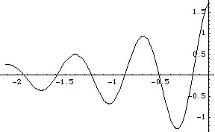
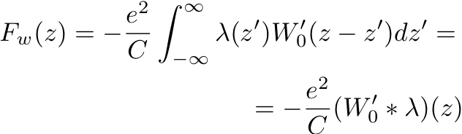

General equations of longitudinal motion
First of all we would like to write the full equations of the longitudinal dynamics by singling out all the different contributions (external voltage, space charge and wake field)
We consider for the moment only wake fields decaying over one turn, or in the distance between two subsequent bunches of a train
W‘₀
∫W‘₀(z-z‘)λ(z‘)dz‘
λ(z‘)
z‘
z-z‘<0
z
z

Slide 28
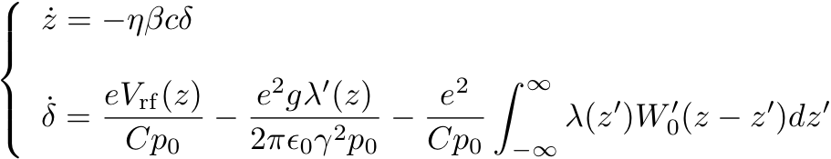
General equations of longitudinal motion
Let’s limit ourselves for now to the case of a stationary bucket.
However, it should be noted that in the case of accelerating bucket, both the space charge term and the wake field term will be included into the momentum equation in a similar fashion, simply exchanging z with ζ, because both space charge fields and wake fields move with the bunch!
External rf
Wake fields
Space charge
Ex. Write the general Hamiltonian of this system, and specify it to the case of resistive wall and two in-phase rf systems on h=1 and h=3

Slide 29



Space charge impedance
Now we will justify that we can always drop the space charge term from the general equations, because it can be included in the wake field formalism through an ad-hoc defined “space charge impedance”
Therefore, we will be able to retain the only wake field term in the equations of the longitudinal dynamics.
because

Slide 30


Space charge impedance
Longitudinal space charge can be easily included in the frame of the impedances through a newly defined “space charge impedance”
The space charge impedance is purely reactive and exhibits a linear dependence on frequency. This is an approximation valid only in a range of frequencies well below the cut-off frequency of the beam pipe
It is intuitive that the space charge impedance is proportional to the length of the accelerator and inversely proportional to the square of the beam energy.
It will be shown in the following that, as purely imaginary, the space charge impedance does not contribute to the bunch energy loss. This is physically consistent with space charge being an internal force, which cannot determine a net energy loss over the full bunch (it can only happen that the energy lost through space charge by a part of the bunch, is transferred to another part of it). However, unlike in the transverse plane, here it can drive an instability (negative mass)

Slide 31
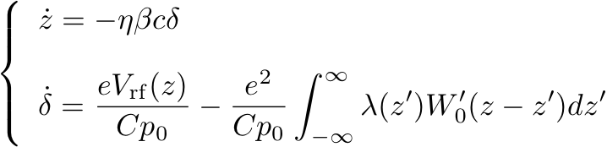

Energy loss of a bunch
We can write the equations in the above form without losing generality
We are ready to calculate the energy loss due to the wakes
  First the energy loss suffered by a particle at the z coordinate inside a bunch
  Second, the energy loss suffered by the whole bunch

Slide 32


Energy loss of a bunch
Even if single particles within the bunch can have a net energy loss or gain (sign of ΔE(z) not defined), as they can acquire more energy left behind by the preceding part of the bunch than what they lose on creating their own wake, the whole bunch can obviously only lose energy interacting with an external passive structure (ΔE<0)
The value W’₀(0) accounts for the energy loss of the source of the wake
  It can be seen by calculating the energy loss of a very short bunch (see below)
  However, the final expression of the energy loss will be more complex because, as said above, part of the energy lost by a part of the bunch can be recovered by a following part of the bunch
W’₀(0) quantifies the energy lost by the almost point-like (in z) source q=N_{b}e on creating its own wake
We assumed W’₀(z) to be a continuous function in z, and thus also in z=0. This is true only in the non-ultrarelativistic case. See next page for the ultrarelativistic case.

Slide 33
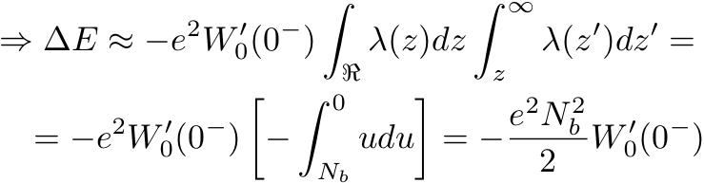

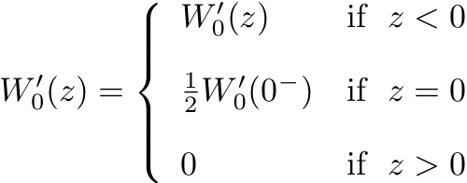
Energy loss of a bunch
In the ultrarelativistic case, since there cannot be any wake field in front of the bunch itself, when the bunch becomes very short the wake field tends to its limit for 0⁻
This result is the beam-loading theorem
The factor ½ comes from the fact that, because of the ultrarelativistic assumption, even an ultra-short bunch will only see in the average half of its charge.
To keep the meaning of W₀’(0) unchanged, we can define:

Slide 34

Energy loss of a bunch
Now we go back to the energy loss of a bunch and try to express it as a function of the longitudinal impedance:
The energy loss only depends on the overlap between the real part of the longitudinal impedance and the bunch spectrum. Therefore, space charge (as well as any other purely reactive impedance) does not cause energy loss
This result is only valid for the case of wake field decaying over one turn (broad-band impedance)

Slide 35
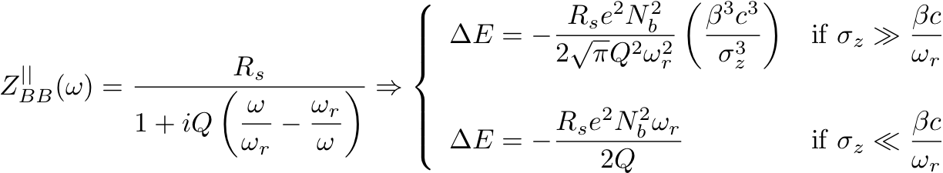
Energy loss of a bunch
Exercises: calculate for a Gaussian bunch
  The energy loss per unit length due to a resistive pipe of radius b and conductivity σ
  The energy loss due to a broad band resonator (when needed make approximations on bunch length and resonator width)

Slide 36
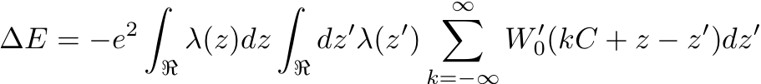
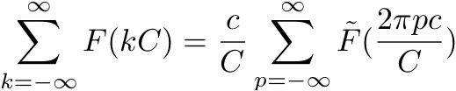

Energy loss of a bunch
If the wake field decays very slowly and still has a significant amplitude by the time the bunch takes to go around the machine, bunch and wake field will interact on several passages
In this case we take this into account into the calculation (assuming that the bunch distribution is basically stationary, i.e. does not significantly change from turn to turn -> λ(z) periodic with period C).
We need to make use of the following general property of Fourier transforms

Slide 37

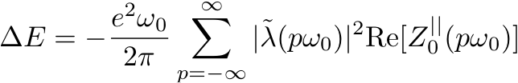
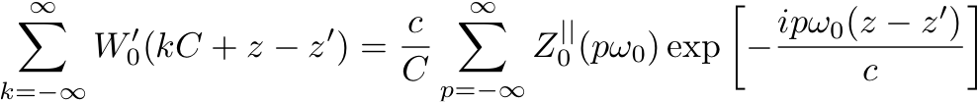

Energy loss of a bunch
From the Eq. on the previous page, we derive a closed expression for the multi-turn energy loss of a bunch (can be also multi bunch, if we can approximate the finite summation on the number of bunches, M, with an infinite summation

Slide 38
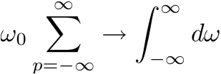
Energy loss of a bunch
Exercises:
  Discuss when the multi-turn formula for the energy loss reduces to that for single pass
  Using the single pass and multi-turn results, discuss the multi-bunch case for different filling patterns of the machine
    M bunches uniformly distributed (PSB, M=h=1 or M=h=2)
    M bunches separated by C/h, with h>>M (long gap) (SPS, M=72, h=4620)
    M bunches separated by C/h with h≈M (short gap) (PS, M=6, h=7)

Slide 39
V_{rf}(z): use of second harmonic
General equations of longitudinal motion for a bunch in a stationary bucket
V_{rf}(z) depends on the specific rf system and can contain several harmonics, determining eventually, together with the wake fields, the shape of the bunch
An important example is when V_{rf}(z) has the contribution of only two harmonics, h₁ and h₂=2h₁. Assuming the lower harmonic as the main harmonic, the second harmonic can lengthen or shorten the bunch (BL or BS mode) according to its relative phase to the first harmonic

Slide 40
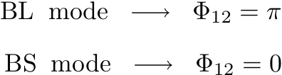
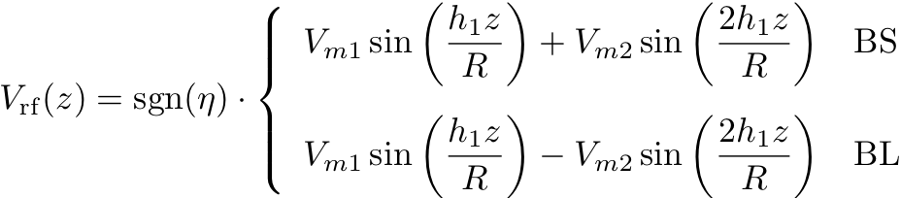

V_{rf}(z): use of second harmonic
In BS mode focusing must be strengthened, so the two harmonics need to be in phase
In BL mode, focusing is weakened and the two harmonics are out of phase
Flattening of the bunch in the center can be optimized by making the slopes of the two forces around the origin equal and opposite in sign (equivalently, requiring first and second derivatives of the force to be 0 in the origin)

Slide 41



Hamiltonian of the system
We write the general Hamiltonian of the system, using a general potential for the rf force, U(z), which can be specified for each case
Examples

Slide 42
Hamiltonian of the system
Examples of U(z) for the case of single harmonic and double harmonic with different voltage ratios (r=0.5 and a case r>0.5)
The case r=0.5 shows perfect flattening, but some times a ratio r>0.5 is used in order to increase the bunching factor further and reduce the effect of transverse space charge.

Slide 43
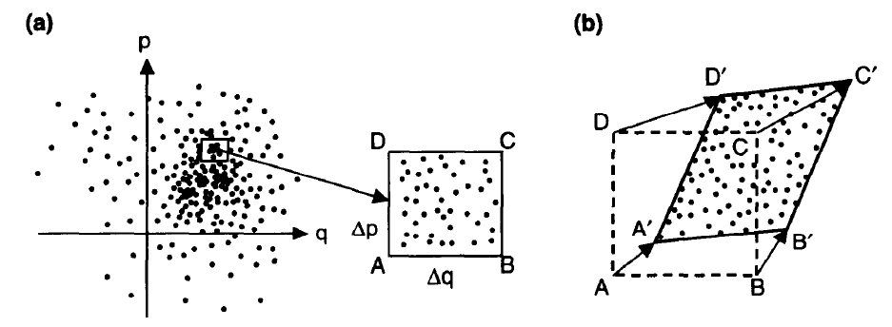
Vlasov equation
Let’s consider a phase space distribution of particles such that
  There are no mechanisms of generation/loss
  Single particles evolve following a Hamiltonian law of motion
This distribution behaves like an uncompressible fluid, i.e. has the property that whatever area occupied by a fraction of the particles is conserved during the evolution (Hamiltonian flow)
This entails that the total time derivative of the distribution is zero

Slide 44
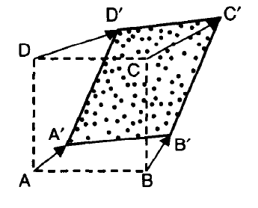

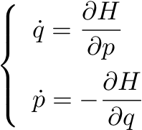
Vlasov equation

Slide 45
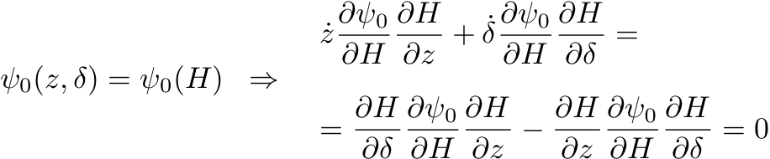
Vlasov equation
The beam (bunch) is described by a distribution function Ψ(z,δ,t), solution of the Vlasov equation
The stationary (equilibrium) solutions Ψ₀(z,δ) can be easily found because they must be functions of the Hamiltonian of the system

Slide 46


Stationary solutions
General solution with wake fields
General solution without wake fields
Distribution has to satisfy the normalization condition

Slide 47



Stationary solutions, matching
(no wake fields)
Let’s use the linearized potential (bunch much shorter than the bucket)
and we choose an exponential solution (double Gaussian)
This corresponds to a simply Gaussian momentum distribution

Slide 48



Stationary solutions, matching
(no wake fields)
And also Gaussian distribution in z
The extensions of line density and momentum distribution, quantified by their rms values, are not independent, but related through the matching condition

Slide 49

Stationary solutions, matching
(no wake fields)
A possible equilibrium solution for the short bunch is therefore
σ_{z} and σ_{δ} must be determined through
  Lepton machine: Gaussian solution matches naturally the problem, because the Gaussian distribution in momentum, as well as its rms value σ_{δ}, are fixed by the equilibrium between radiation damping and quantum excitation. The σ_{z} is then given by the matching condition
  Hadron machine: Gaussian distribution could be incorrect or inaccurate. However, we usually know the longitudinal emittance (conserved through a chain in absence of any, voluntary or not, blow up mechanism) and can therefore determine σ_{z} and σ_{δ} of a Gaussian solution from the emittance (proportional to the product γσ_{z}σ_{δ}) and the matching condition
The matching condition is true only for short bunches, the problem of nonlinear matching will be considered later

Slide 50
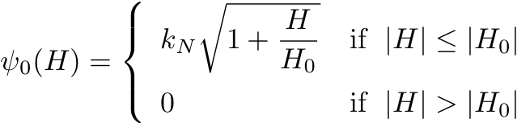
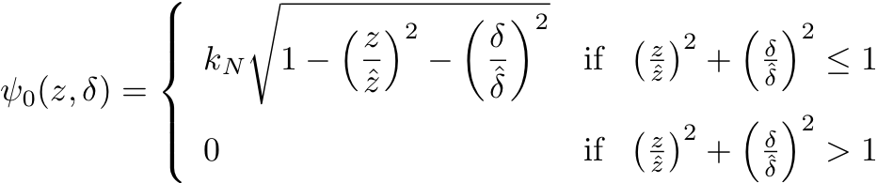

Stationary solutions, matching
(no wake fields)
For hadrons, some times an elliptical distribution in phase space could be preferable, which corresponds to parabolic distributions in z and δ (exercise 1)
Exercise 2: prove that the matching condition is satisfied also for an elliptical distribution

Slide 51


Stationary solutions, nonlinear matching (no wake fields)
When the bunch occupies a vast area in the longitudinal phase space (comparable to the bucket area), matching is more complex
The exponential solution has to be cut at the limits of the stability region in order to give a possible stationary solution of Vlasov equation
The equation of the domain of stability is usually given by the equation H=H_{max}, with H_{max} being the Hamiltonian of the system at the first unstable fixed point(s).
Typically for hadrons, because lepton machines are designed with very large buckets in order to improve the Touschek lifetime of the beam.

Slide 52
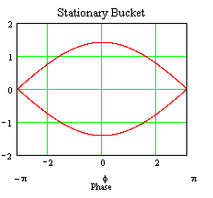



Stationary solutions, nonlinear matching (no wake fields)
Let’s consider for instance the case of a long bunch inside a single harmonic stationary bucket (e.g. the LHC beam at the injection plateau in the SPS )

Slide 53
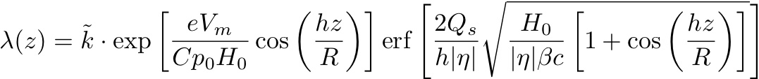


Stationary solutions, nonlinear matching (no wake fields)
If we know the bunch length, we can write the line density in closed form, determine the two constants k and H₀ by using the conditions below and then calculate the only possible rms momentum spread that solves the problem.
If we know the longitudinal emittance as an input, the nonlinear matching requires expressing the momentum distribution, as well, and the problem becomes more involved.

Slide 54
Stationary solutions, nonlinear matching (no wake fields)
In a double harmonic rf system the boundary of the stability is different
  if the ratio between the voltage is below 0.5, the origin of the longitudinal phase space is still a stable point and the effect of the second harmonic is just to flatten the separatrices around it
  If the ration is above 0.5, the origin becomes an unstable fixed point, but the trajectories around it are still limited and the total stable area increases further.
r < 0.5
r > 0.5
δ
δ
P

Slide 55
Stationary solutions, unmatched case (no wake fields)
But what happens when the beam parameters do not fulfill the matching condition (linear or nonlinear)? In other words, what happens if we inject a beam into a machine with length and momentum spread not matched with the waiting bucket?
  No stationary solutions exist, the beam parameters at injection have to be used as initial condition to solve the Vlasov equation in time varying regime
  The problem can also be solved using the envelope equation formalism (see yesterday’s lecture from Elias).
  In the linear case: the beam will start rotating in phase space, at a frequency that is twice the single particle synchrotron tune. This is called a “quadrupole oscillation” and is undamped, i.e. it would in principle last forever.
  In the nonlinear case, the quadrupole oscillation dies out in time at the expense of longitudinal emittance increase (dilution) caused by phase space filamentation. Since particles at large amplitudes rotate at slower frequencies, they will be left behind while the core is executing the oscillation at twice the nominal synchrotron frequency. The beam will decohere and eventually occupy a larger region, matching itself naturally to the bucket. In this case, there exists an asymptotic solution, but again, not a stationary solution.
  Mismatching can be done on purpose, e.g. to have a fast bunch rotation or longitudinal emittance blow-up

Slide 56

Stationary solutions with wake fields
Potential well distortion
We study now the equilibrium bunch distribution in presence of wake fields.
We take the linear approximation for the rf force (quadratic potential)
From the momentum distribution:
Haissinski equation

Slide 57
Stationary solutions with wake fields
Potential well distortion
The Haissinski equation is an implicit integral equation in the unknown λ(z).
  Lepton machines: The momentum spread σ_{δ} is given, and we can use the equation to determine the line density alone, with the coefficient in front solely defined by the normalization condition. Since the solution for the momentum distribution is Gaussian, this type of solution is specially suited for this type of machines.
  Hadron machines: The longitudinal emittance is given. In this case a joint solution (λ(z), σ_{δ}) must be sought such that the resulting pair (σ_{z}, σ_{δ}) satisfies the condition on the longitudinal emittance.
A way of solving Haissinski equation numerically consists in using successive iterations. A first order perturbed λ₁(z) is calculated by plugging the unperturbed Gaussian shape in the RHS of the equation, then λ₂(z) will be calculated by plugging λ₁(z) in the RHS, and so on until the procedure converges.
An analytical treatment of the problem can be made assuming that the wake fields only produce a small deviation from the unperturbed solution
  The bunch shape stays Gaussian
  The center of the bunch moves from z=0 to z=z₀, such that the associated synchronous phase Φ_{s}=(hz₀)/R ensures constant compensation for the energy loss caused by the real part of the impedance
  The bunch length will change, such as to re-match the bunch to the distorted bucket. This adjustment can produce shortening or lengthening with respect to the unperturbed solution, according to whether the impedance produces more or less net focusing.

Slide 58
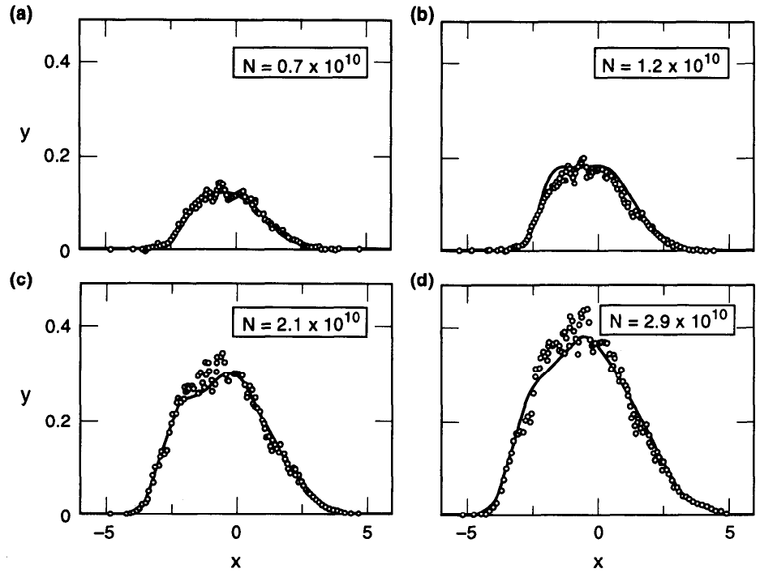
Stationary solutions with wake fields
Potential well distortion
Numerical solution of the Haissinski equation for the electron damping ring for the SLAC linear collider
Bunch shape is Gaussian at low intensity
Distortion occurs as intensity increases. In particular, the distribution tends to lean forward (z>0) in order to compensate with the rf for the parasitic loss due to the impedance

Slide 59
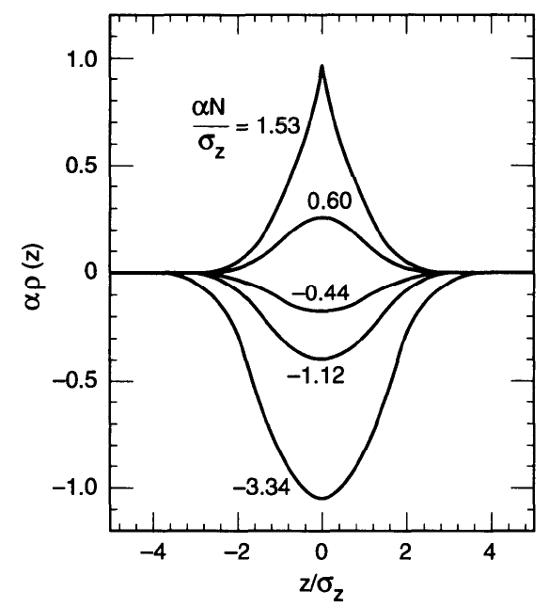
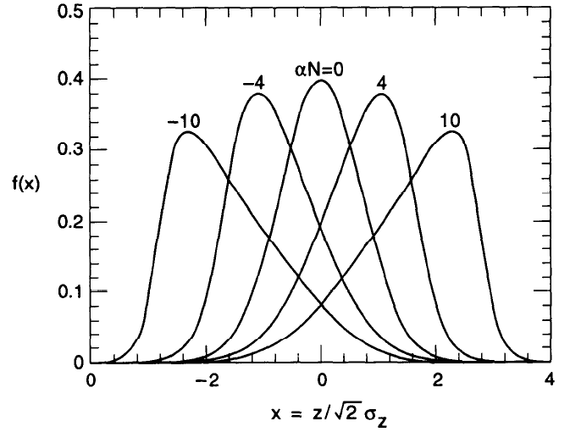
Stationary solutions with wake fields
Potential well distortion
Solution of the Haissinski equation for the two special cases:
  Reactive impedance (left plot), iSZ₀. The parameter α is proportional to S/η, so that α>0 means either above transition+capacitive impedance or below transition+inductive impedance. In both cases the bunch shortens.
  Resistive impedance (right plot), SZ₀. Below transition (α<0) the bunch moves backward, and it moves forward above transition. In both cases the bunch takes power from the rf to compensate for the energy loss.

Slide 60


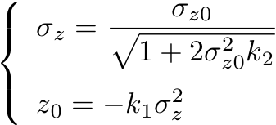
Stationary solutions with wake fields
Potential well distortion
For small deviation, we assume then that the bunch distribution stays Gaussian (ansatz)
We can also expand in Taylor series around z=0 the wake field contribution to the Hamiltonian as it appears in the Haissinski equation.
N.B. Rigorously speaking, these are still implicit equations, because k₁=k₁(σ_{z}) and k₂=k₂(σ_{z}), but they are not functions of z₀ because the wake moves with the bunch

Slide 61


Stationary solutions with wake fields
Potential well distortion
Calculation of k₂ first
This is the second order term in the Taylor expansion of the wake field contribution to the Hamiltonian

Slide 62
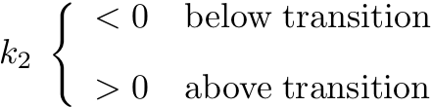
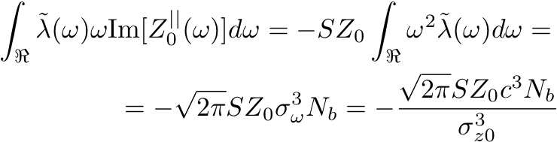
Stationary solutions with wake fields
Potential well distortion
The sign of k₂ determines whether there is bunch lengthening or bunch shortening (K₂<0 => σ_{z}>σ_{z0} and vice versa).
From the expression on the previous page, the sign of k₂ is jointly determined by the sign of η and that of the integral, which in turn depends on the overlap between the impedance and the bunch spectrum.
For Gaussian bunch and space charge-type impedance –iSZ₀ω:

Slide 63


Stationary solutions with wake fields
Potential well distortion
Calculation of k₁
This is the first order term in the Taylor expansion of the wake field contribution to the Hamiltonian
-
-
The bunch will move to the left (z₀<0) below transition and to the right (z₀>0) above transition

Slide 64


Stationary solutions with wake fields
Synchrotron tune shift
  We still rely on the second order term in z in the Taylor expansion of the wake field contribution to the Hamiltonian
Exercise: how should the synchrotron tune move due to space charge ? Verify that with the above formula it goes in the right direction and the formula on slide 22 is recovered

Slide 65
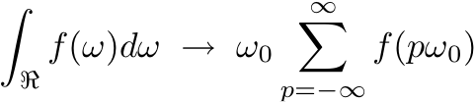
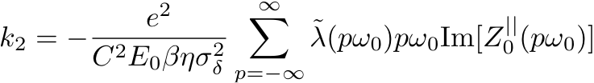


Stationary solutions with wake fields
Generalization to multi-pass
  All the formulae obtained so far to describe the potential well distortion can be generalized in the multi-turn regime in a similar fashion as was done for the energy loss!
Rule:

Slide 66



Stationary solutions with wake fields
Potential well distortion
Exercise: calculate center shift and bunch length of a bunch under the action of:
A purely resistive impedance
A purely reactive impedance
Another possibility to calculate the center shift from the Haissinski equation imposing the condition:

Slide 67


Linearization of Vlasov equation
First, we need to change the system of coordinates
We define polar coordinates (r, Φ), such that the unperturbed Hamiltonian can be written as a function of r alone, which translates into unperturbed solutions of Vlasov equation of the type Ψ₀(r).
We will search for wave-like solutions of the Vlasov equation in the form below
Since Ψ₀(r) is the solution of the unperturbed Vlasov equation, the potential well distortion will be also included in the wave term (Ω=0)

Slide 68

Linearization of Vlasov equation
We also write the wake field term in the momentum equation directly in a form that includes the multi-turn contribution to the force

Slide 69


Linearization of Vlasov equation
We recast the wake field term in the momentum equation in a form that contains an explicit dependence on the longitudinal impedance

Slide 70




Linearization of Vlasov equation
Next step, we need to recast the Vlasov equation in the polar coordinates previously defined in order to simplify its structure

Slide 71




Linearization of Vlasov equation
We first substitute the ansatz on the previous slides for Ψ(r,Φ,t), and then we use the periodicity in the Φ coordinate to expand both sides of the equation in Fourier series
Next, we specify to the case of Ψ₀(r) being of water-bag type

Slide 72

Linearization of Vlasov equation
Now we are ready to equal the Fourier coefficients (index l) individually from both sides. This yields, in the limit of weak intensity beam, an equation for the (complex) frequency shifts associated to each mode.
When an observer (impedance) sees the component λ₁^{(l)}(z), the beam is executing the l-th mode of oscillation
The imaginary part of the frequency shift gives the growth (or damping) rate of the mode. It only depends on the real part of the impedance
For a broad band impedance the summation tends to an integral. Since the real part of the impedance is an even function of the frequency, as well as J_{l}², in this case the growth rate of all modes tends to zero because the function under summation (integral) is an odd function of frequency.
Short-lived wake fields (broad-band impedances) do not make beams longitudinally unstable

Slide 73


Linearization of Vlasov equation
The modes given by the index l oscillate at frequencies close to lω_{s}.
Since they have been introduced in relation with the azimuthal structure of the longitudinal phase space, they are referred to as longitudinal azimuthal modes
From their definition and their oscillation frequencies, they can easily be associated to well distortion (l=0), dipole oscillation (l=1), quadrupole oscillation (l=2), etc.

Slide 74


Linearization of Vlasov equation
1. (m=0 and l=1)
2. (m=0 and l=2)
Seen at a wide band pick up that can resolve the bunch (e.g. a wall current monitor)
These are mountain range plots showing the evolution in time of the bunch shape
The bunch is executing a rigid dipole oscillation in the longitudinal phase space at the synchrotron frequency
The bunch is mismatched in the bucket and it executes a quadrupole oscillation in the longitudinal phase space at twice the synchrotron frequency

Slide 75

The Robinson instability
An interesting (and usual) case is when the impedance is peaked around a value hω₀ (impedance of the main rf cavity), because only the two terms p=±h in the summation will contribute to the growth rate
We also take the short bunch approximation (anyway the wake field lasts much longer than the bunch, being the impedance narrow-band)
Instability or not, depends on the sign of this part…. Reminds: dRe(Z)/dω(hω₀)

Slide 76



The Robinson instability
The unstable modes that can be triggered by the rf cavities are called Robinson modes
The most unstable one is the fundamental mode l=1, which is found also with a simple one particle approach.

Slide 77
The Robinson instability
Physically, the fundamental Robinson instability comes from the fact that the revolution frequency of an off-momentum beam is actually ω₀(1-ηδ). If the beam has an energy error, it will start a dipole oscillation and circulate at a frequency slightly higher than nominal when ηδ<0, or slightly lower when ηδ>0. Only if the beam samples the resistive part of the impedance such that it loses more energy when δ>0 than when δ<0, the motion will be damped.
Although the Robinson instability was originally considered for the fundamental mode of the rf cavities, obviously the same analysis equally applies to all higher order rf modes
  Attention must be paid that none of the pω₀ lands accidentally on the wrong side of some higher order impedance peak
  Since there are typically several higher order modes in a cavity, and their tuning could be difficult to control, it is sometimes better to rely on a design of the cavity that damps these modes.
The relative tuning of cavities with respect to the beam nominal revolution frequency is therefore yet one more thing that needs to be carefully controlled upon crossing transition in an accelerator…. (beside the rf phase and the sign of chromaticity)

Slide 78


The Robinson instability
HOMs in cavities
To avoid getting into troubles with High Order Modes (HOMs) due to Robinson instabilities (or other types, too), usually cavities are equipped with HOM absorbers, purposely designed to absorb and suppress all the HOMs in the cavities
Special purpose cavities, like crab cavities for example, which are not required to operate routinely on their fundamental mode, may need also LOM and SOM absorbers.
Recently, the so called “photonic band” cavities are under investigation: through a special transverse arrangement (array-like structure), they have a very peaked resonance on the fundamental mode and naturally have all the HOMs flow away.

Slide 79
Radial modes
Having assumed a water bag model for the unperturbed distribution, it turned out that one index alone would be sufficient to describe the collective motion, which we called l and was introduced in relation with the azimuthal structure in the longitudinal phase space
This was an extremely simplified situation. For a general distribution, two longitudinal indices are needed. We call them l and n, where n is newly introduced to describe also the radial structure in the longitudinal phase space.
Even with a distribution that highlights the radial structure of the longitudinal phase space, in the limit of zero beam intensity, all radial modes having the same azimuthal index l are degenerate and correspond to the same mode frequency Ω=lω_{s}. As the beam intensity is increased slightly, their frequencies shift away from this unperturbed value and modes with different n’s will move differently, breaking the previous degeneracy.

Slide 80




Radial modes
Oscillation frequencies of the radial modes for different azimuthal families can be calculated for parabolic and Gaussian beams, for example
Although not rigorous, the formulae here below are used in practice to establish synchrotron tune shifts and growth rates of the most prominent radial modes for each azimuthal mode
Effective impedance

Slide 81


Radial modes
For each mode, real and imaginary part of the coherent frequency shifts depend on the effective impedance associated to the mode
For a broad-band resonator, the effective impedance is purely imaginary because the real part of the impedance is an even function. Again, we find the result that a broad-band impedance cannot make a weak beam unstable, not even when we consider radial modes in the analysis

Slide 82
Mode coupling
All the previous analyses have been made for low intensity beams, and we always found that instability can only occur when the impedance consists of sharp peaks, or equivalently, when the wake fields last longer than the revolution period (Robinson type)
The previous statement still holds even when radial modes are included in the analysis
The reason is that, when the considered beam intensity is weak, the mode frequency shifts are small compared with the ω_{s} and hence, coupling between modes belonging to different azimuthal families could be excluded.
When the beam intensity is increased and the frequency shifts become comparable to ω_{s}, possible coupling among modes must be taken into account, which can give rise to a different type of instability than the Robinson one.
These instabilities are referred to as “microwave”, “mode coupling”, “mode mixing”, “turbulence” -type

Slide 83
Mode coupling
Mode coupling is first investigated with an unperturbed water bag distribution and a broad-band impedance.
As we know, for each azimuthal family, all radial modes converge together due to the radial degeneracy of the water bag distribution.
For each azimuthal index l, the mode shift can be expressed as a function of a parameter ϒ, proportional to the bunch intensity
For a broad-band impedance model (shunt impedance R_{s}), it is found that there exists a threshold value ϒ_{thr} above which two adjacent modes merge into one, meaning that two previously real solutions become a pair of complex conjugates, one damped and the other unstable
Therefore, ϒ_{thr} determines the bunch intensity above which an instability sets in. This instability is clearly a high intensity effect and is of a different nature than the one developed at lower beam intensities for sharply peaked impedances.

Slide 84


Mode coupling
Mode 0 does not shift, because it corresponds to the potential well distortion. Mode 1 should not shift either, because it is related to rigid dipole motion and the wake field moves with the beam
The reason why a shift appears in the plot on the right is that the term that would cancel it, i.e. a potential well distortion term, is neglected in the mathematical treatment. The physical behavior of mode 1 is shown
Unlike in the transverse plane, since modes 0 and 1 do not move, mode coupling instability in the longitudinal plane always involves modes with l≥2

Slide 85


Turbulent bunch lengthening
The mode coupling instability is usually a non-destructive instability.
In fact, as the intensity threshold for this instability is crossed, the beam becomes unstable and lengthens, causing the parameter ϒ (inversely proportional to the 3/2 power of the bunch length) to fall back below the threshold value.
Potential well distortion below mode coupling threshold: example for an electron machine, with bunch shortening and constant momentum spread

Slide 86

Stability of bunches in realistic rf systems
Until now, we made an assumption on the Hamiltonian of the system, which limits the applicability of all results to the case of linear restoring force.
The case of the stability of bunches in realistic rf systems (nonlinear) has been also studied in detail –at least for single and double sinusoidal voltage in the accelerating and stationary cases.
The main general result of this study is that the nonlinearity of the force causes a spread in the synchrotron tune distribution, which helps stabilize the beam through Landau damping. The instability rates predicted by the case with linearized terms are therefore the “worst-case” ones.
Calculated and measured synchrotron tunes for particles having different synchrotron amplitudes (case of single harmonic cavity)

Slide 87

Stability of bunches in double harmonic rf systems
The stability of bunches in a double harmonic rf system (accelerating and stationary bucket) has been studied.
The main result is that the stability is found to depend on the derivative of the distribution of synchrotron tunes for particles at different amplitudes in the bucket:
  Landau damping is lost in regions in which the derivative of the distribution of Q_{s} goes to zero. Beam current perturbations are enhanced and a microwave-type instability sets in.
  Therefore, the single harmonic bucket is intrinsically stable, but when higher harmonic cavities are included, sensitive regions of the bunch are created (in fact we fall locally in the “worst case” mentioned on the previous slide).
Calculated and measured synchrotron tunes for particles having different synchrotron amplitudes (case of double harmonic cavity)

Slide 88




Coasting (unbunched) beams
For an unbunched beam, the previously used equations of longitudinal motion still hold, assuming that V_{rf}(z)=0 and the only driving term in the momentum equation comes from space charge and wake fields
Given the unbunched and periodic nature of the solution, the unperturbed distribution will be only function of δ and we express the z-dependence of the perturbation through an angle variable

Slide 89

Coasting (unbunched) beams
We change perspective: a charge located in z at time t feels the effect of the z’ slice through the wake generated in z by the line density at a time Δt=(z’-z)/c earlier
The constant part λ₀ (not a function of z) only contributes with a constant term, which is a net energy loss if ∫W‘₀(z)dz>0, or equivalently Re[Z₀||(ω=0)]>0, (i.e. the beam produces dc losses)
The time varying part of λ(z,t) generates a retarding field potentially responsible for instabilities
W‘₀
∫W‘₀(z-z‘)λ(z,t-(z‘-z)/c)dz‘
λ(z,t-(z‘-z)/c)
z-z‘<0
z‘
z
z

Slide 90

Coasting (unbunched) beams
We easily recast the wake field driving term in terms of impedance (by simply using the definition of impedance), and then substitute it in the Vlasov equation

Slide 91




Coasting (unbunched) beams
We now change from the variable δ to the variable ω₀, and we prefer to have a distribution function normalized to unity

Slide 92

Coasting (unbunched) beams
Dispersion relation
If we specify the momentum (or equivalently, revolution frequency) distribution, the previous dispersion relation can be used to find the solutions Ω, expressing the frequency shift
Complex solutions with positive imaginary part indicate instability
The use of the dispersion relation is often to consider Z₀||(Ω) as a free complex number and then draw in the complex (impedance) plane the curve Im[Ω]=0, which is the stability boundary separating the stable region (Im[Ω]<0) from the unstable region (Im[Ω]>0)
Then care must be taken that the impedance of the machine falls within the stability region
This approach is usually considered valid both for coasting beams and for long bunched beams with slow synchrotron motion (Boussard criterion)

Slide 93

Coasting (unbunched) beams
Exercise: Show that, if the beam is monochromatic (i.e., all particles circulate with the same revolution frequency ω₀), it is always unstable above transition with a capacitive impedance (e.g. space charge) and below transition with an inductive impedance. The instability with space charge above transition is simply a negative mass instability
Different distributions have different stability regions, whose extension depends on the thickness of the tails of the distribution (see above). The mechanism behind the existence of a stability region is Landau damping (stabilization through spread of the frequencies), hence it is wider for larger spreads.

Slide 94

Coasting (unbunched) beams
It can be shown that, for a given impedance, the dispersion relation always has two solutions, with opposite signs of Re[Ω-nω₀], corresponding to a fast wave and a slow wave. Both are stable inside the stability region, whereas the slow wave is unstable outside of it (the fast wave is always stable)
Fast and slow wave can be clearly seen in the Schottky spectrum of the beam, i.e. the Fourier transform of a wide-band pick up installed in a ring. When no significant coherent motion is present (i.e. for weak space charge and low impedance), the Schottky spectrum simply shows lines centered at multiples of ω₀ whose width can be related to the momentum spread of the beam.

Slide 95


Coasting (unbunched) beams
A dip in the momentum distribution function strongly reduces the stability region. However, the instability only serves the purpose to fill the dip and create a stable distribution
Beside the stability boundary, it is also useful to draw all curves Im[Ω]=k in the impedance plane, so that the growth time of an instability for a given impedance working point can be deduced from the instability chart.

Slide 96


Coasting (unbunched) beams
If the detailed spectral information is not available and the dispersion relation cannot be solved in detail to determine a stability region, the simplified so called ‘Keil-Schnell’ criterion for stability can be used
It is a handy formula and gives a rough estimate whether the beam is stable or not against microwave instability. F is a form factor always close to 1.
It can be applied to bunched beams, as well, provided that the growth rate of the instability is much larger than the synchrotron frequency and the wavelength of the perturbation (~R/n) is much smaller than bunch length (~4σ_{z})
Keil-Schnell criterion

Slide 97


Coasting (unbunched) beams
The perturbative Vlasov approach is good to estimate stability regions and instability rise time, when the beam is expected to become unstable
However, the longitudinal instability of coasting beams can be also solved numerically by using
  Macroparticle simulations
  Poisson-Vlasov solvers

Slide 98

Coasting (unbunched) beams
The two main features that emerge from the nonlinear evolution are:
  Nonlinear wave steepening leading to saturation and decay (formation of holes in phase space)
  Momentum overshoot: when the beam reaches another steady state, the momentum spread is typically higher than the one required to stabilize the initial beam
The longitudinal instability measured at the GSI-ESR shows an impressive resemblance to the evolution predicted with a Vlasov model

