Slide 1


General introduction to multi-particle effects
G. Rumolo and E. Métral
USPAS Course on collective effects
Monday, 22.06.2009

Slide 2
Program of the week
This introduction aims at giving a general intuitive approach to the multi-particle effects, trying to explain glossary and classification.
All the subjects treated during this lecture will be explained in detail later on during the week

Slide 3
General definition of multi-particle processes in an accelerator or storage ring
Class of phenomena in which the evolution of the particle beam cannot be studied as if the beam was a single particle (as is done in beam optics), but depends on the combination of external fields and interaction between particles. Particles can interact between them through
  Self generated fields:
    Direct space charge fields
    Electromagnetic interaction of the beam with the surrounding environment through the beam‘s own images and the wake fields (impedances)
    Interaction with the beam‘s own synchrotron radiation
  Long- and short-range Coulomb collisions, associated to intra-beam scattering and Touschek effect, respectively
  Interaction of electron beams with trapped ions, proton/positron/ion beams with electron clouds, beam-beam in a collider ring, electron cooling for ions
Multi-particle processes are detrimental for the beam (degradation and loss, see next slides)

Slide 4
Direct space charge forces
Longitudinal space charge
Force decays like 1/γ²
it can be attractive above transition
δp/p₀
z
x
Transverse space charge
Force decays like 1/γ²β
It is always repulsive
y

Slide 5
Wake fields (impedances)
2b
When the beam goes through a discontinuity, it induces an e-m field which keeps ringing after the beam has passed:
→ Energy loss
→ Effect intra-bunch and on following bunches

Slide 6



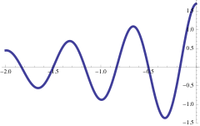
Wake fields (impedances)
z
W₀(z)
L
e
q
s
Model:
A particle q going through a device of length L, s (0,L), leaves behind an oscillating field and a probe charge e at distance z feels a force as a result. The integral of this force over the device defines the wake field and its Fourier transform is called the impedance of the device of length L.

Slide 7
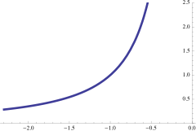
Wake fields (impedances)
z
L
W₀(z)
e
q
s
Model (cont‘s):
The device of length L can also be a segment of accelerator (defined by the simple beam pipe) and the wake is generated by the finite conductivity of the pipe material. In this case the wake field and the impedance are said to be of resistive wall type and the integration can be done over L=2π R

Slide 8
Wake fields (impedances)
The full ring is usually modeled with a so called total impedance made of three main components:
Resistive wall impedance
Several narrow-band resonators at lower frequencies than the pipe cutoff frequency c/b (b beam pipe radius)
One broad band resonator at ω_{r}~c/b modeling the rest of the ring (pipe discontinuities, tapers, other non-resonant structures like pick-ups, kickers bellows, etc.)
The total impedance is allocated to the single ring elements by means of off-line calculation prior to construction/installation
Total impedance designed such that the nominal intensity is stable

Slide 9
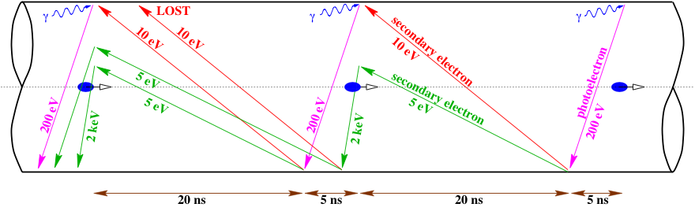
Electron cloud
Principle of electron multipacting:
Example of LHC
Electron multiplication is made possible by:
  Electron generation due to photoemission, but also residual gas ionization
  Electron acceleration in the field of the passing bunches
  Secondary emission with efficiency larger than one, when the electrons hit the inner pipe walls with high enough energy

Slide 10
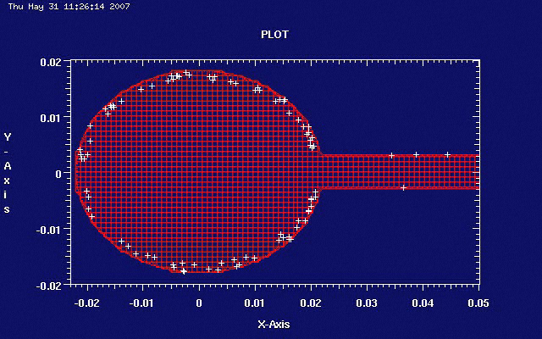
Electron cloud
Photoelectrons produced by the synchrotron radiation are accelerated by the bunches and quickly accumulate in the vacuum chamber (example, wiggler of a CLIC damping ring)

Slide 11
Several names to describe these effects...
‚Multi-particle‘ is the most generic attribute. ‚High-current‘, ‚high-intensity‘, ‚high brightness‘ are also used because these effects are important when the beam has a high density in phase space (many particles in little volume)
Other labels are also used to refer to different subclasses
  Collective effects (coherent):
    The beam resonantly responds to a self-induced electromagnetic excitation
    Are fast and visible in the beam centroid motion (tune shift, instability)
  Collective effects (incoherent):
    Excitation moves with the beam, spreads the frequencies of particle motion.
    Lead to particle diffusion in phase space and slow emittance growth
  Collisional effects (incoherent):
    Isolated two-particle encounters have a global effect on the beam dynamics (diffusion and emittance growth, lifetime)
  Two-stream phenomena (coherent or incoherent):
    Two component plasmas needed (beam-beam, pbeam-ecloud, ebeam-ions) and the beam reacts to an excitation caused by another „beam“

Slide 12
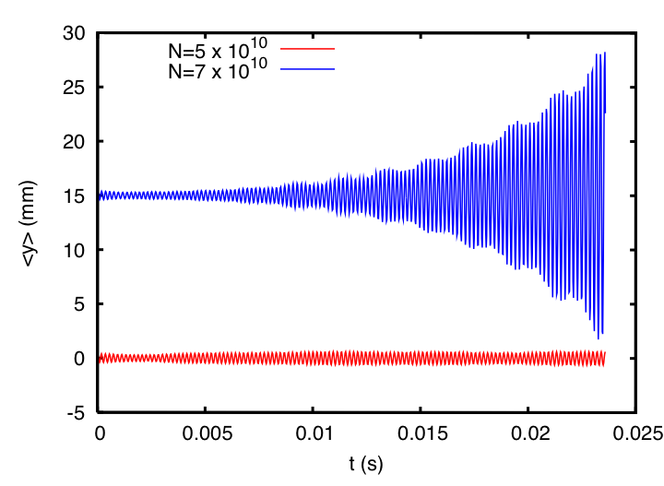
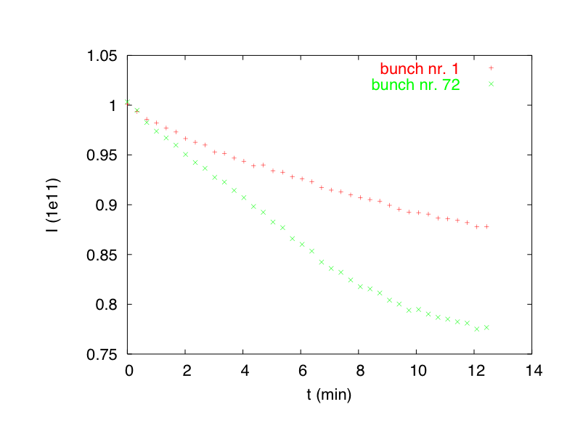
Some examples….
Coherent effect:
When the bunch current exceeds a certain limit (current threshold), the centroid of the beam, e.g. as seen by a BPM, exhibits an exponential growth and the beam is lost within few milliseconds (simulation of an SPS bunch)
Incoherent effect:
Slow beam loss. First and last bunch of an SPS train of 72 bunches gradually lose their particles (10% and 25%, respectively) over several minutes (data from SPS, 2004)

Slide 13
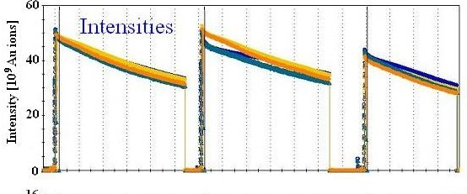
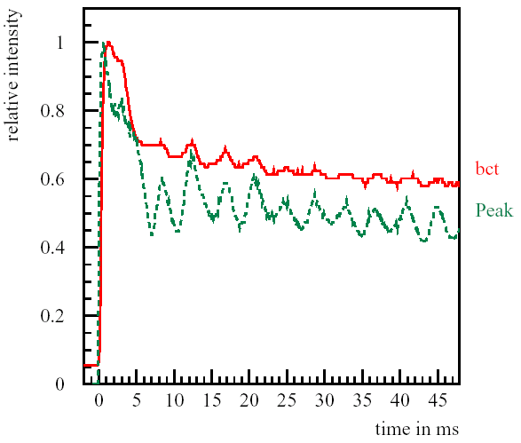
More examples… (plots show measured beam intensity vs time)
BNL-RHIC, Au-Au operation, Run-4 (2004)
CERN-SPS (II) TMC Instability (2003)
16h
Note the different time scale on these plots!

Slide 14
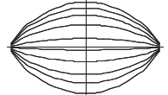
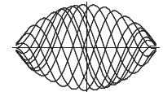
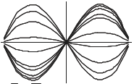
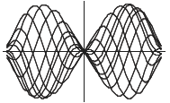
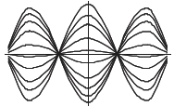
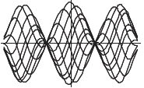
Examples of coherent modes seen at a wide-band pick-up (BPM)
h
  The patterns of the head-tail modes depend on chromaticity
Q’=0
Q’≠0
⬅ m=1 and l=0 ➔
⬅ m=1 and l=1 ➔
⬅ m=1 and l=2 ➔

Slide 15
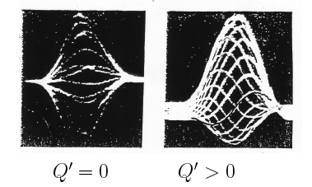
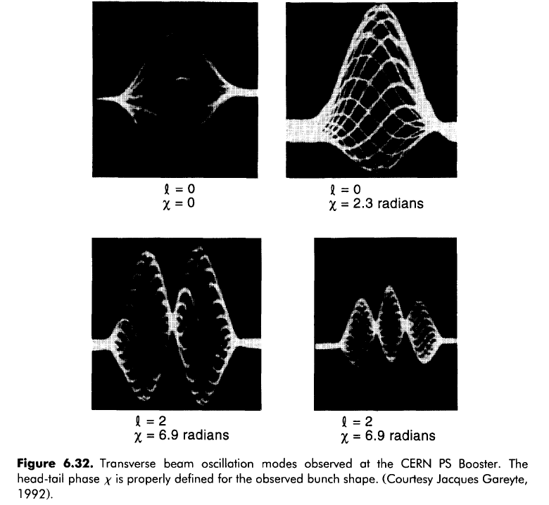
Coherent modes measured at a wide-band pick-up (BPM)
m=1 and l=0
1

Slide 16
Why are multi-particle effects important ?
The performance of an accelerator is usually limited by a multi-particle effect!!
When the beam current in a machine is pushed above a certain limit (intensity threshold), intolerable losses or beam quality degradation appear due to these phenomena
How these effects can affect the beam:
  Coherent effects can be:
    Transverse
      coherent tune shift
      fast beam loss due to instability
    Longitudinal (energy loss, bunch lengthening, synchrotron tune shift)
  Incoherent effects can be:
    Longitudinal or transverse
      emittance growth, incoherent tune shift, tune spread, bad lifetime
  Two-stream phenomena are:
    result into coherent or incoherent effects

Slide 17
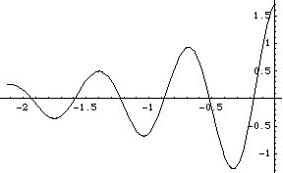
Types of collective effects (I)
  Single or multi-bunch behavior depends on the range of action of the wake fields
    Single bunch effects are usually caused by short range wake fields (broad-band impedances)
    Multi bunch or multi-turn effects are usually associated to long range wake fields (narrow-band impedances)
Wake decays over a bunch length ➔ Single bunch collective interaction
W
Wake decays over many bunches ➔ Coupled bunch collective interaction
W
∫W(z-z‘)λ(z‘)dz‘
z
∑W(kd)Ν(kd)
s
d
s

Slide 18
Types of collective effects (II)
  Transverse:
    Single bunch
      Rigid bunch instability, head-tail instability
      Transverse Mode Coupling Instability (TMCI), also referred to as beam break-up or strong (fast) head-tail instability
      Electron Cloud Instability (ECI)
    Coupled bunch instability
      Coupling between subsequent bunches through long range wake fields or electron cloud, Ion Instability, Fast-Ion Instability
  Longitudinal:
    Single bunch
      Potential well distortion, energy loss
      Microwave instability, turbulent bunch lengthening
    Coupled bunch instability

Slide 19
Space charge
Multi-particle effects
images
direct
Collective
Two-stream
Incoherent/collisional
Transverse
Longitudinal
Beam/beam
E-cloud/trapped ions
Multi- bunch
IBS/Touschek
Microwave/turbulent
Potential well distortion
Head-tail
TMCI
Incoherent tune spread
Instability/beam loss
Coherent tune shift
Beam quality degradation/ emittance growth

