Slide 1
Numerical modeling and measurement techniques
G. Rumolo and E. Métral
USPAS Course on collective effects
Thursday, 25.06.2009

Slide 2
One summary remark:
Cures for coherent effects
Impedance reduction (i.e. control and budget specification in the design phase, or identify and remove sources for running machines)
Since these effects are consequence of a resonant response to excitations on the beam natural frequencies, a spread in these frequencies in general helps
use nonlinearities (e.g. sextupoles and octupoles) to increase the transverse detuning with amplitude against transverse instabilities
use higher harmonic number rf-systems to enhance the spread in the synchrotron frequencies against longitudinal instabilities
Increase the longitudinal emittance (if possible), because the high density (in phase space) beams are more unstable
this helps against both longitudinal and transverse instabilities
Use active feedback (also called damper)
system of pick-up + kicker that detects coherent motion and suppresses it
depending on the type of instability, it may be too demanding in terms of power or band-width. Easier against slow, low-frequency instabilities
Two-stream phenomena are generally avoided by fighting the prime cause
e.g., improve vacuum, use coated beam pipes with low secondary emission

Slide 3
Contents of this lecture:
Numerical simulations for modeling of multi-particle effects
the electromagnetic problem
definition or calculation of the driving terms (field or particle distributions)
the beam dynamics problem
put the driving terms previously calculated into the tracking of the beam particles and study the effects
the simulation technique
some examples of simulations of single-bunch effects
head-tail instabilities
TMCI
longitudinal effects (use of the 2nd harmonic, potential well distortion, microwave instability)
Examples of observations of coherent effects in existing accelerators and comparisons with simulations
tune shift measurements
instabilities

Slide 4
How do we simulate numerically a multi-particle effect on a particle beam ? (1st step –the electromagnetic problem)
Space charge:
relies on analytical formulae for ellipsoidal/Gaussian bunches
uses a Poisson solver to get the beam field
Impedance. A reliable model for the ring impedance is needed
One part is the resistive wall component from the beam pipe (analytical)
The other part:
It can be given as the sum of the individual contributions given by each accelerator component. These contributions, stored in databases, are previously calculated by means of
electromagnetic codes for complex geometries, which can output the field maps of the given device when excited with a pulse
analytical formulae for simple geometries (e.g. tapers, steps)
bench measurements
It is the broad–band approximation of the accelerator
Two stream:
relies on a numerical model of electron cloud formation/ion accumulation

Slide 5
How do we simulate numerically a multi-particle effect on a particle beam ? (2nd step –the beam dynamics problem)
Space charge:
the additional space charge force is included in the single particle tracking by localizing it in some selected kick points along the lattice
Impedance. Once the response of the ring to a pulse excitation is known, it can be used for calculating the corresponding kick on each particle of a bunch
single bunch effects have to be studied with full 6D bunches subdivided into longitudinal slices and calculating on each particle the effect of the kicks from the wakes of all preceding slices
multi bunch effects can be usually modeled with 4D bunches (x-y), which feel the effect of the wakes of all the preceding bunches
Two stream:
electron cloud: beam particles are tracked through the accelerator and interact electromagnetically with an electron cloud lumped at some selected locations (single bunch)
ions: usually the ions are generated and tracked together with the beam particles (multi bunch)

Slide 6
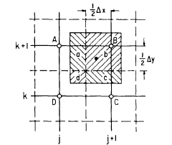
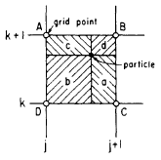
The electromagnetic problem: space charge
The problem of the electromagnetic fields of some standard beam distributions in open space has been solved analytically for some cases. For example:
Ellipsoidal: R.W. Garnett and T.P. Wangler, 1981
Gaussian: M. Bassetti and G.A. Erskine. Closed expression for the electrical field of a two-dimensional Gaussian charge. CERN-ISRTH/80-06, 1980.
Formulae including the beam images for some standard chamber shapes, e.g. rectangular, also exist (see previous lecture)
Poisson solvers for the general case
their input of the charge density is given by distributing the particles on a grid (usually with the Particle-In-Cell method)
their solution includes the contribution of
the images through the use of the appropriate
boundary conditions
they can be based on solutions with the finite differences or FFT methods
they can have an adaptive grid and are usually very fast

Slide 7
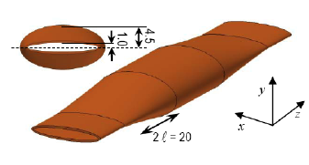
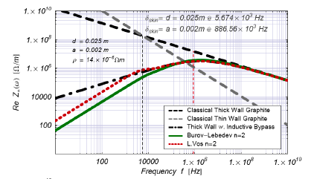
The electromagnetic problem: impedance (analytical)
Wake fields in relatively simple structures may be quite accurately obtained via analytical treatment leading to closed mathematical expressions.
Geometric effects (induced by changes of cross-section, irises, cavities, etc., usually purely inductive impedances)
Tapers in the inductive and diffractive regime, recently improved model w. r. t. the previous model by Yokoya and Stupakov
higher order terms included
elliptical cross-section
Surface roughness
correlated and uncorrelated bumps
periodically corrugated structures
Resistive wall effects (several regimes beyond the classical):
long-range (low frequency, inductive by-pass)
short-range (high frequency, ac conductivity)
multi-layer boundary

Slide 8
The electromagnetic problem: impedance (numerical -1)
Wake fields in a general structure may be most accurately obtained via numerical solution of Maxwell’s equations.
in the ’80s the first 2D and 3D codes were developed to solve numerically the Maxwell equations in given geometries (time or frequency domain)
TBCI, MAFIA, ABCI, NOVO, XWAKE, ….
More recently: GdfidL, HFSS, Microwave Studio, Particle Studio
While newer rings built in the ’90s tended to be based on a smooth design of the vacuum chamber such as to minimize geometric wakes from steps and abrupt transitions, they were made with flat/asymmetric chambers and shorter bunches (e.g. Linac based FELs):
demand more powerful computation
smaller mesh (often over a larger volume) & longer integration time
larger memory and cpu time
Many of these codes have been parallelized and can run on a cluster of cpu’s
GdfidL divides the integration space in sub-volumes, to be distributed over different nodes
PBCI decomposes the computational volume with a load balancing scheme

Slide 9
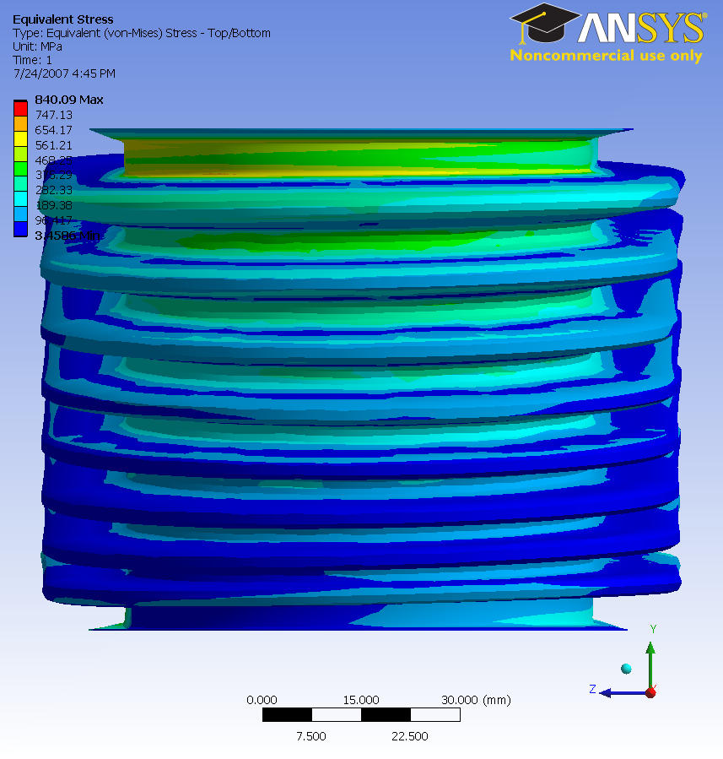
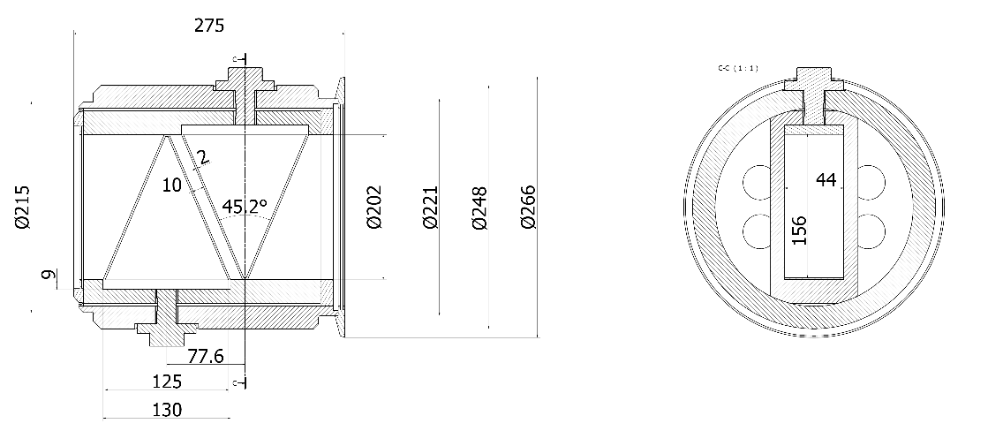
The electromagnetic problem: impedance (numerical -2)
Examples:
Diagnostics equipments. For instance:
Wire scanners
Beam Position Monitors
Kickers (injection, extraction, Q-measurement, dump)
Collimators (betatron, energy), spoilers, scrapers
Interconnectors, bellows
SPS BPMs
PS bellow

Slide 10
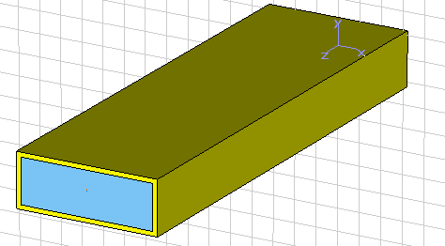
The electromagnetic problem: impedance (numerical -3)
Example of use of Particle Studio:
gives directly the wake field using a Gaussian bunch as source
can be used for a simple structure for benchmark with theory
Geometric parameters
Thickness Copper = 0.2cm 1cm
Length = 1m 0.2m
Vacuum Chamber:
Rectangular shape : height=2cm; width= 6cm
Particle Beam Parameters
σbunch = 1cm, 0.8cm, 0.5cm
Charge = 1e-9
β=1

Slide 11
The electromagnetic problem: impedance (numerical -4)
Example of use of Particle Studio:
with the previous structure we expect to see the resistive wall wake field
since it is rectangular we could also disentangle dipolar and quadrupolar wakes
as expected from the chosen aspect ratio, the Yokoya coefficients are recovered

Slide 12
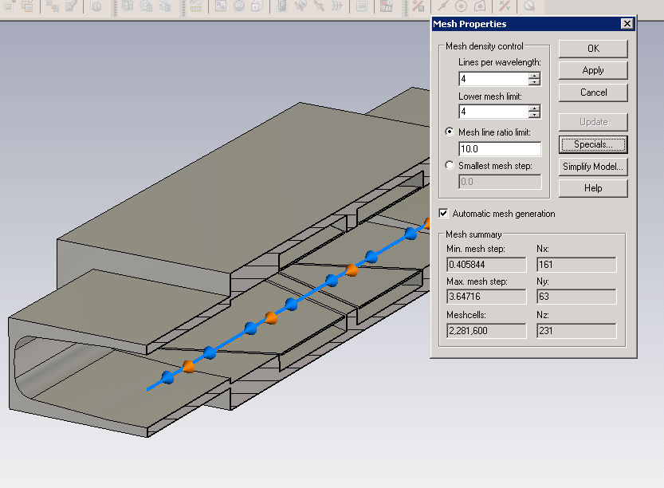
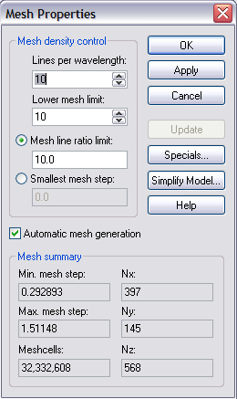
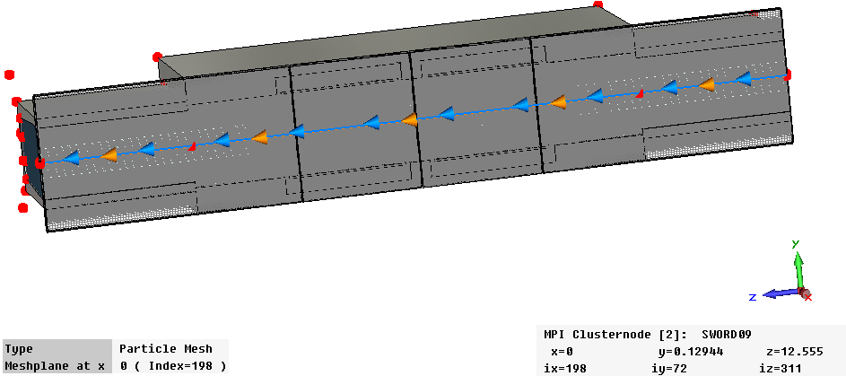
The electromagnetic problem: impedance (numerical -5)
Example of use of Particle Studio:
More complicated structures can be simulated, e.g. the SPS-BPMs

Slide 13
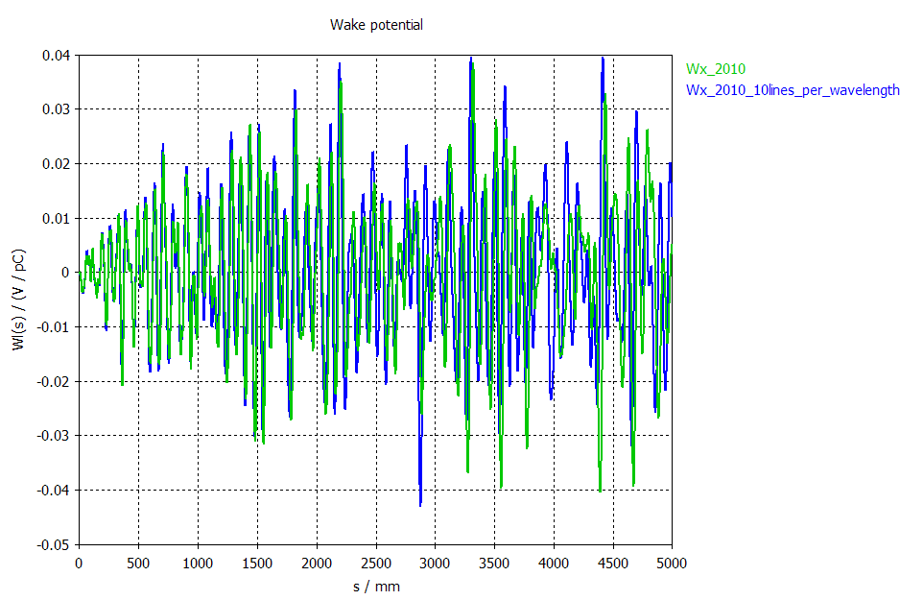
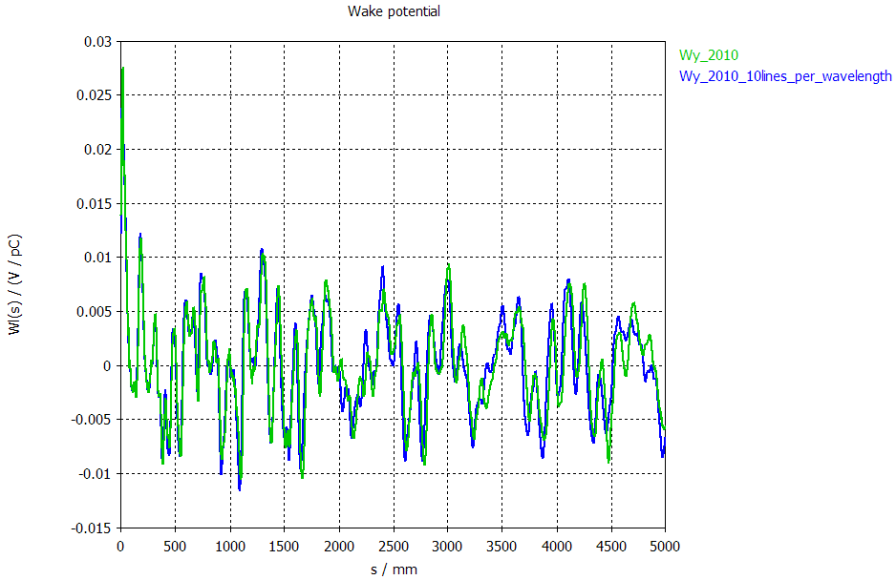
The electromagnetic problem: impedance (numerical -6)
Example of use of Particle Studio:
More complicated structures can be simulated, e.g. the SPS-BPMs
W_{x}
W_{y}
MovieEx, MovieEy, MovieEz, MovieEz2

Slide 14
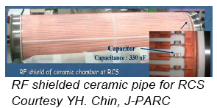
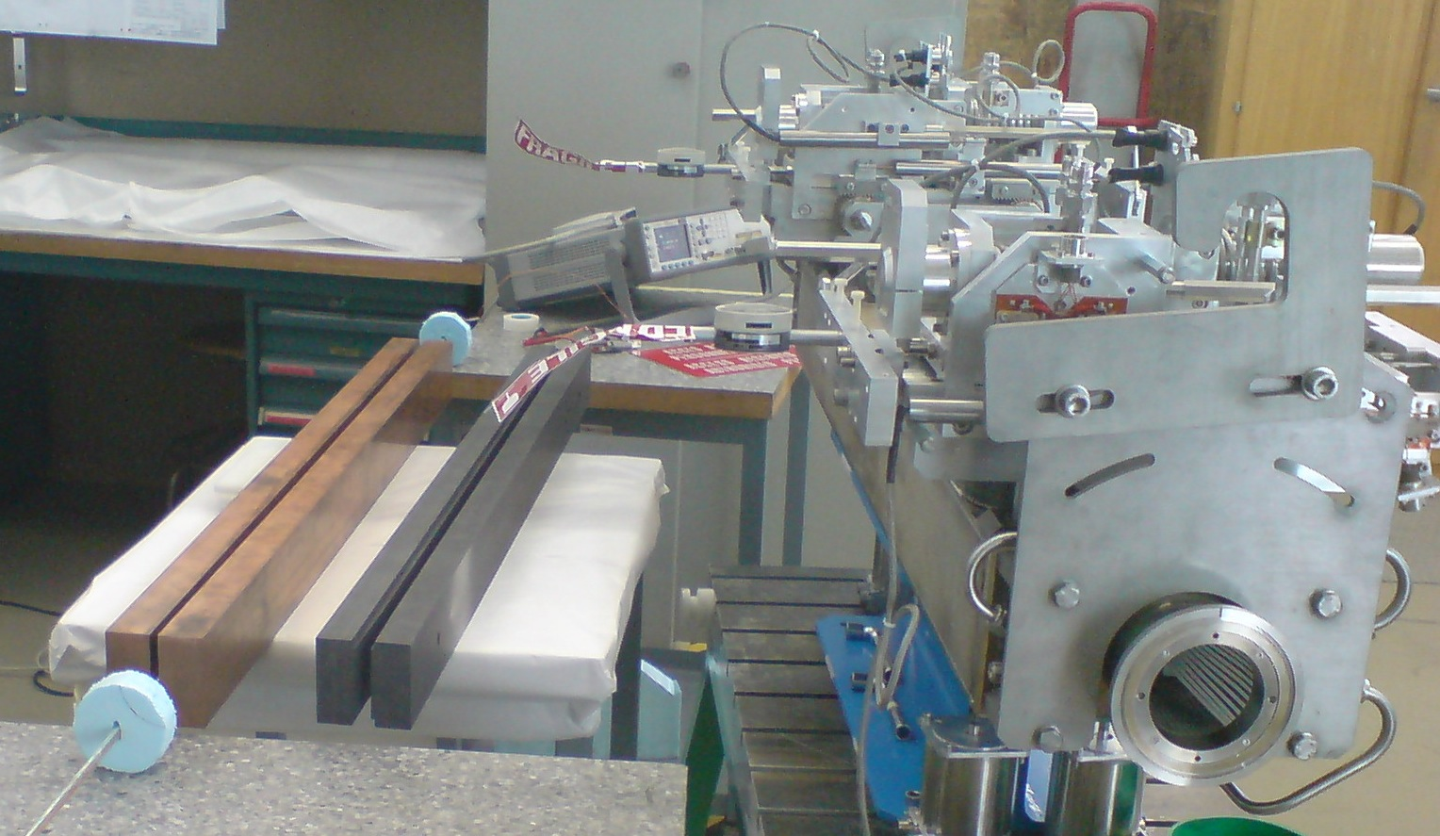
The electromagnetic problem: impedance (bench)
Some devices can be tested in lab and their impedance is estimated from the scattering coefficients obtained with the 1- or 2- wire method. For example:
Tubes (shielded, coated, grooved)
Collimators (betatron, energy)
Kickers
LHC collimator prototypes in copper and graphite

Slide 15
The electromagnetic problem: two-stream (electron cloud)
To study the effect on the beam, we first need to model the electron cloud formation (ECLOUD code, F. Zimmermann et al.)
focus on a beam line section (1m for ex.)
Beam pipe
slice bunch and interbunch gaps
Electrons are macroparticles: they are created (photoemission or gas ionization) and accelerated in beam and image fields
+
+
if the e- hits the wall create secondaries by changing its charge.
After many bunches, the electrons come to a dynamic „steady“ state

Slide 16
The beam dynamics problem: The physical model for single bunch (HEADTAIL)
Localized impedance source
The collective interaction is lumped in one or more points along the ring (kick points), where the subsequent slices of a bunch (macroparticles) interact with an impedance (through the wake) or with an electron cloud

Slide 17
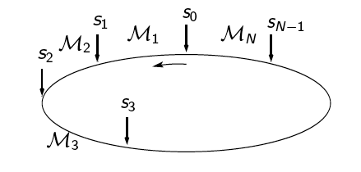
The beam dynamics problem: Numerical implementation (wake fields)
Bunch macroparticles are transported across different interaction points through the sector matrices
At each interaction point macroparticles in each slice receive the kick from the wakes of the preceding slices
Slicing is refreshed at each turn taking into account the longitudinal motion
Longitudinal
W_{i} = W_{II}(i Δz)
Slice 1
Slice 2
Slice i
Slice N_{s}
i-1
N_{s}-1
W₀N₁
W₁N₁+W₀N₂
Σ W_{k}N_{i-k}
Σ W_{k}N_{i-k}
K=0
K=1
Energy loss

Slide 18
The beam dynamics problem: Numerical implementation (wake fields)
Bunch macroparticles are transported across different interaction points through the sector matrices
At each interaction point macroparticles in each slice receive the kick from the wakes of the preceding slices
Slicing is refreshed at each turn taking into account the longitudinal motion
Transverse (x)
dipolar:
W_{id} = W_{dx}(i Δz)
quadrupolar:
W_{iq} = W_{qx}(i Δz)
x_{i} centroid of slice i
x position of particle
Slice 1
Slice 2
Slice i
Slice N_{s}
i-1
N_{s}-1
N₁(W_{1d}x₁+W_{1q}x)
Σ N_{k}(W_{kd}x_{k}+W_{kq}x)
Σ N_{k}(W_{kd}x_{k}+W_{kq}x)
K=1
K=1

Slide 19
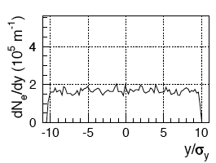
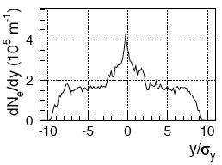
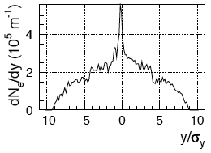
The beam dynamics problem: Numerical implementation (electron cloud)
Bunch macroparticles are transported across different interaction points through the sector matrices
At each interaction point macroparticles in each slice interact with the electron cloud, as it was modified by the interaction with the preceding slices
Slicing is updated
Slice 1
Slice 2
Slice i
Slice N_{s}
Electrons step 0
Electrons step 1
…
Electrons step i-1
…
Electrons step N_{s}-1

Slide 20
Features included in the HEADTAIL model (I)
Full transverse and longitudinal motion
Transverse motion modeled through a single turn matrix or transporting each particle‘s coordinates from one interaction point to the next one by using the correct transport matrices from MAD-X
Synchrotron motion can be
Linear
Sinusoidal voltage
With and optional second rf system that can be switched on during the simulation
Inside an accelerating bucket, with or without higher order terms of η
Debunching (rf off)
Periodic over the circumference (coasting beam)
Bunch initial distribution can be
Longitudinally: Gaussian or uniform
Transversely: Gaussian
Chromaticity in both planes
Detuning with amplitude
Linear coupling

Slide 21
Features included in the HEADTAIL model (II)
Electron cloud kick(s):
Soft Gaussian approach with finite size electrons (used till 2002, obsolete)
PIC module on a grid inside the beam pipe
PIC solver with optional conducting boundary conditions
Uniform or 1-2 stripes initial e-distributions
Kicks can be given at locations with different beta functions and different electron cloud initial distributions (densities)
Electrons can move in
field free space
dipole
solenoid
combined function magnet
The initial distribution of electrons can be optionally loaded from the output of the ECLOUD code, which can save the exact electron distribution at saturation, right before the bunch passage

Slide 22
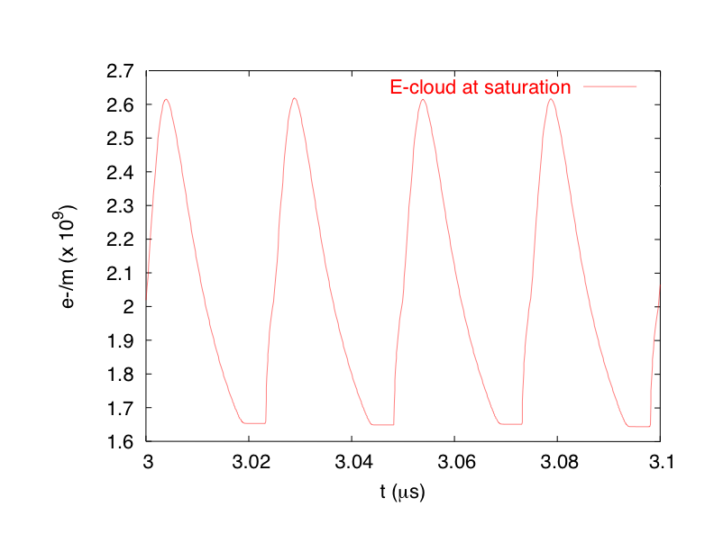
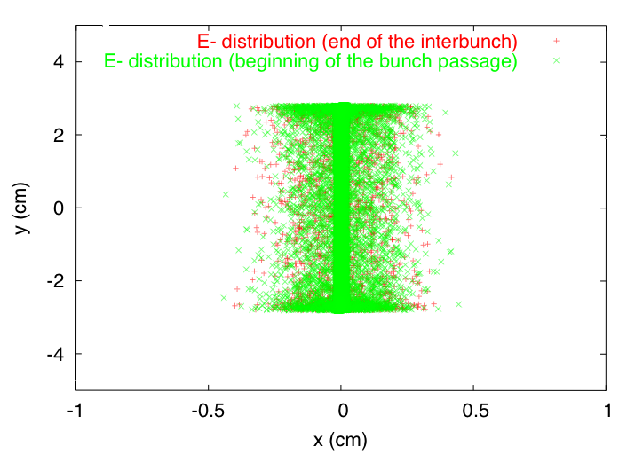
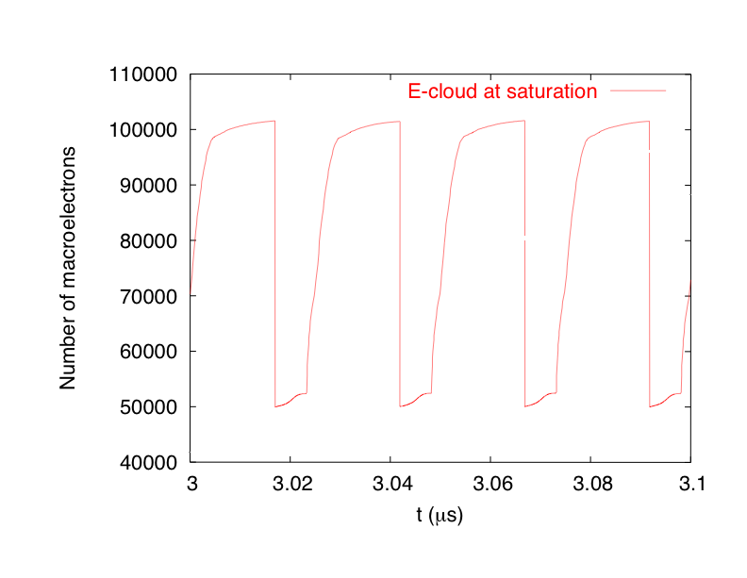
Quasi-selfconsistent model of electron cloud
→ Electron distribution used in HEADTAIL generally was uniform in the beam pipe
→ Model can be improved by using as an input the distribution of electrons at the beginning of a bunch passage, as it comes out of the build up ECLOUD code
interbunch
beam
y
Beam pipe
x

Slide 23
Features included in the HEADTAIL model (III)
Short range wake field is from
a broad band impedance
Classical thick resistive wall.
Resistive wall with inductive by-pass
Loaded from external table
Space charge. Optionally, each bunch particle can receive:
a transverse kick proportional to the local bunch density around the local centroid
a longitudinal kick proportional to the local derivative of the beam line density

Slide 24
Example of simulation/measurements: the head-tail instability
Due to chromaticity, single bunches develop head-tail modes (m=1), which can be strongly unstable at high intensity. The most dangerous mode is the mode l=0:
It is unstable below transition (γ < γ_{t}), if the chromaticity is positive (ξ_{x,y} > 0)
It is unstable above transition (γ > γ_{t}), if the chromaticity is negative (ξ_{x,y} < 0)
Higher order modes (l≥1) are unstable for negative chromaticities below transition and for positive chromaticities above transition. However, they are much slower and they can be naturally damped by other sources of tune spread, or can be suppressed with a damper.
As a consequence, it is critical to control the mode l=0 by operating the machine with the correct sign of chromaticity.
Machines that run always below their transition energy (usually hadron machines) must have negative chromaticity (e.g., the CERN-PSB, GSI-SIS) and they can live with their natural chromaticity, which is negative for a classical lattice design. These machines can also avoid to use sextupoles for chromaticity correction
Machines that run always above transition energy (lepton machines, CERN-LHC, BNL-RHIC with protons) need chromaticity correction (and therefore two families of sextupoles) in order to make their chromaticity slightly positive.
Machines that cross transition (CERN-PS, CERN-SPS, BNL-RHIC with ions) need a scheme of synchronized swap of the sign of chromaticity at transition crossing

Slide 25
Example of simulation: the head-tail instability
The fundamental mode of a head-tail instability (m=1, l=0) can be simulated to have a detailed look at the instability evolution for different chromaticity values (assuming the SPS parameters and a simple broad band model for the impedance)
Movies show the evolution of the Δ (centroid) signal along the bunch over 1045 turns of unstable evolution for two chromaticity values (-0.4 and -0.9)

Slide 26
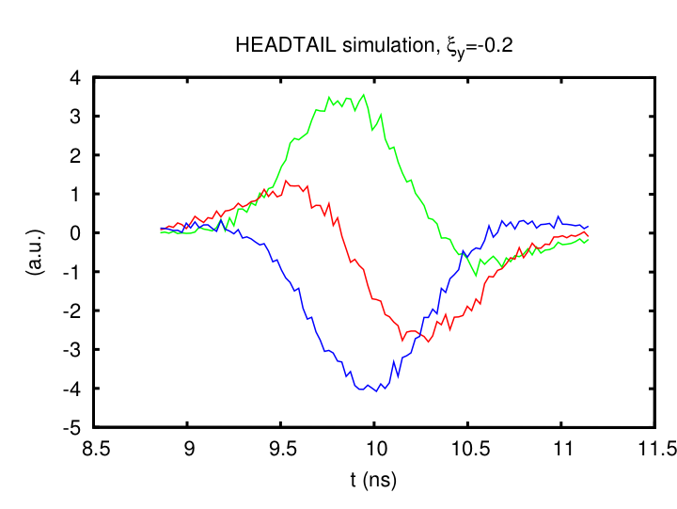
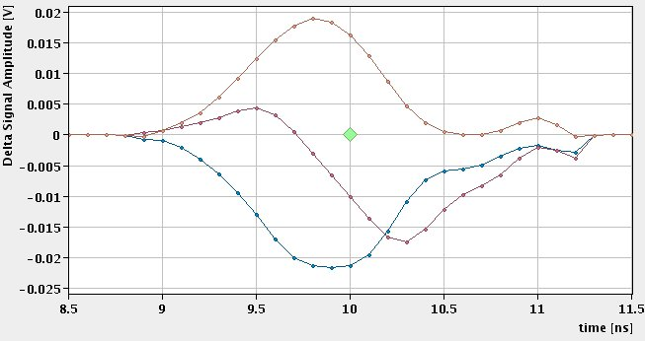
Example of simulation/measurements: the head-tail instability
The fundamental mode of a head-tail instability can be simulated to have a detailed look at the instability evolution for different chromaticity values (assuming the SPS parameters and a simple broad band model for the impedance)
The comparison between measurement and theory is impressive!
Plots show three consecutive traces of the centroid signal along the bunch while the instability is growing
Measurement at the SPS (06.08.2007), ξ_{y}=-0.2

Slide 27
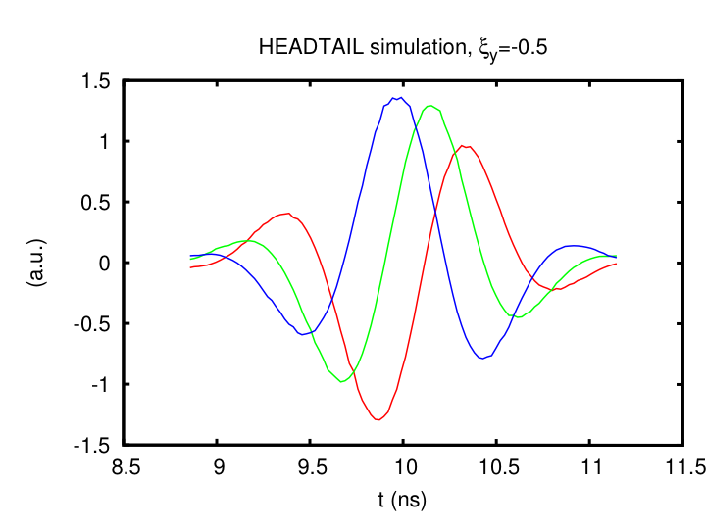
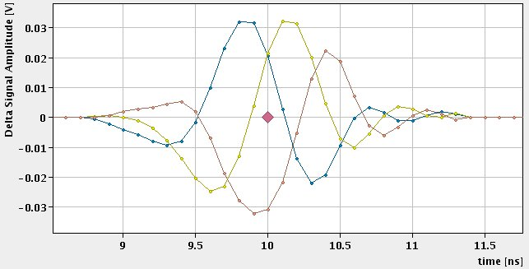
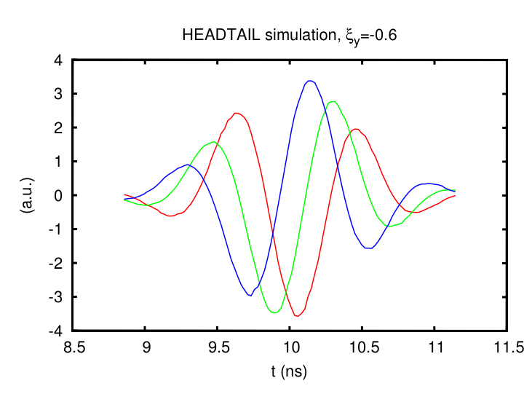
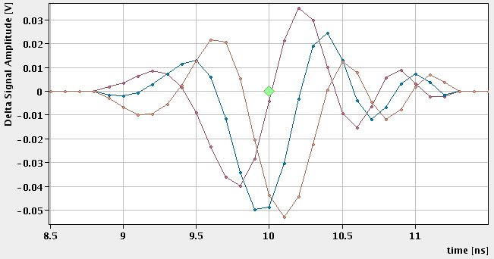
Example of simulation/measurements: the head-tail instability
More benchmark of data and simulations for different values of chromaticity…
Measurement at the SPS (06.08.2007), ξ_{y}=-0.5
Measurement at the SPS (06.08.2007), ξ_{y}=-0.6

Slide 28
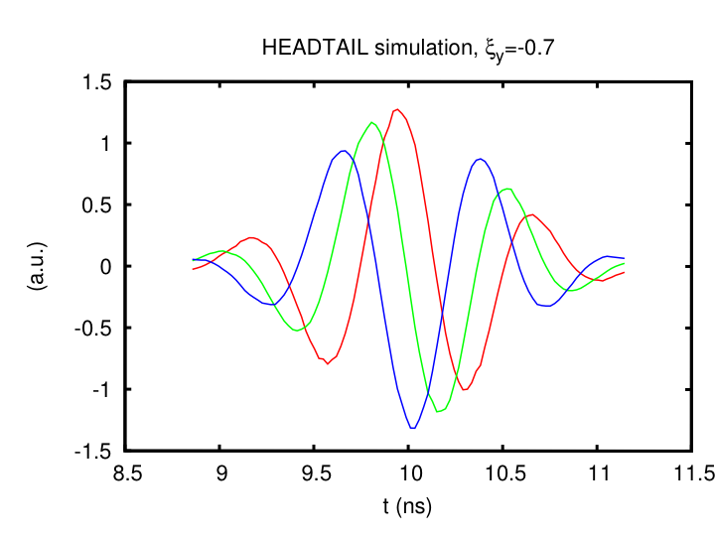
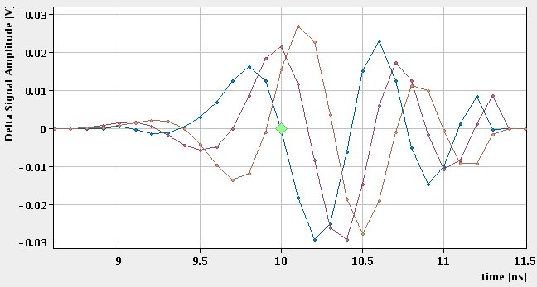
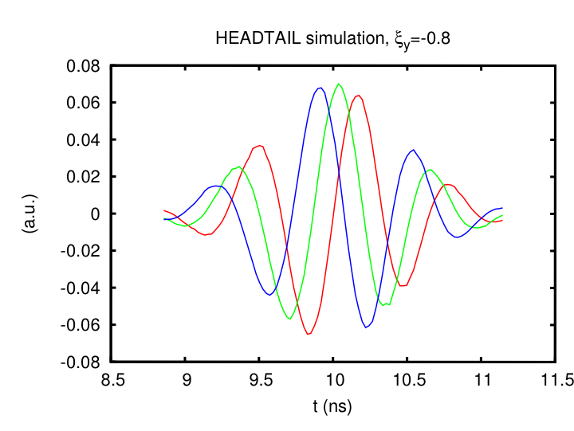
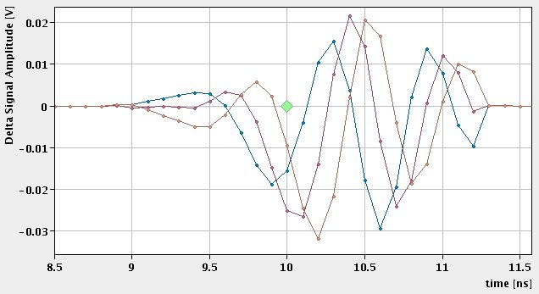
Example of simulation/measurements: the head-tail instability
More benchmark of data and simulations for different values of chromaticity…
Measurement at the SPS (06.08.2007), ξ_{y}=-0.7
Measurement at the SPS (06.08.2007), ξ_{y}=-0.8

Slide 29
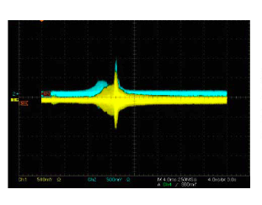
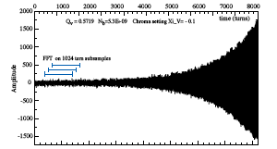
Example of measurements: the head-tail instability
The growth rates of the head-tail modes are proportional to the real part of the machine impedance
The beam can be intentionally rendered unstable to obtain an estimation of the real part of the impedance of a machine by measuring the instability growth rate
If the bunch is long enough, the impedance spectrum can be probed by taking measurements at different chromaticity values.
Method applied to ORNL-SNS and to CERN-SPS
Single bunch instability measured at SNS V. Danilov, et al., HB2006
Single bunch instability measured at SPS H. Burkhardt et al. CERN-SL-2002-030

Slide 30
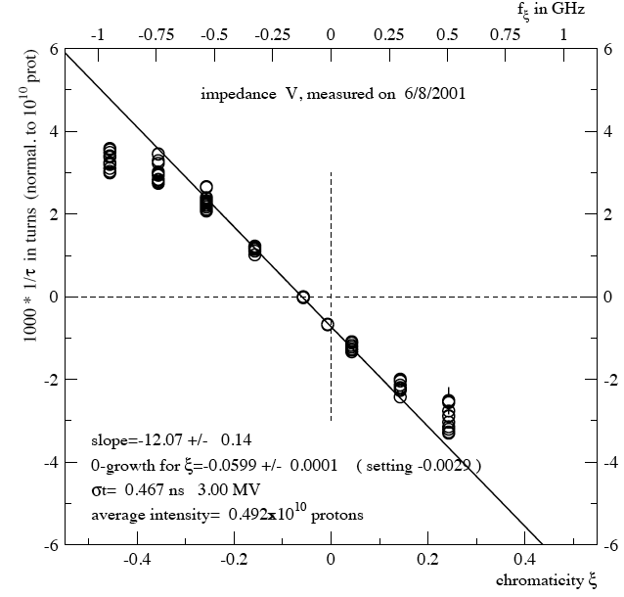
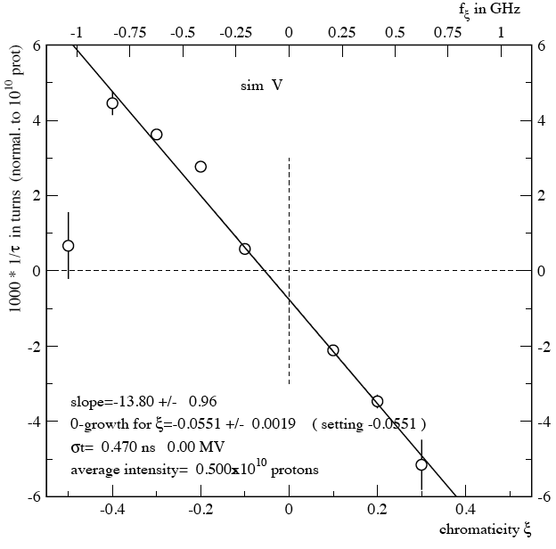
Example of measurements: the head-tail instability
The growth rates of the head-tail modes are proportional to the real part of the machine impedance
Growth/damping rates of the l=0 mode are measured as a function of chromaticity
The bunch behavior is reproduced in simulation with a broad-band impedance model whose parameters are adjusted such as to match the observed trend
Example: SPS (2001)

Slide 31
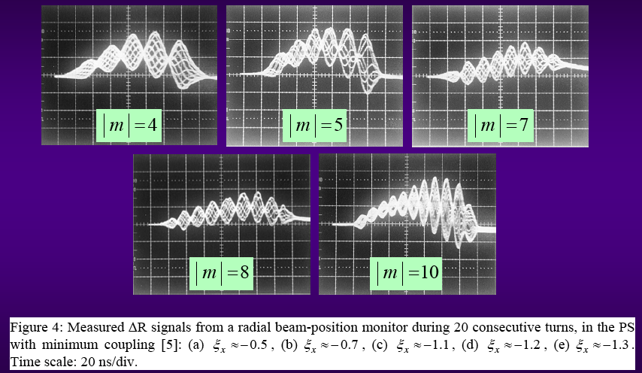
Example of measurements: the head-tail instability
Higher order head-tail modes (l≥1) are usually stabilized by tune spread and/or active feedback. However, if a high intensity beam stays in a machine long enough without sufficient tune spread and without feedback, these modes can also slowly grow.
For example, a high intensity bunch becomes unstable in the CERN-PS over 1.2 s due to resistive wall
|l| = 4
|l| = 5
|l| = 7
|l| = 8
|l| = 10

Slide 32
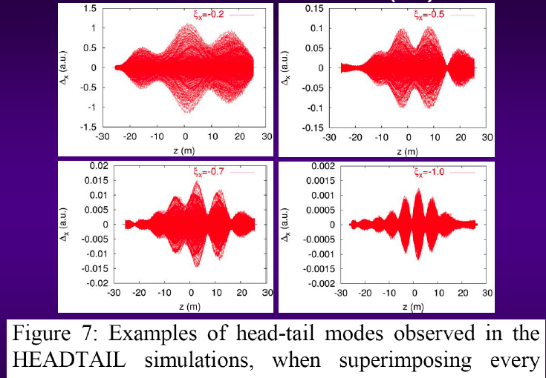
Example of simulation: the head-tail instability
Higher order head-tail modes in the PS have also been simulated using the PS resistive wall impedance. These simulations are very demanding in terms of cpu time, because the bunch has to be tracked over about 500000 turns in order to see the effect arising from initial noise (E. Métral, G. Rumolo, B. Salvant)

Slide 33
Example of measurements/simulation: the TMCI
The Transverse Mode Coupling Instability is another type of single bunch instability and has different features from the head-tail instability.
It does not depend on the chromaticity setting, and it actually occurs also for corrected chromaticity (in theory, for zero chromaticity)
It has a threshold intensity above which it appears.
The threshold value depends on the longitudinal emittance of the bunch, and bunches having lower longitudinal emittances tend to become more unstable
It is usually very fast (rise time shorter than the synchrotron period), that’s why it is also called ‘strong head-tail instability’ or ‘beam break-up’.
The shape of the Δ signal along the bunch is not caused by a head-tail phase shift from chromaticity, but depends on the spectrum of the driving impedance.
Mathematically, it appears when two head-tail modes merge at high intensity and two real solutions of the dispersion relation are replaced by a pair of complex conjugate solutions.
For many years the TMCI has been observed exclusively in lepton machines. The reason is that in hadron machines its threshold is increased by space charge and is usually higher than the threshold for the longitudinal microwave instability. However, the TMCI has been recently observed in the CERN-SPS (after the longitudinal impedance reduction campaign), in the CERN-PS and BNL-RHIC close to transition crossing.

Slide 34
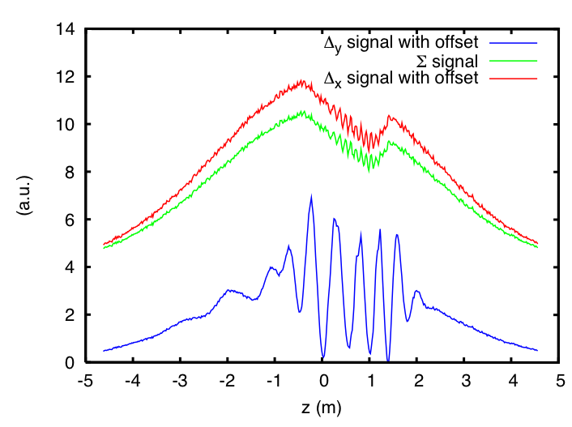
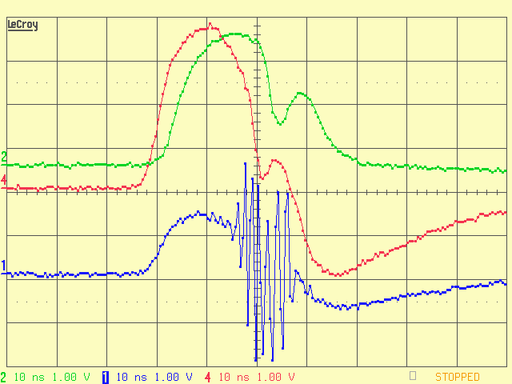
Example of measurements/simulation: the TMCI
The case of the PS high intensity bunch close to crossing transition energy (E. Métral et al.)
Beam loss was observed when crossing transition
The Δ_{y} signal along the bunch clearly showed turbulent vertical motion at a specific bunch location (i.e. a little off the peak towards the tail), where also the losses occurred
Simulations with a broad-band model could well reproduce the instability and the loss
Sum and Delta signals of the PS bunch at transition crossing.
Measurement (left) and simulation with a broad-band model (right)
Z_{eff}=3 MΩ/m @ 1 GHz
Movie

Slide 35
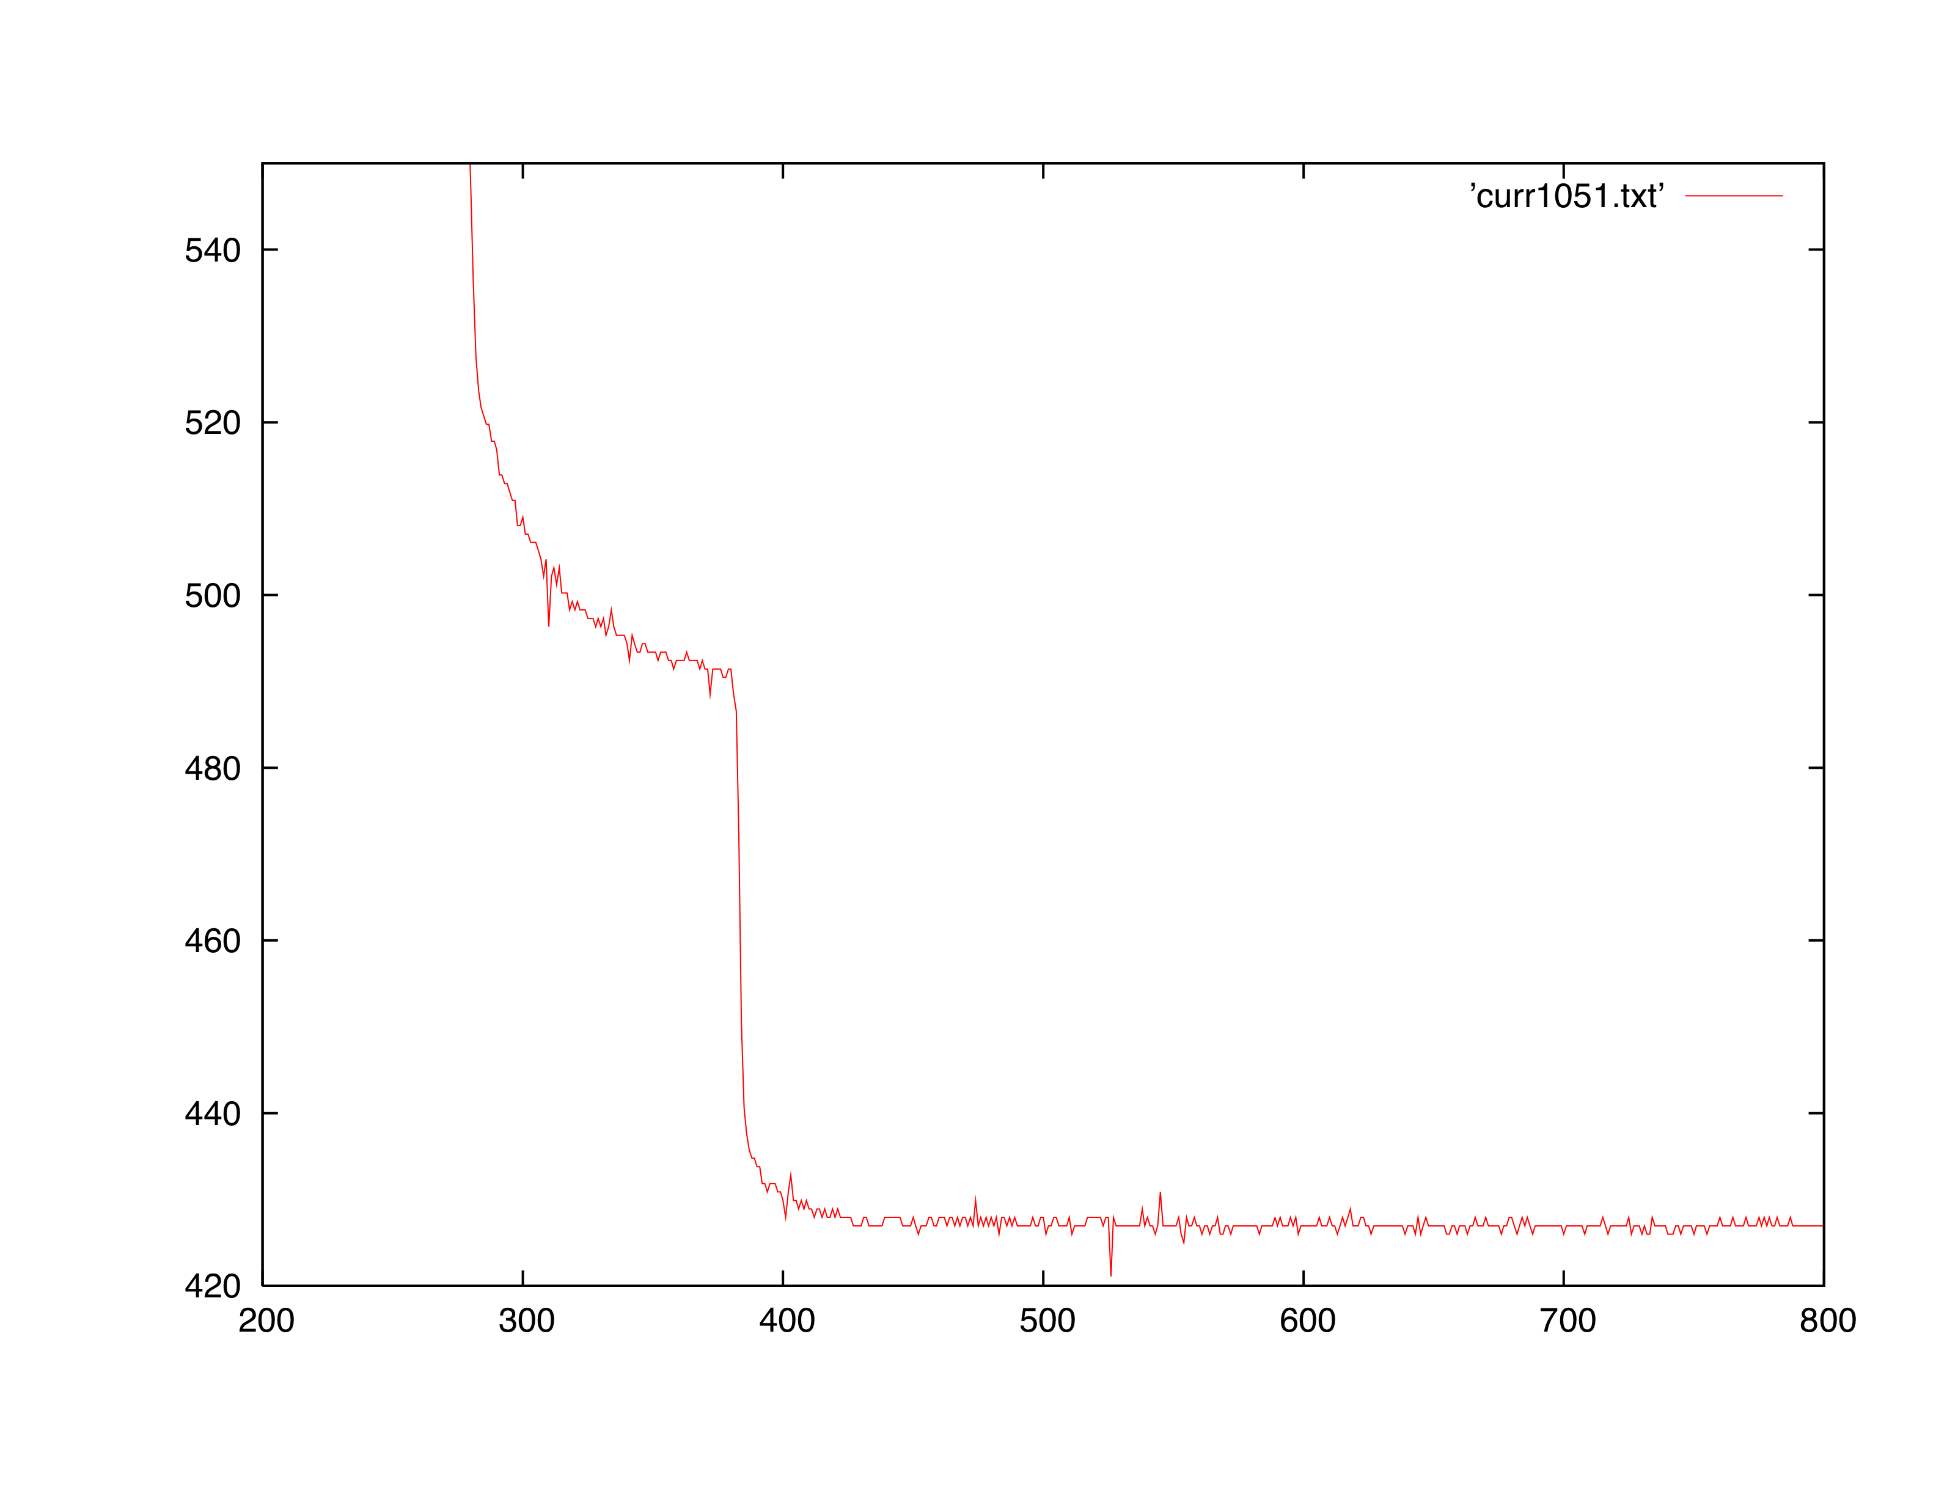
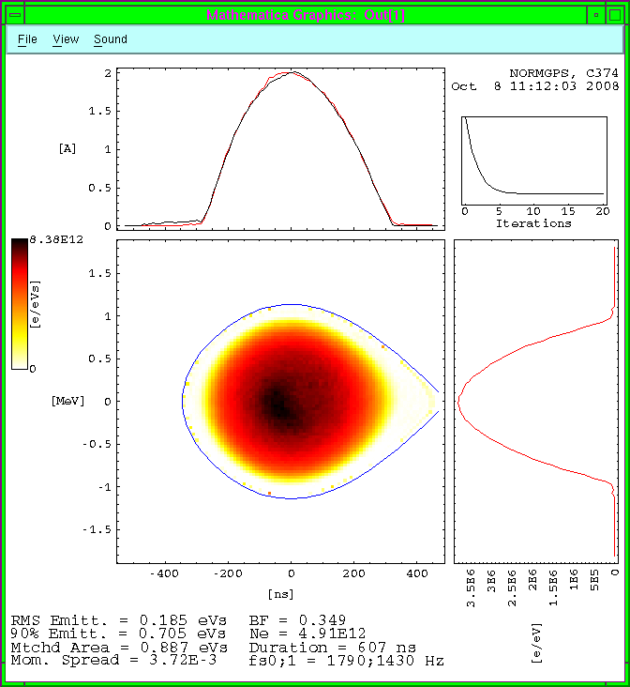
Example of experiment: the TMCI
A PSB high intensity bunch becomes unstable along the ramp (A. Findlay, D. Quatraro)
Beam loss is observed at a specific point of the ramp when the damper is off
The Δ_{x} signal along the bunch clearly shows turbulent horizontal motion propagating from the tail of the bunch toward the head
Suspected TMCI
Beam loss as measured by a Beam Current Transformer
τ= 30 μs

Slide 36
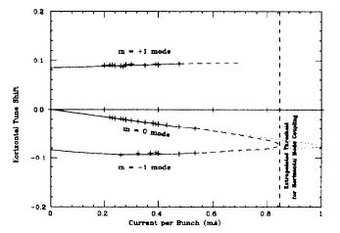
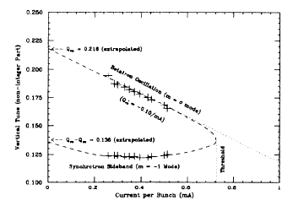
Example of measurements/calculation: Tune shift and TMCI
Measurements of coherent tune shift as function of intensity in the CERN-LEP revealed other spectrum lines and in particular, the first synchrotron side bands (head-tail mode l=±1)
The two lines l=0 and l=-1 tend to merge as intensity increases
Measured values are in impressive agreement with the theoretical lines
B. Zotter, Comparison of Theory and Experiment on Beam Impedances: The Case of LEP, EPAC92

Slide 37
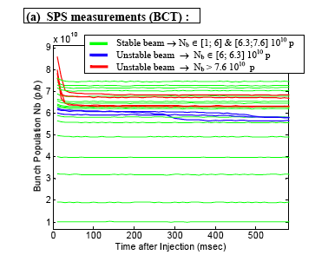
Example of measurements/simulation: Tune shift and TMCI
Measurements of coherent tune shift as function of intensity in the SPS have revealed that, using a low longitudinal emittance bunch, a vertical TMCI can be observed at injection above a certain intensity threshold (G. Arduini, E. Métral, G. Rumolo, B. Salvant)
Beam loss is observed at injection in some intensity ranges
The Δ_{y} signal along the bunch clearly shows turbulent vertical motion propagating from the tail of the bunch toward the head
A moderately unstable intensity range seems to be followed by a stable one before getting into a strong instability region
The simulated evolution of the bunch predicted the existence of slightly unstable regions for intensities lower than 8 x 10¹⁰
Movie

Slide 38
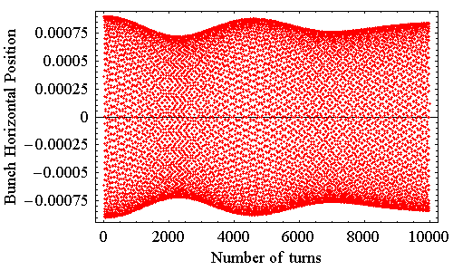
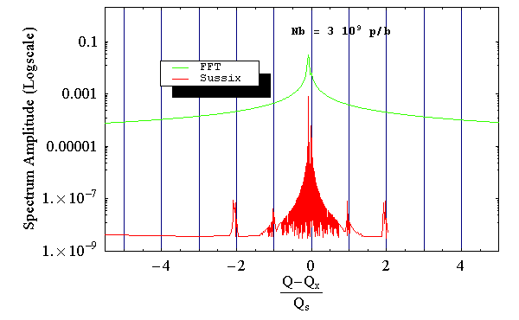
Benchmarking MOSES and HEADTAIL (I)
The fine structure of the coherent modes can be revealed from the HEADTAIL output of the centroid motion by applying SUSSIX to the complex BPM signal (x + j β_{x}x‘)
Standard FFT or SUSSIX
(*) Sussix code : R. Bartolini, F. Schmidt, SL Note 98-017AP, CERN 1998
Theory behind Sussix : R. Bartolini, F. Schmidt, LHC Project Report 132, CERN 1997
J. Laskar et al., Physica D 56, pp. 253-269 (1992)

Slide 39
Benchmarking MOSES and HEADTAIL (II)
Scanning in intensity we can observe how the mode in the spectrum shift....
Round Chamber
y
x

Slide 40
Benchmarking MOSES and HEADTAIL (III)
Round beam pipe / no chromaticity / no coupling - displaying Re[ΔQ]=f(I_{b})

Slide 41
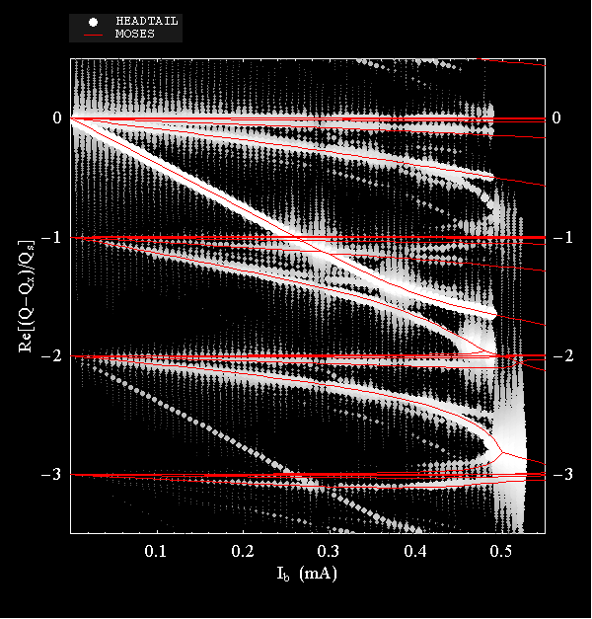
Benchmarking MOSES and HEADTAIL (iV)
Re[ΔQ]=f(I_{b}) and comparison with MOSES
Results from MOSES coherent mode analysis and HEADTAIL are superimposed and the agreement is excellent
Most of the radial modes per azimuthal number can be seen from HEADTAIL
There are few ghost lines, probably due to a small initial mismatch of the bunch in the bucket

Slide 42
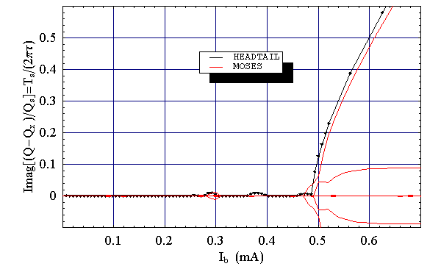
Benchmarking MOSES and HEADTAIL (V)
Im[ΔQ]=f(I_{b}) and comparison with MOSES
Also the agreement between the predicted instability growth rates is very good

Slide 43
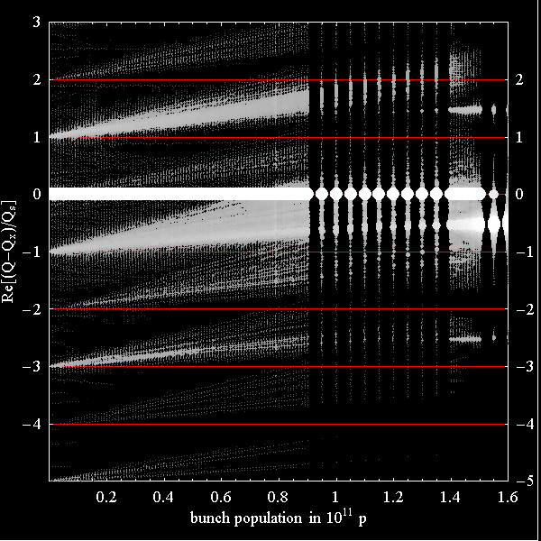
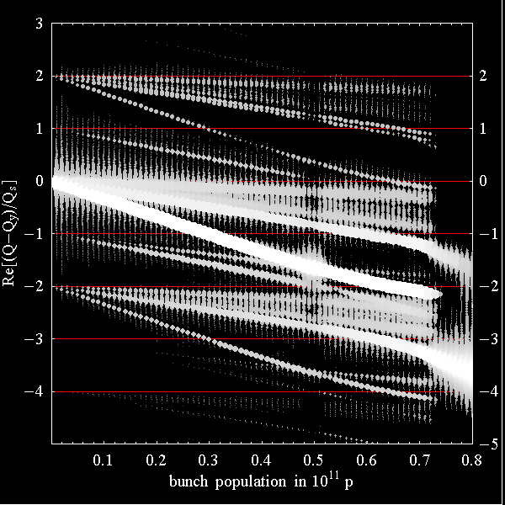
HEADTAIL with flat pipe
Flat (x)
Flat (y)
Flat Chamber
y
x
Mode analysis with flat pipe:
→ Modes shift differently in x and y
The instability threshold in x is found to be about twice the threshold in y
This suggests that linear coupling could help in this case....

Slide 44
Example of measurements: Tune shift
What we can measure below the TMCI threshold (B. Salvant et al.)….

Slide 45
Example of measurements: Tune shift
Measurements of coherent tune shift as function of intensity in the CERN-SPS (H. Burkhardt, G. Rumolo, F. Zimmermann)
From the slope of the tune shift one can infer the low frequency imaginary part of the machine impedance (iZ_{eff}). Machines with flat beam pipes show usually no tune shift in the horizontal plane and significant tune shift in the vertical plane
Tune shift measurements done with high longitudinal emittance bunches can extend to high intensities because the TMCI threshold is higher

Slide 46
Example of measurements: Tune shift
Measurements of coherent tune shift as function of intensity at the SSRF (Shangai Synchrotron Radiation Facility)
J. Bocheng, C. Guanglin, C. Jianhui, “Collective effects of SRRF storage ring 3 GeV Phase I commissioning”, SSRF internal note, April 2008; J. Bocheng, “Impedance budget of SSRF storage ring”, SSRF internal note, April 2008.

Slide 47
Example of measurements: Tune shift
Measurements of coherent tune shift as function of intensity at the Soleil
R. Nagaoka, MP. Level, L. Cassinari, ME. Couprie, M. Labat, C. Mariette, A. Rodriguez, R. Sreedharan, PAC07
Measured Z_{eff} is measured to be larger than expected by a factor of ~2 both in H and V planes.

Slide 48
Example of measurements: Tune shift
Measurements of coherent tune shift as function of intensity in low energy machines is more tricky because the contribution of the beam images (indirect Space Charge) has to be disentangled from the contribution of the Machine Impedance (in principle independent of energy)
Measurements at different energies can be used for this purpose
The method has been applied recently to the CERN-PSB (D. Quatraro, M. Chanel, B. Mikulec, G. Rumolo)
Z_{eff}=14 MΩ/m=Z_{MI}+Z_{SC}(160 MeV)
Z_{eff}=5 MΩ/m=Z_{MI}+Z_{SC}(1 GeV)

Slide 49
Example of measurements: Tune shift
Some times the tune shift can be measured changing in a controlled way a known impedance source inside the machine
Typical “tunable” impedance sources are movable collimators, scrapers or other intercepting devices, as the transverse impedance scales like g⁻³ (g being the device gap)
Tune measurement in the CERN-SPS while a prototype of LHC collimator (installed in the machine for test purposes) was being moved inward and outward in the horizontal plane. The vertical tune variation is due to the beam loss caused by the collimator when moved in
Collimator MD@SPS on the 1 November 2006 (E. Métral, S. Redaelli, B. Salvant, R. Steinhagen, etc.)

Slide 50
Simulations of the collimator with HEADTAIL
Classical resistive wall
Resistive wall with inductive by-pass
Inductive by-pass with distribution cut
Distribution cut with nonlinear wake terms

Slide 51
Simulations of the collimator with HEADTAIL
Comparing the tune shifts extrapolated from HEADTAIL simulations (left plot) with the experimental ones (right plot, red points) and those from analytical theory (right plot, green, magenta, blue points), the agreement is excellent.

Slide 52
Example of measurements: Tune shift (longitudinal)
Measurements of synchrotron tune shift as function of intensity can be also done in the longitudinal plane in order to estimate the longitudinal impedance
The shift appears in the quadrupole mode, therefore the technique uses e.g. the synchrotron oscillations of a bunch injected with a mismatch
Q_{s} can be extrapolated from bunch length or peak amplitude measurements
Example: SPS measurements by E. Shaposhnikova, T. Bohl, J. Tuckmantel
Z_{IIeff} /n ≈ 5 Ω

Slide 53
Example of simulations: Longitudinal impedance acting on an SPS bunch
Simulating the effect of a longitudinal impedance on an SPS bunch we can clearly distinguish the effects in lower and higher intensity regimes
Potential well distortion regime shows with a linear increase of the bunch length as a function of the bunch intensity, while the unstable regime is characterized by a change of slope in bunch lengthening
Potential Well Bunch Lengthening
regime
Microwave
Instability
regime
Broad-band, Z⏐⏐/n=10 Ω, f_{r}=700 MHz

Slide 54
Example of simulations: Longitudinal impedance acting on an SPS bunch
Simulating the effect of a longitudinal impedance on an SPS bunch we can clearly distinguish the effects in lower and higher intensity
Bunch lengthening regime: slow evolution towards a new equilibrium with a slightly shifted synchronous phase due to energy loss.
Unstable regime: micro-bunching appear.
Bunch shape evolution in the regime of potential well distortion (10¹¹ ppb, left movie) and just above the threshold for microwave instability (1.7 x 10¹¹ ppb, right movie)

Slide 55
Example of measurements: Other methods to estimate Z_{IIeff}
In order to estimate the longitudinal impedance, it is also possible to look at
Bunch lengthening (ex. DIAMOND, R. Bartolini)
The energy loss measured through the synchronous phase shift (ex. Australian light source, R. Dowd, M. Boland, G. LeBlanc, M. Spencer, Y. Tan, PAC07

Slide 56
Example of estimations: Effects of the longitudinal impedance in ALBA
Simulations can suggest what longitudinal impedance budget is affordable for the future ALBA
Scan plausible values for R_{s}. Obviously, the effect of potential well distortion is higher for higher values of R_{s}
Scan possible values for the frequency. At around 5 GHz the effect of the impedance on the bunch swaps sign (it goes from shortening to lengthening)
~
λ(ω)
~
λ(ω)

Slide 57
Example of estimations: Effects of the longitudinal impedance in ALBA
Simulations can suggest what longitudinal impedance budget is affordable for the future ALBA
Above a certain value of longitudinal impedance, the microwave instability sets in
We can distinguish the bunch length trend below and above the microwave instability threshold (i.e. potential well and turbulent bunch lengthening regimes) for different frequencies of the BB impedance
time
time

Slide 58
Example of observations: Microwave instability in the SPS
Microwave instability of a debunching bunch has been used in the SPS to investigate on the spectrum of the longitudinal impedance and try to spot the main frequencies (E. Shaposhnikova, T. Bohl and T. Linnecar)
This allows identifying the main candidates as impedance sources
Long bunch samples better in frequency.
Simulation with the SPS longitudinal impedance model
SPS data: below transition energy (left) and above (right)

Slide 59
Longitudinal plane: Production of flat bunches
One option is to use a 2nd harmonic rf system
The SPS has the main 200 MHz cavities and the 800 MHz, which can be used in Bunch Shortening or Bunch Lengthening modes
0.7 MV
0

Slide 60
Longitudinal plane: Production of flat bunches
The bunch shape when both rf systems are active clearly shows the expected trends
Importance of this option:
SPS: The 800 MHz cavity is used in BS mode in normal operation to keep the beam stable
LHC upgrade: Stability studies for a beam in a double rf-system in BL mode (flat bunch)

Slide 61
Longitudinal plane: Production of flat bunches
Another option is to create flat hollow (in longitudinal phase space) bunches
Experience with hollow bunches shows that problems of stability exist
Importance of this option:
LHC upgrade: Simulation studies of stability of flat hollow bunches

Slide 62
Longitudinal plane: Production of flat bunches
Flattening bunches is also important in low energy for (transverse) space charge reasons. However also longitudinal space charge can then play a role
For instance, the PSB uses the two rf systems with h=1 and h=2 to accelerate higher intensities
Single rf (h=1): effect of space charge
space charge lengthens the bunch at equilibrium because we are below transition
space charge causes the oscillations of mismatching to be undamped
Switch on h=2 system at n=3000
in BL mode, with two possible ratios between voltages
in BS mode, with a ratio 0.5 between the two voltages

Slide 63
Longitudinal plane: Production of flat bunches
Combined study 2nd harmonic + space charge
Double rf (h=1 + h=2): strong space charge
for higher bunch current the effect of space charge is evident
oscillations from mismatching are undamped. Feedback (phase loop) needed
Double rf (h=1 + h=2): weak space charge
The final result does not seem to differ much from the case in which space charge was neglected

Slide 64
Double rf (h=1 + h=2): weak space charge
The effect is still significant in not too strong space charge regime, even if the peaks tend to be spread out
In high intensity longitudinal space charge causes a loss in peak reduction efficiency
Double rf (h=1 + h=2): no long. space charge
The effect of the second harmonic on the peak line density (and consequently the beneficial effect against transverse space charge) is evident

Slide 65
Longitudinal plane: Production of flat bunches
Effect of a phase error in the tuning between the two cavities
Slight phase errors cause an asymmetric bunch shape, with an enhancement of the right or left peak, depending on the sign of the phase error

Slide 66
Measurements or estimations of the impedance of a machine: Summary
Transverse:
Use growth rates of the mode l=0 of the head-tail instability to estimate the real part of the impedance
scan in chromaticity allows for a frequency scan of the impedance spectrum
Use onset of TMCI and bunch evolution under the effect of a TMCI
Use coherent tune shift to measure the low frequency imaginary part of the impedance
Longitudinal:
Several ways to determine the low frequency imaginary part
measure the incoherent quadrupole frequency shift for synchrotron oscillations
measure bunch lengthening or momentum spread widening
Real part related to
energy loss, which can be estimated by measuring the synchronous phase shift
onset of microwave instability.
The rise time relates to the magnitude of the impedance
The frequencies involved in the measured evolution also help find possible candidates for main sources of impedance

